Slide 1
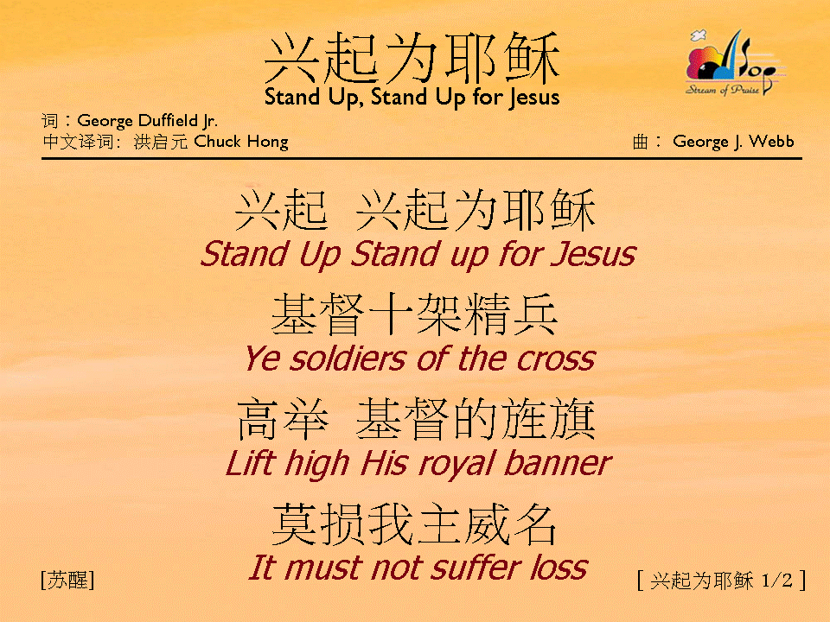
興起為耶穌 (1/2)
[Stand Up, Stand Up for Jesus]

Slide 2

興起為耶穌 (2/2)
[Stand Up, Stand Up for Jesus]

