Slide 1
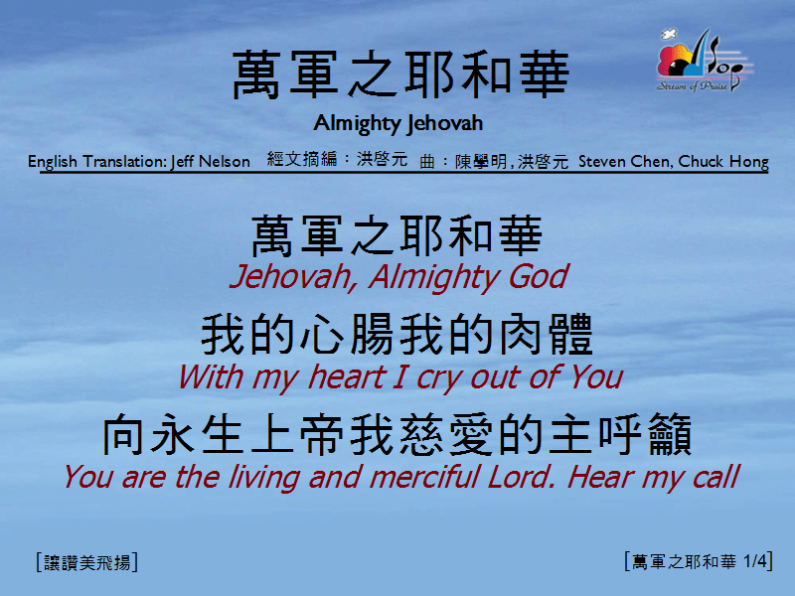
萬軍之耶和華 <1/4>
Almighty Jehovah

Slide 2
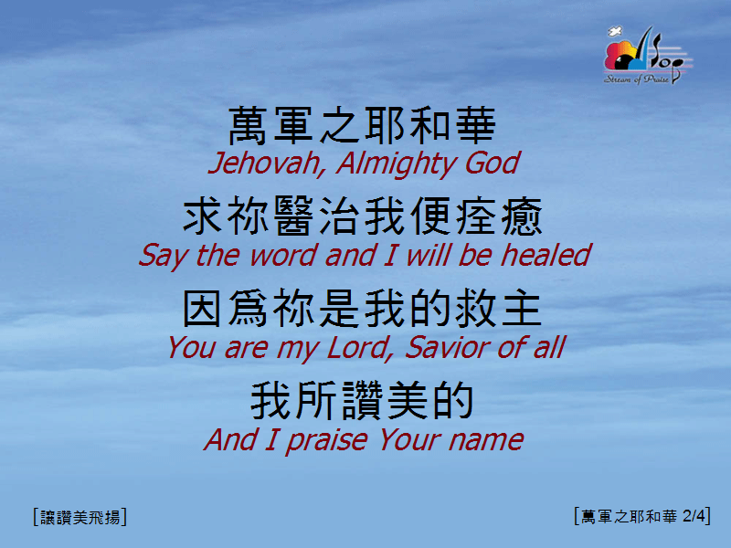
萬軍之耶和華 <2/4>
Almighty Jehovah

Slide 3
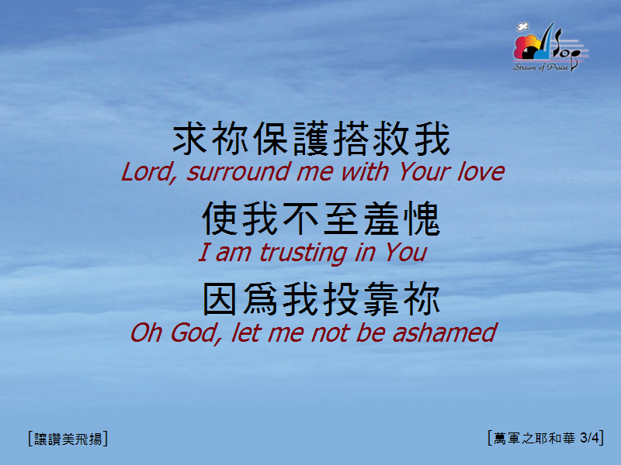
萬軍之耶和華 <3/4>
Almighty Jehovah

Slide 4

萬軍之耶和華 <4/4>
Almighty Jehovah

