Slide 1
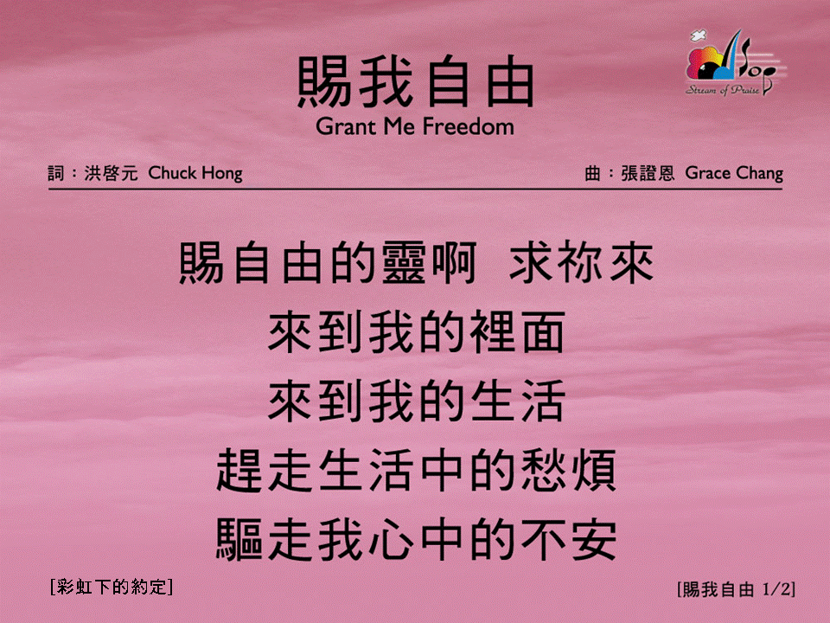
賜我自由 (1/2)
[Grant Me Freedom]
[彩虹下的約定]

Slide 2

賜我自由 (2/2)
[Grant Me Freedom]
[彩虹下的約定]

