Slide 1
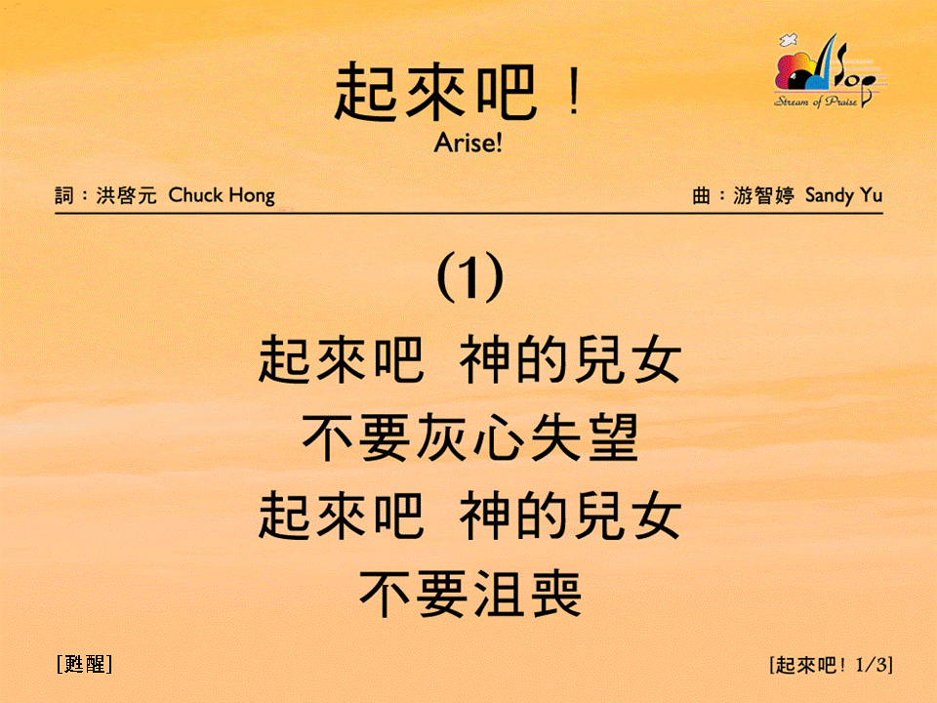
起來吧 (1/3)
[Arise!]
[甦醒]

Slide 2
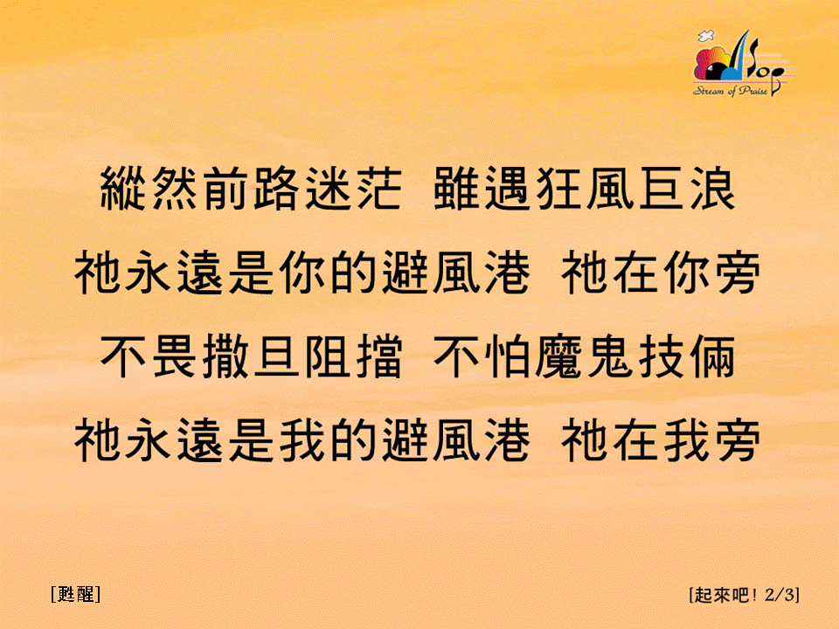
起來吧 (2/3)
[Arise!]
[甦醒]

Slide 3
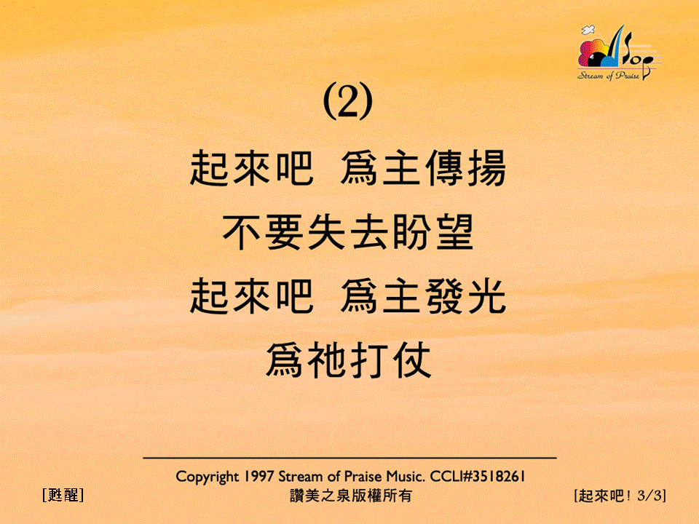
起來吧 (3/3)
[Arise!]
[甦醒]

