Slide 1
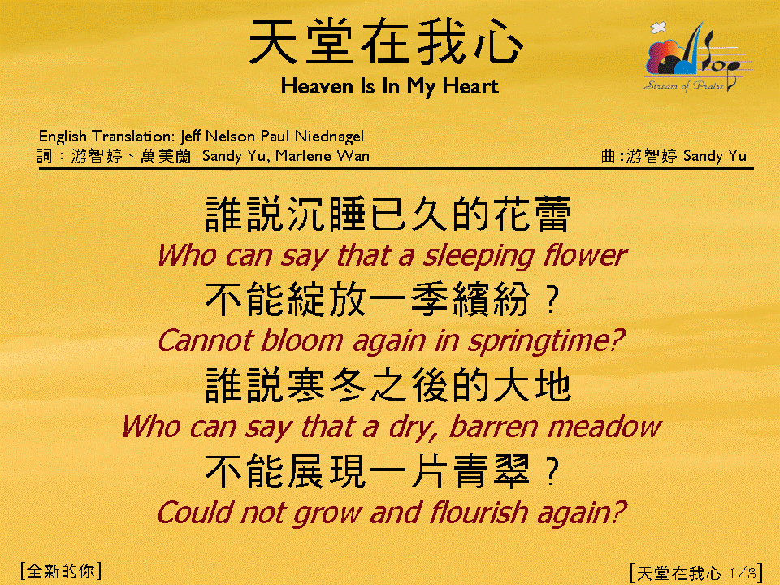
天堂在我心 (1/3)
[Heaven Is In My Heart]

Slide 2
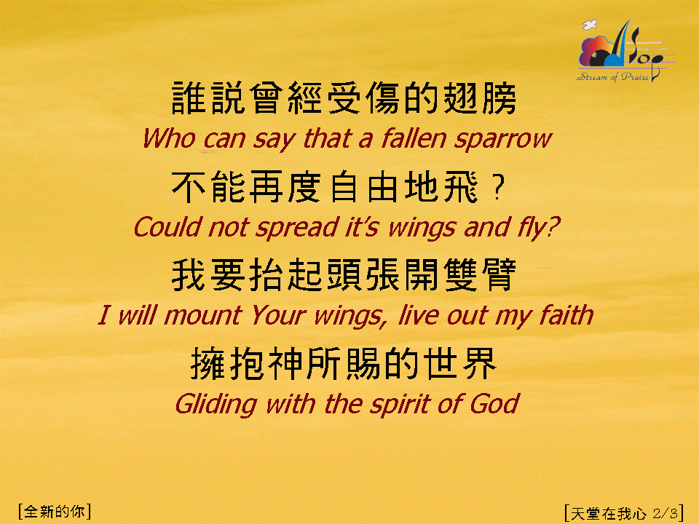
天堂在我心 (2/3)
[Heaven Is In My Heart]

Slide 3
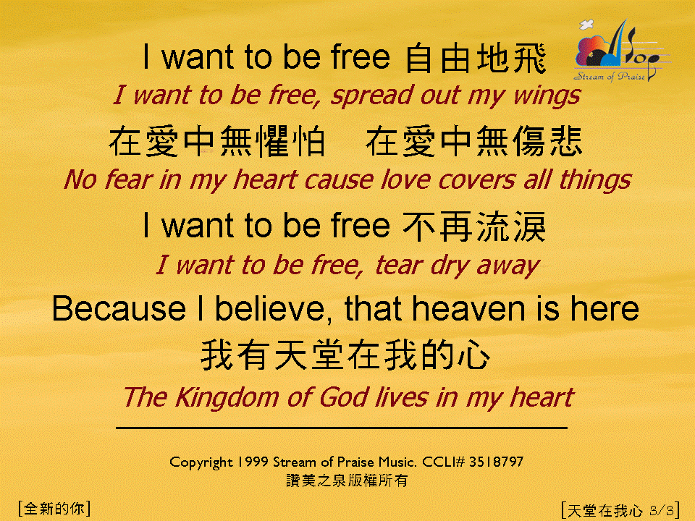
天堂在我心 (3/3)
[Heaven Is In My Heart]

