Slide 1
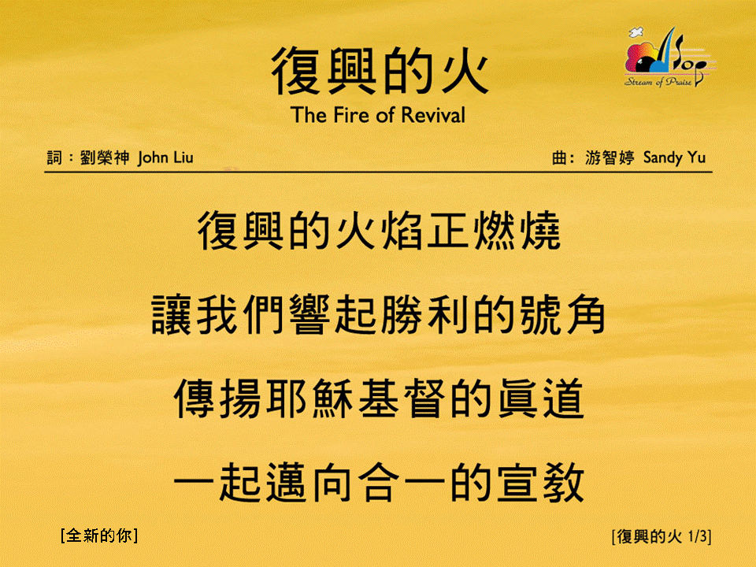
復興的火 <1/3>
The Fire of Revival
[全新的你]

Slide 2
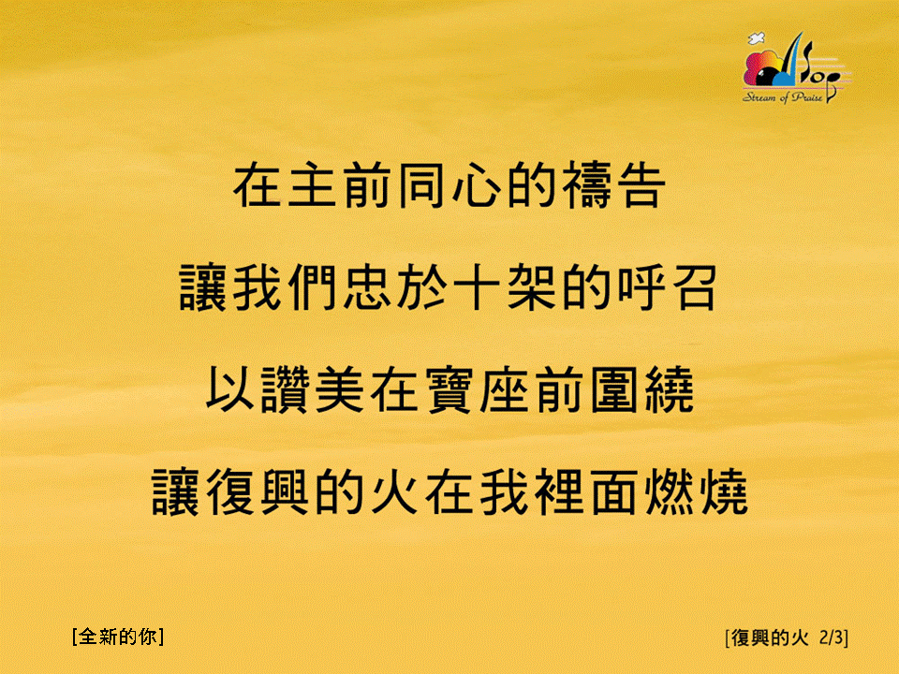
復興的火 <2/3>
The Fire of Revival
[全新的你]

Slide 3
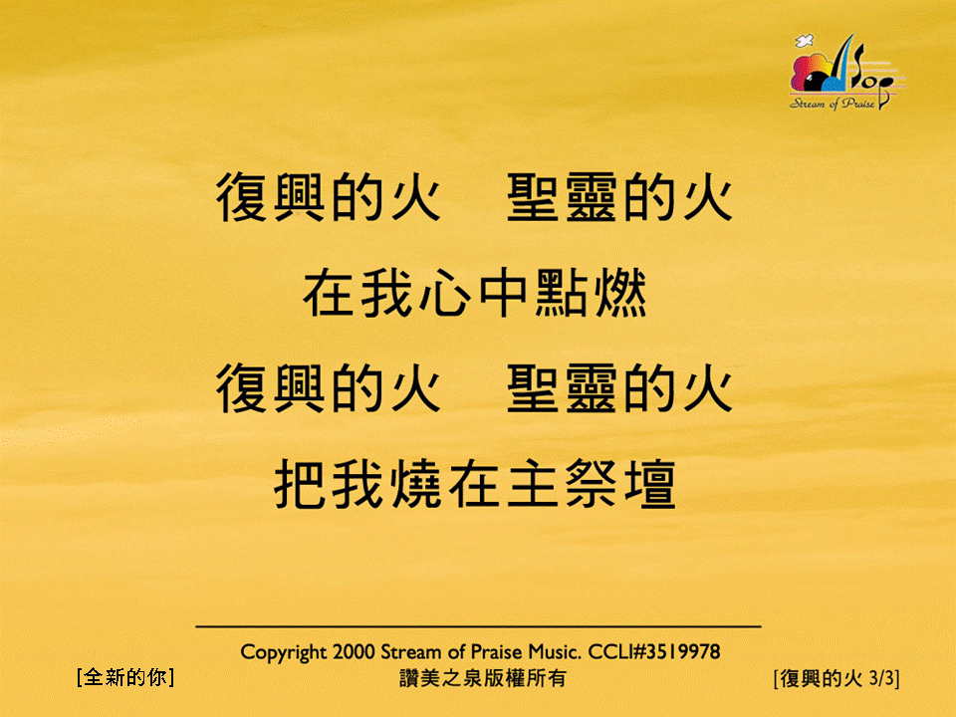
復興的火 <3/3>
The Fire of Revival
[全新的你]

