Slide 1

我一生要讚美你 (1/2)
[I Will Praise You All My Life]

Slide 2
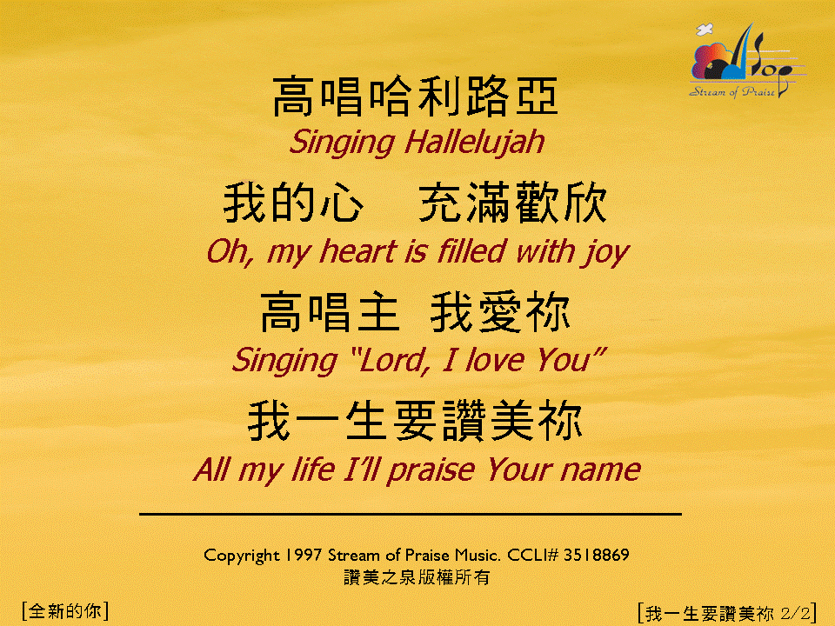
我一生要讚美你 (2/2)
[I Will Praise You All My Life]

