Slide 1
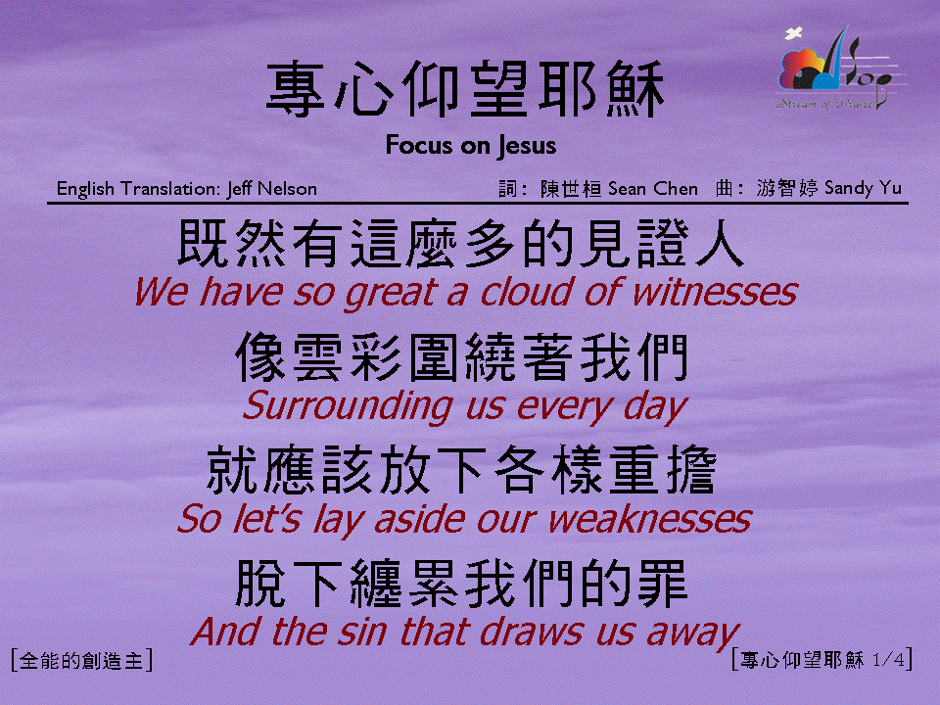
專心仰望耶穌 (1/4)
[Focus on Jesus]

Slide 2
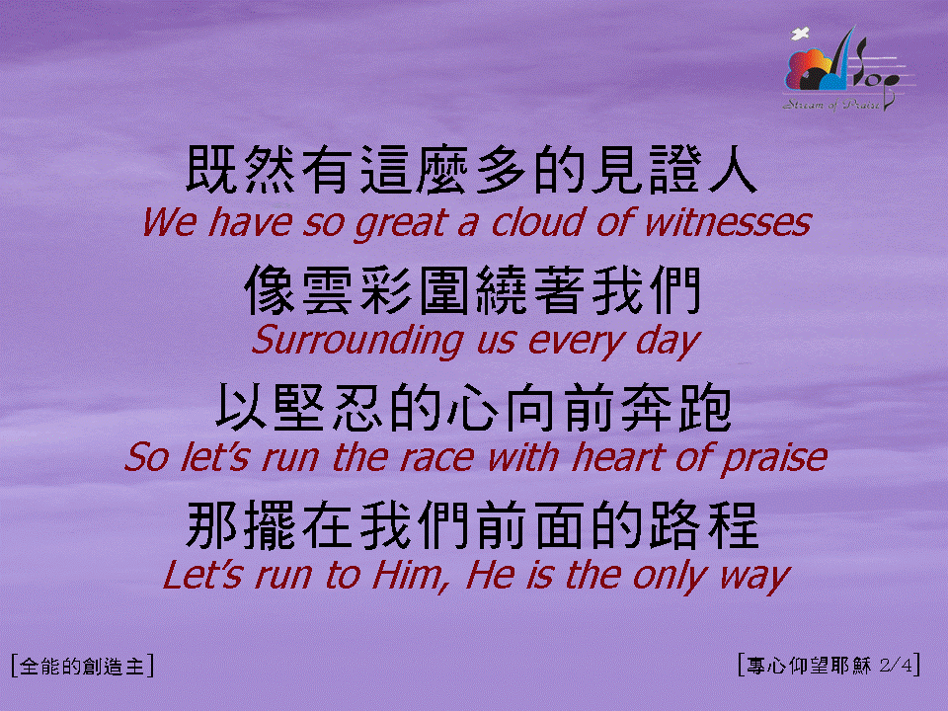
專心仰望耶穌 (2/4)
[Focus on Jesus]

Slide 3

專心仰望耶穌 (3/4)
[Focus on Jesus]

Slide 4

專心仰望耶穌 (4/4)
[Focus on Jesus]

