Slide 1
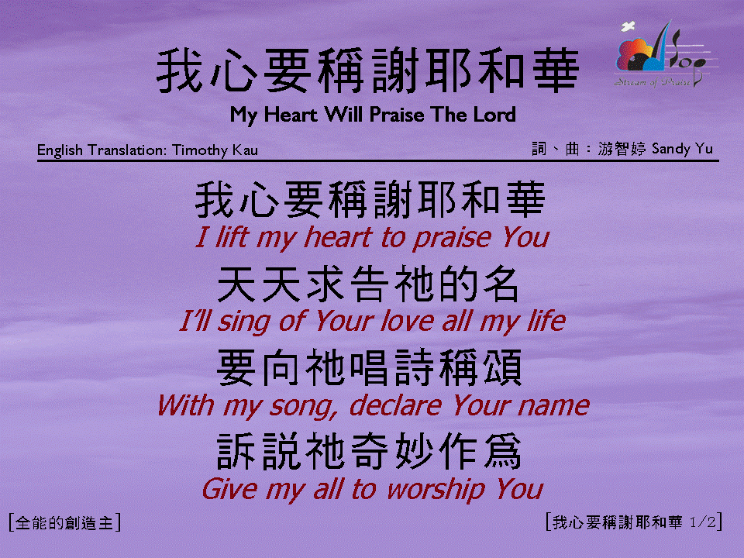
我心要稱謝耶和華 (1/2)
[My Heart Will Praise The Lord]

Slide 2
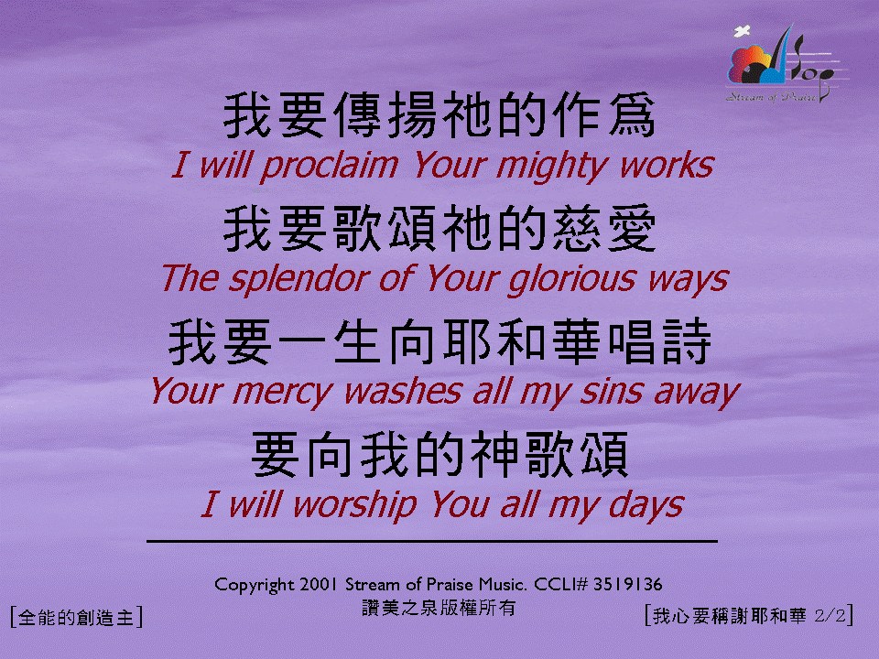
我心要稱謝耶和華 (2/2)
[My Heart Will Praise The Lord]

