Slide 1

求你仰起臉來 (1/3)
[Let the Light of Your Face]

Slide 2
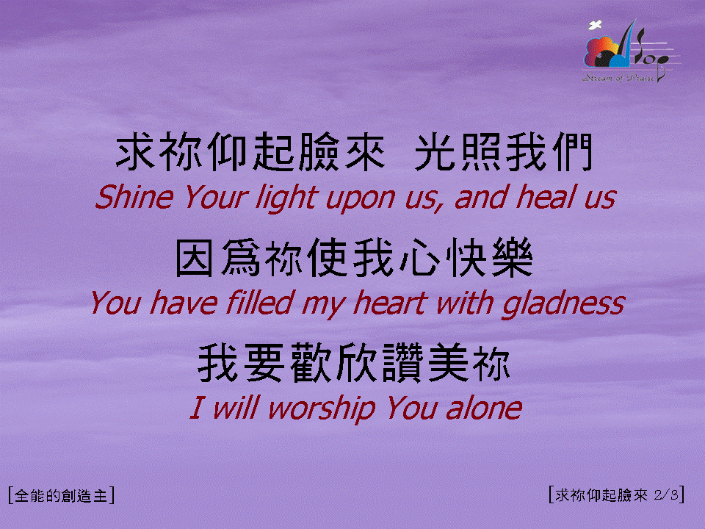
求你仰起臉來 (2/3)
[Let the Light of Your Face]

Slide 3

求你仰起臉來 (3/3)
[Let the Light of Your Face]

