Slide 1
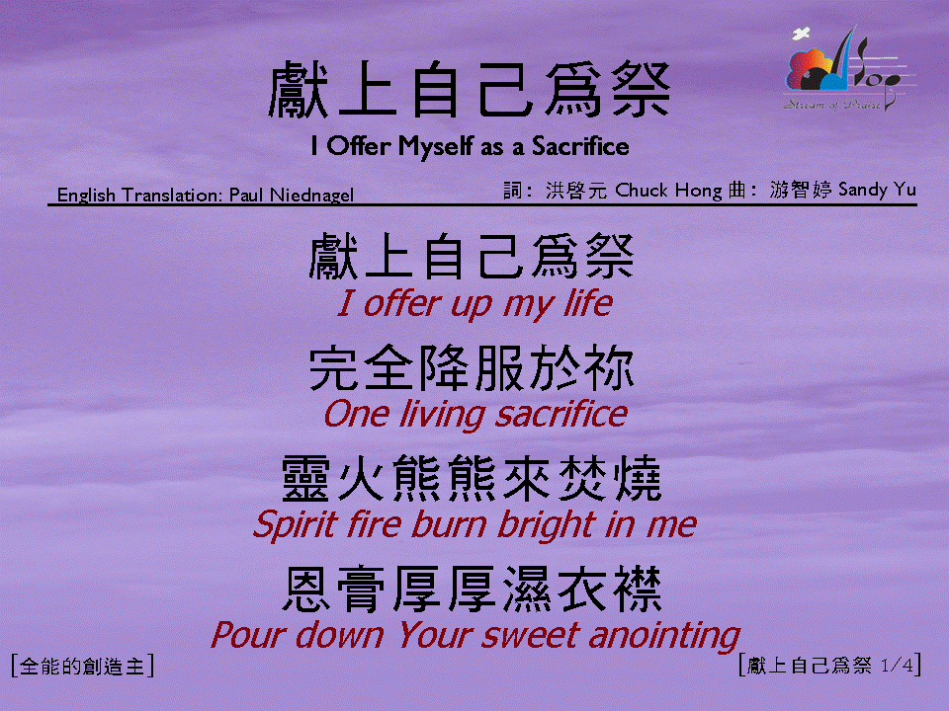
獻上自己為祭 (1/4)
[I Offer Myself as a Sacrifice]

Slide 2
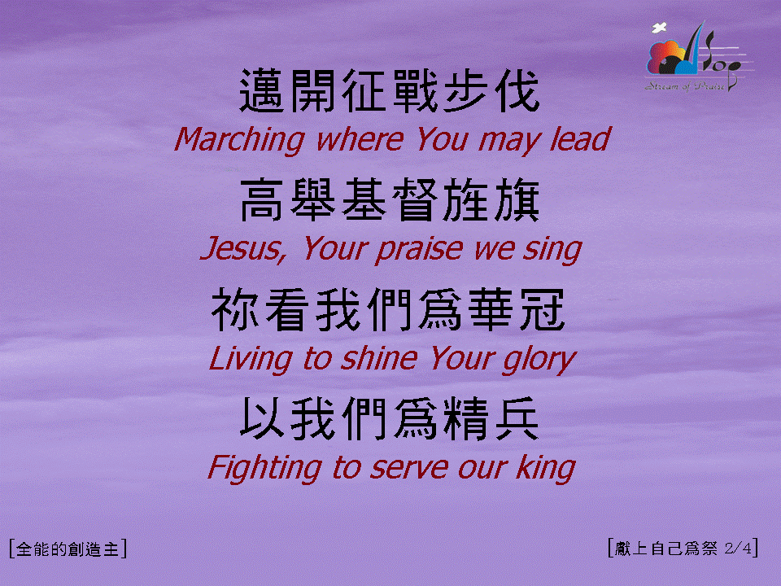
獻上自己為祭 (2/4)
[I Offer Myself as a Sacrifice]

Slide 3
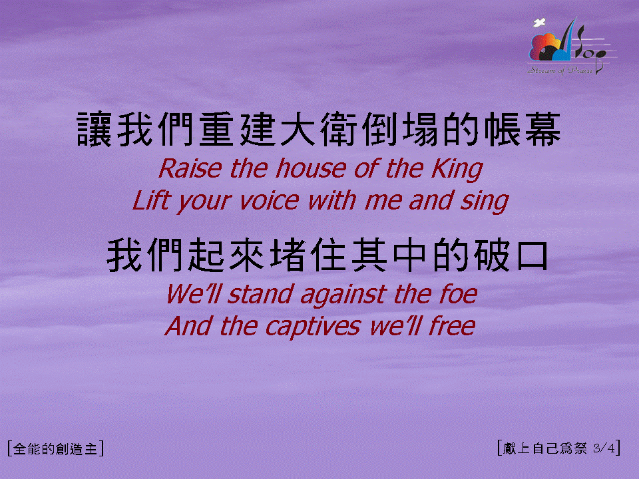
獻上自己為祭 (3/4)
[I Offer Myself as a Sacrifice]

Slide 4

獻上自己為祭 (4/4)
[I Offer Myself as a Sacrifice]

