Slide 1
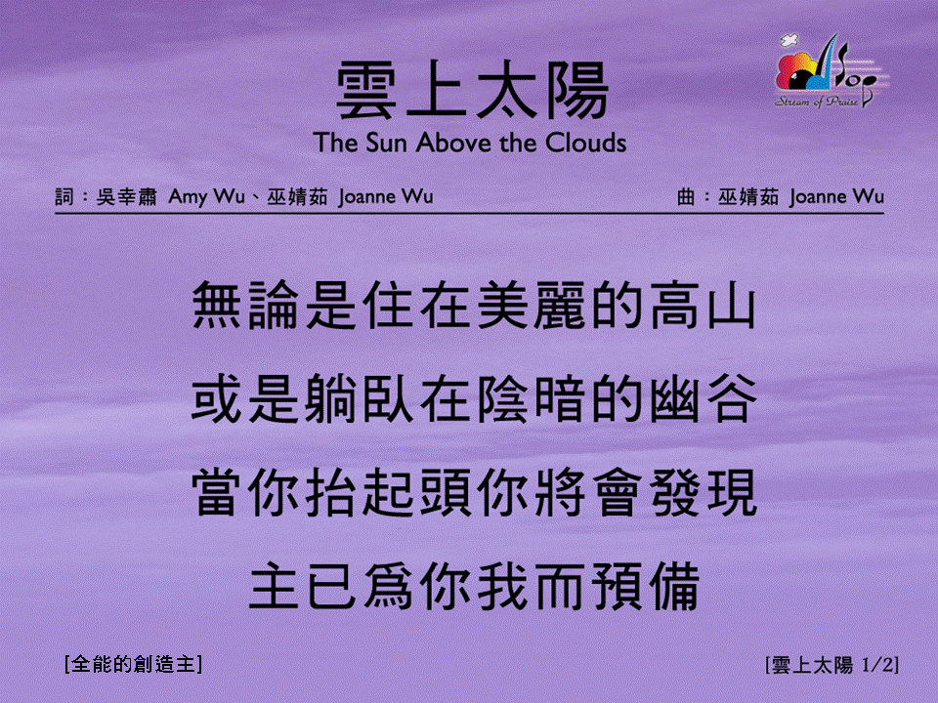
雲上太陽 <1/2>
The Sun Above the Clouds
[全能的創造主]

Slide 2
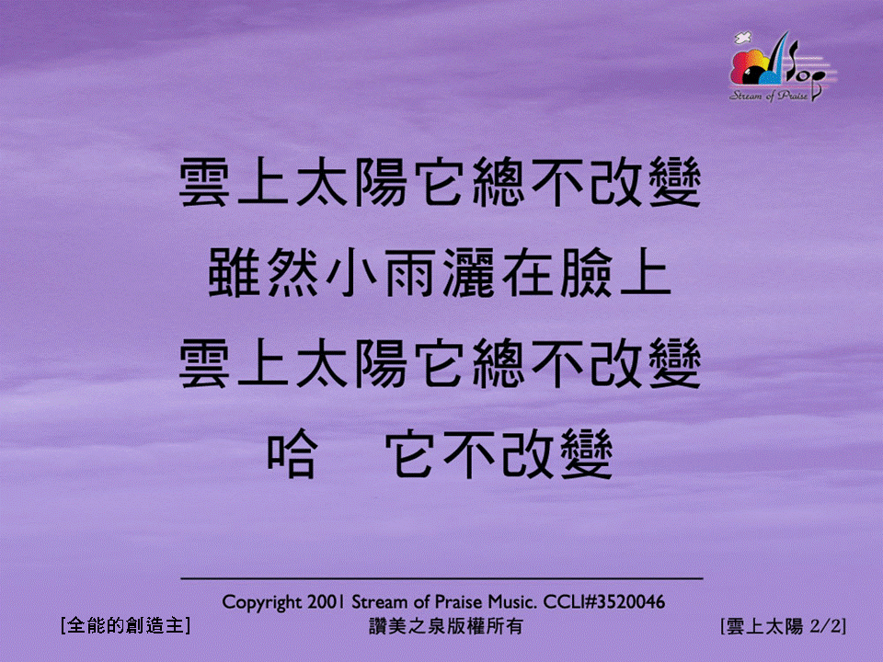
雲上太陽 <2/2>
The Sun Above the Clouds
[全能的創造主]

