Slide 1
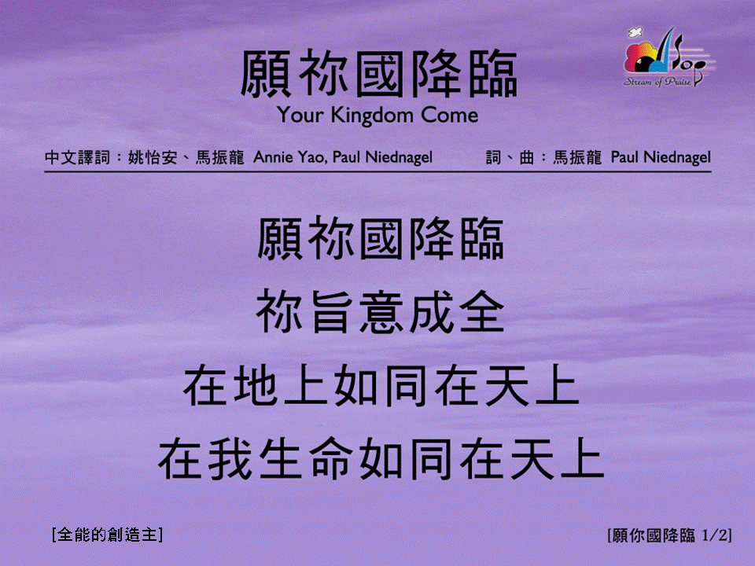
願你國降臨 <1/2>
Your Kingdom Come
[全能的創造主]

Slide 2
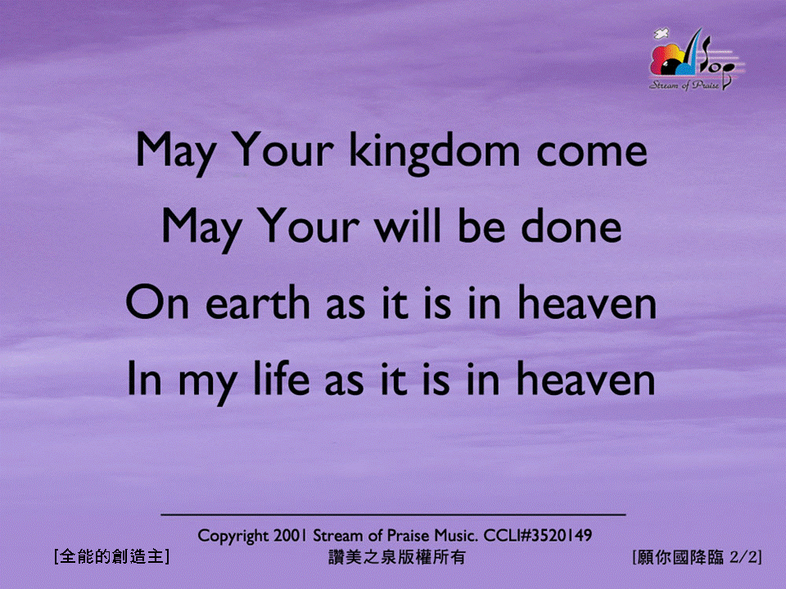
願你國降臨 <2/2>
Your Kingdom Come
[全能的創造主]

