Slide 1
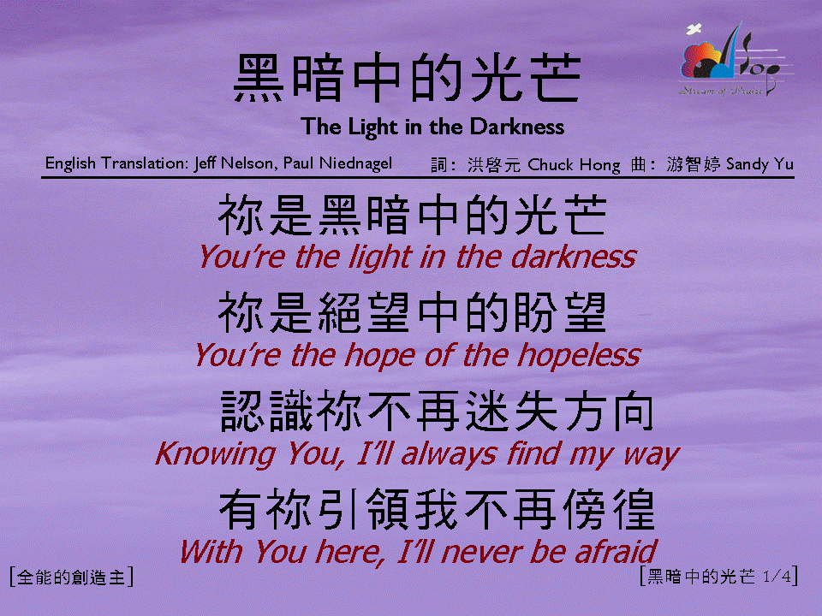
黑暗中的光芒 (1/4)
[The Light in the Darkness]

Slide 2
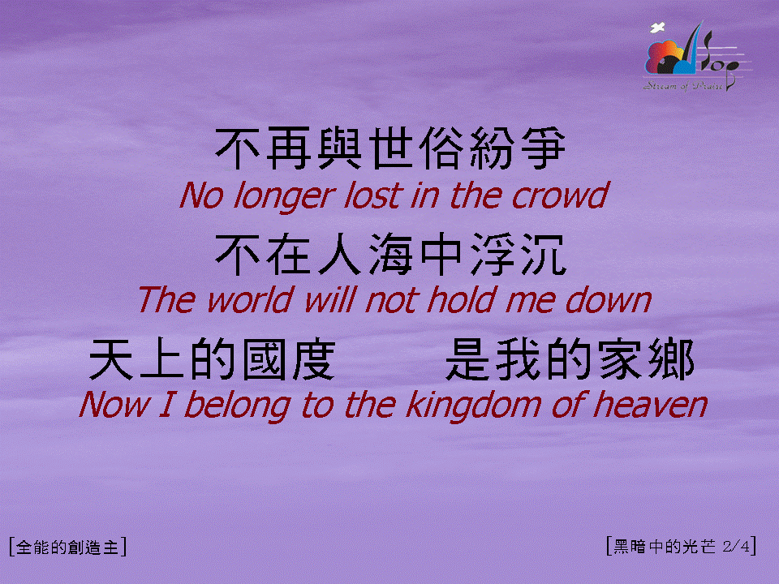
黑暗中的光芒 (2/4)
[The Light in the Darkness]

Slide 3
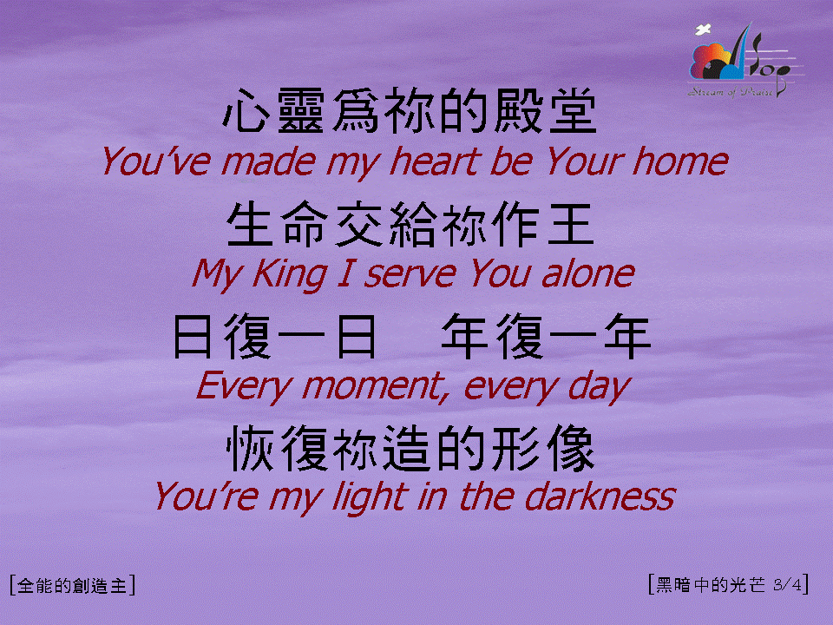
黑暗中的光芒 (3/4)
[The Light in the Darkness]

Slide 4

黑暗中的光芒 (4/4)
[The Light in the Darkness]

