Slide 1

如果你想知道 <1/3>
If You Want To Know
[展開清晨的翅膀]

Slide 2
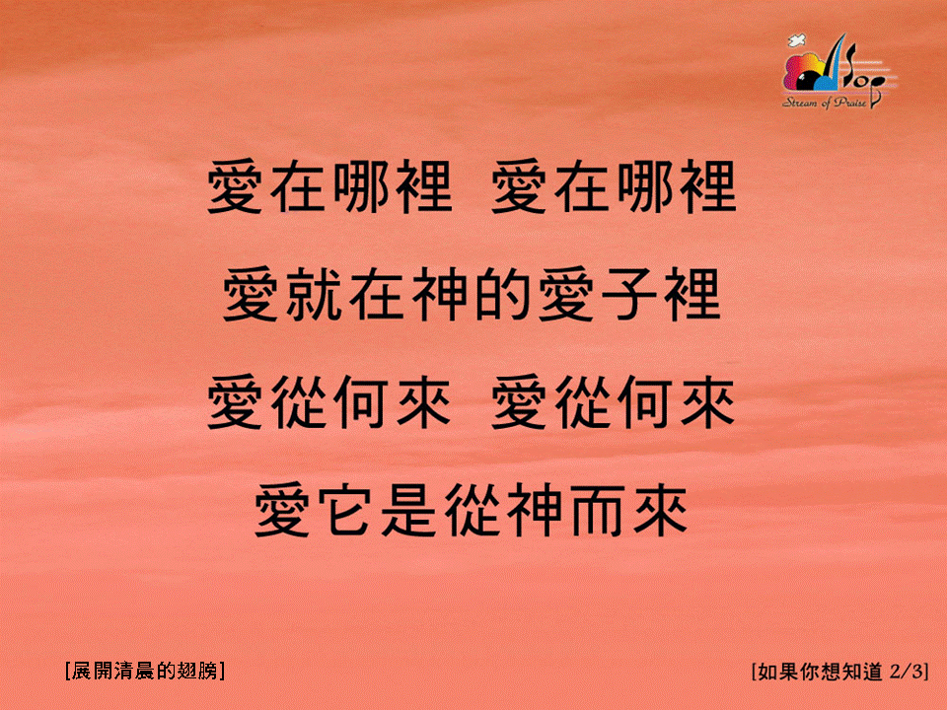
如果你想知道 <2/3>
If You Want To Know
[展開清晨的翅膀]

Slide 3

如果你想知道 <3/3>
If You Want To Know
[展開清晨的翅膀]

Slide 4
如果你想知道 <2/3>
If You Want To Know
[展開清晨的翅膀]

