Slide 1
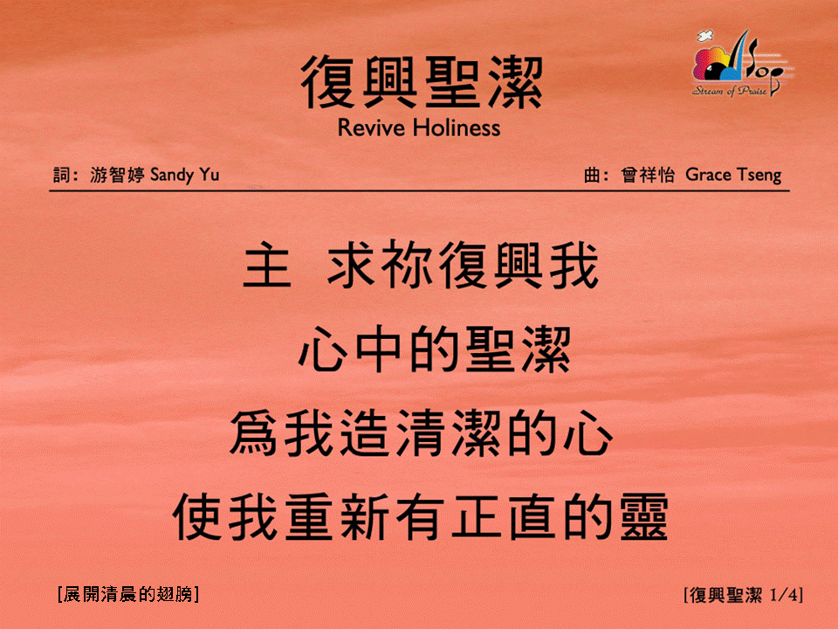
復興聖潔 <1/4>
Revive Holiness
[展開清晨的翅膀]

Slide 2
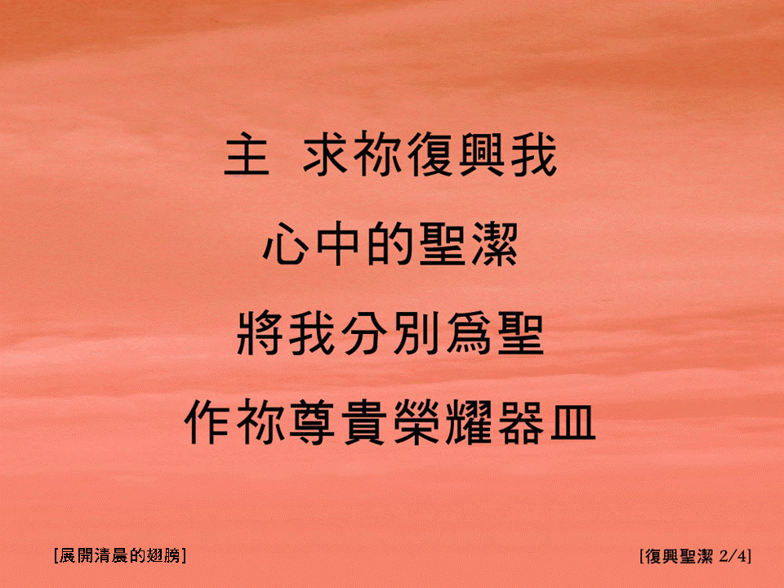
復興聖潔 <2/4>
Revive Holiness
[展開清晨的翅膀]

Slide 3

復興聖潔 <3/4>
Revive Holiness
[展開清晨的翅膀]

Slide 4

復興聖潔 <4/4>
Revive Holiness
[展開清晨的翅膀]

