Slide 1
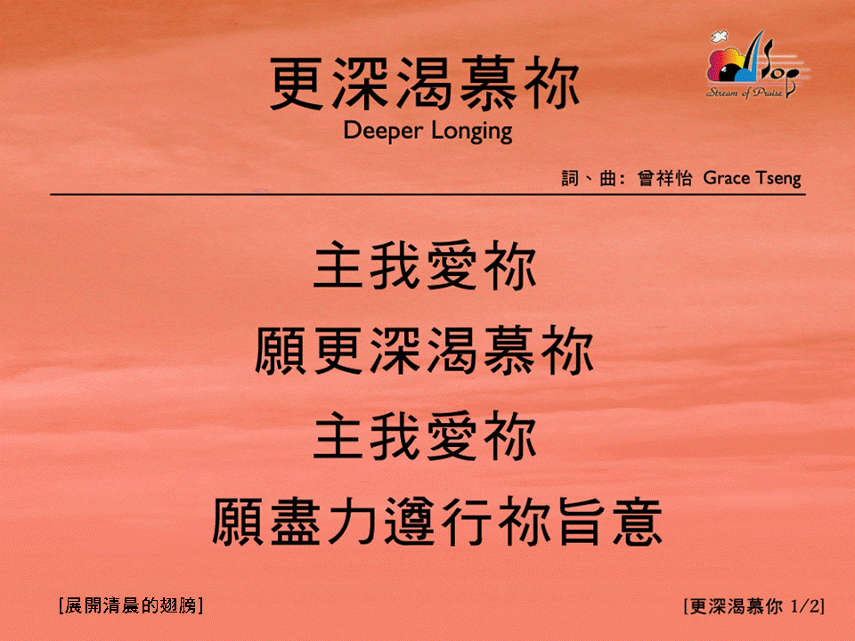
更深渴慕你 <1/2>
Deeper Longing
[展開清晨的翅膀]

Slide 2

更深渴慕你 <2/2>
Deeper Longing
[展開清晨的翅膀]

