Slide 1
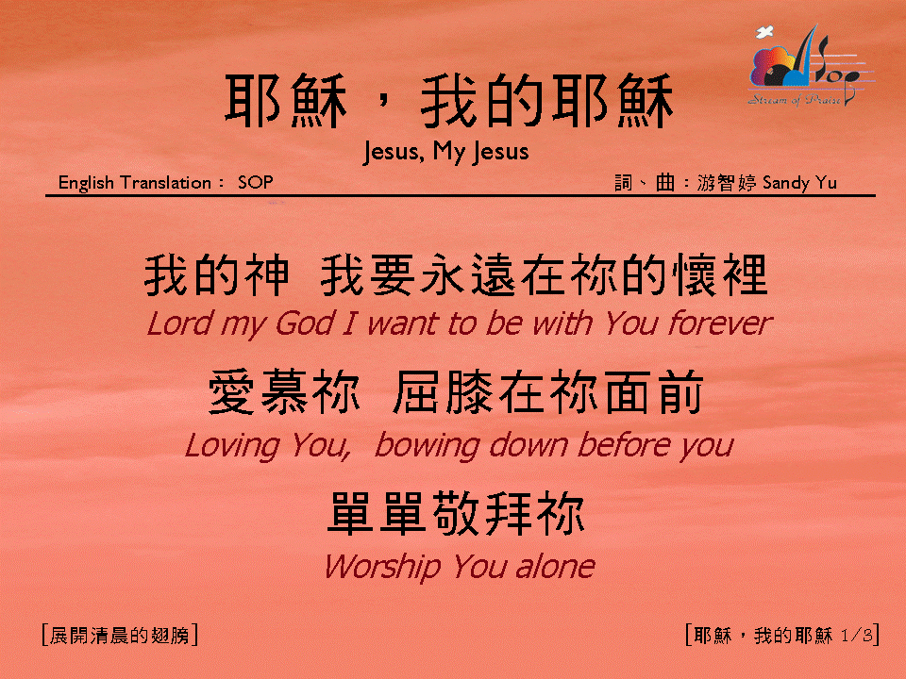
耶穌，我的耶穌 (1/3)
[Jesus, My Jesus]

Slide 2
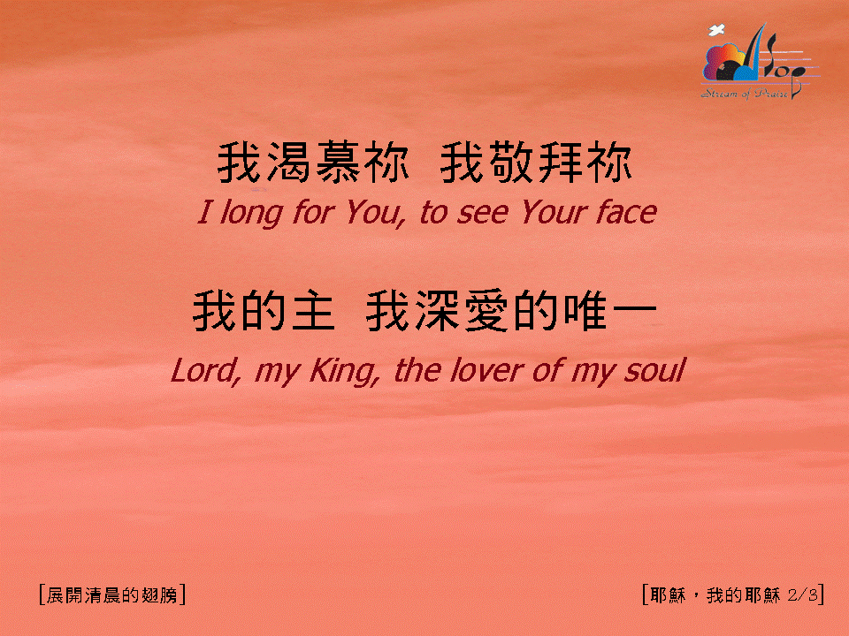
耶穌，我的耶穌 (2/3)
[Jesus, My Jesus]

Slide 3
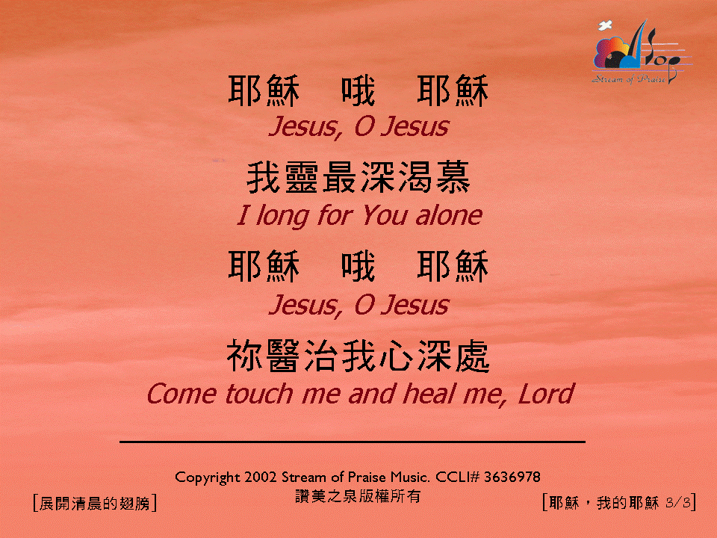
耶穌，我的耶穌 (3/3)
[Jesus, My Jesus]

