Slide 1
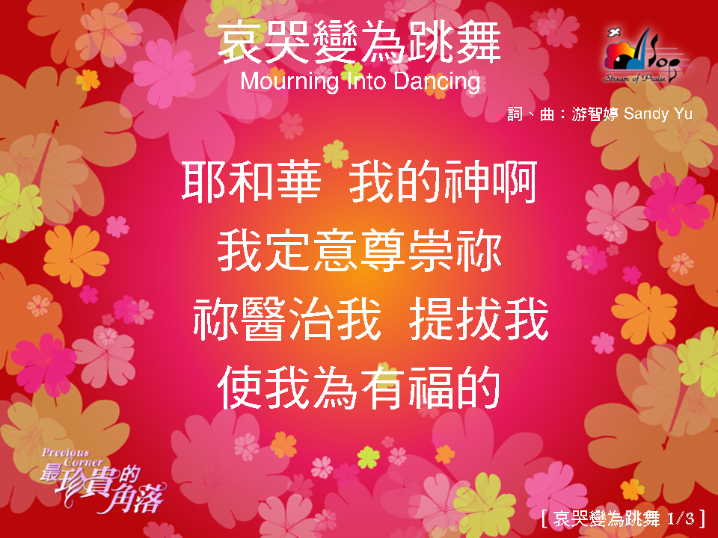
哀哭變為跳舞 1/3

Slide 2

哀哭變為跳舞 2/3

Slide 3

哀哭變為跳舞 3/3

