Slide 1
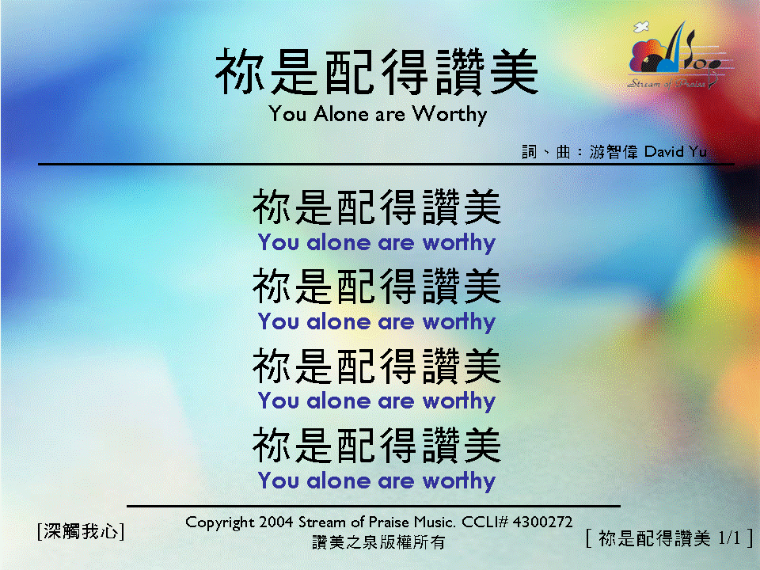
你是配得讚美 <1/1> You Alone are Worthy

