Slide 1
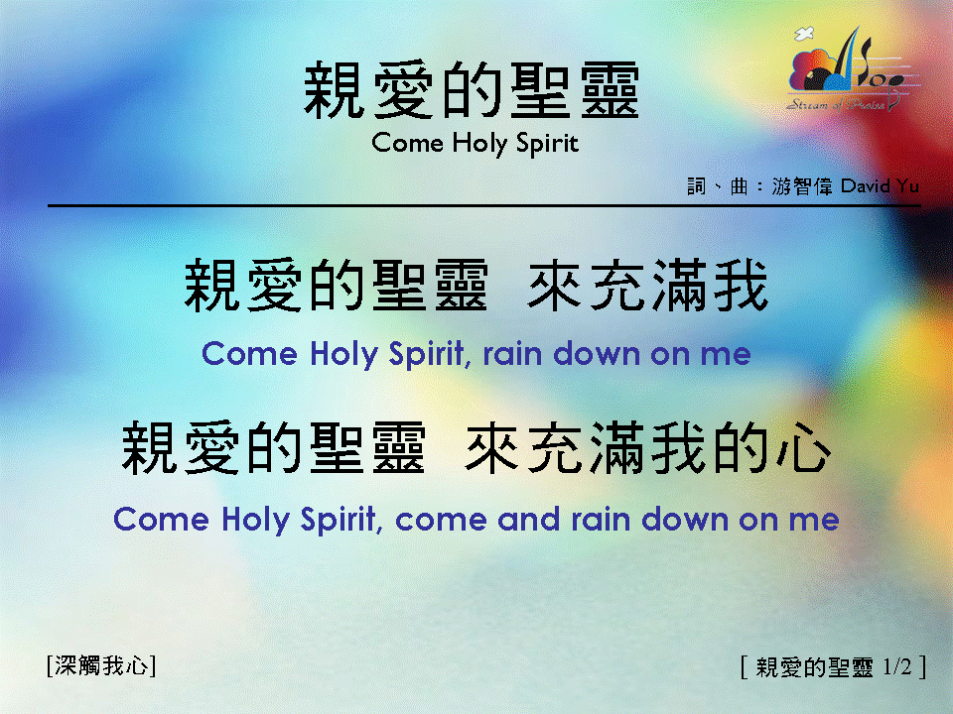
親愛的聖靈 <1/2> Come Holy Spirit

Slide 2
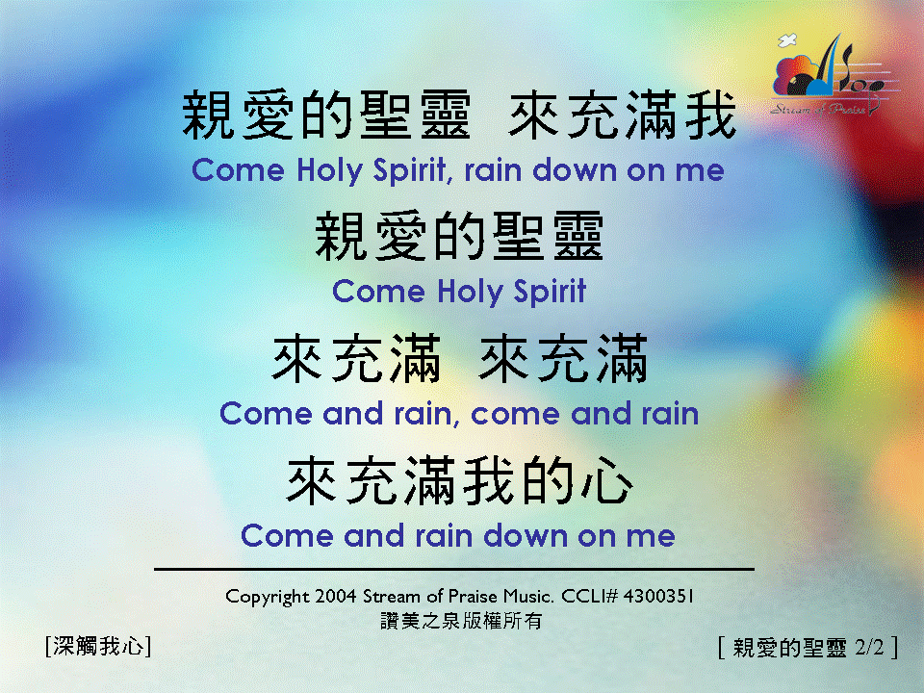
親愛的聖靈 <2/2> Come Holy Spirit

