Slide 1
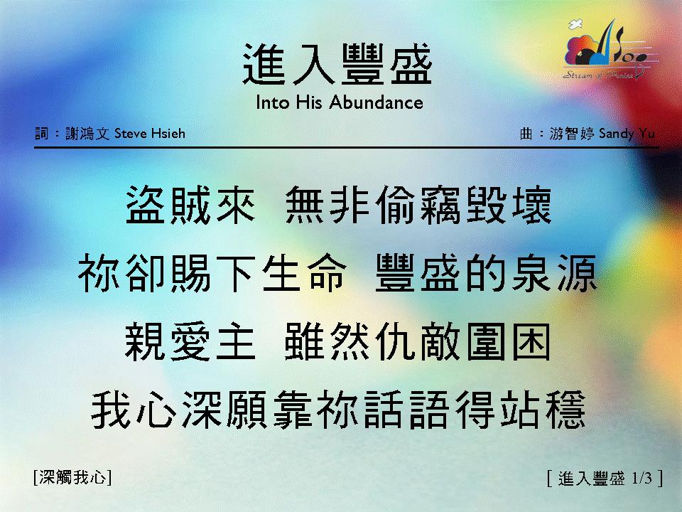
進入豐盛〈1/3 〉
Into His Abundance

Slide 2

進入豐盛〈2/3 〉
Into His Abundance

Slide 3

進入豐盛〈3/3 〉
Into His Abundance

