Slide 1
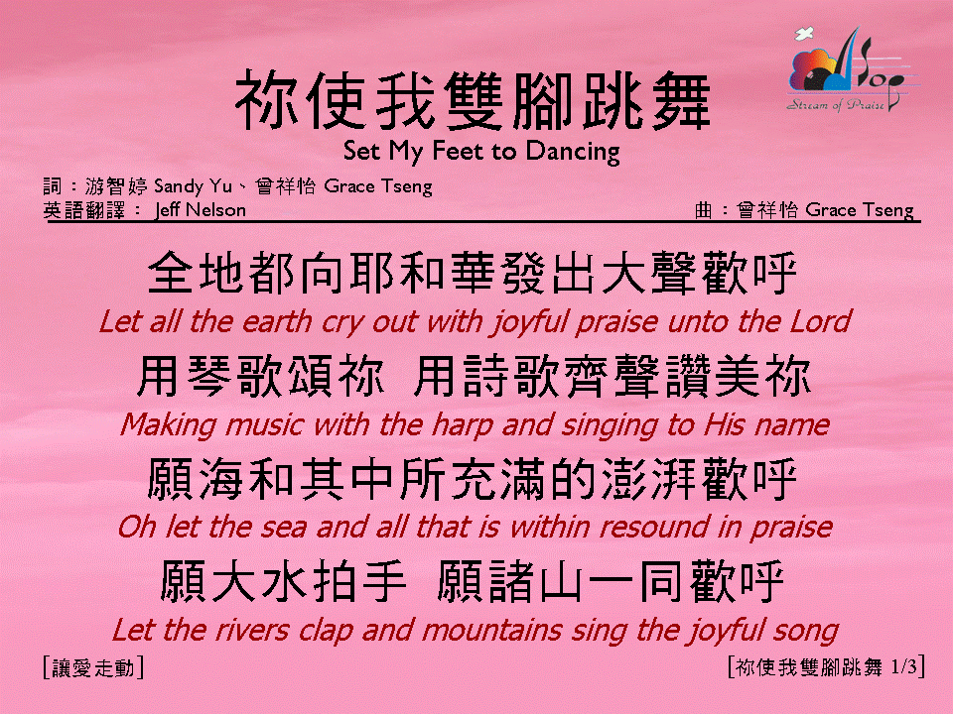

你使我雙腳跳舞 <1/3>
Set My Feet to Dancing

Slide 2
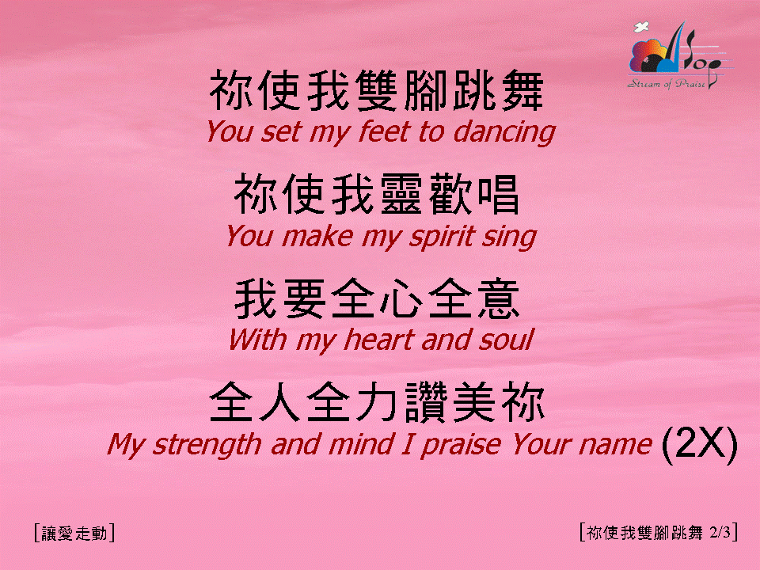
你使我雙腳跳舞 <2/3>
Set My Feet to Dancing

Slide 3

你使我雙腳跳舞 <3/3>
Set My Feet to Dancing

