Slide 1
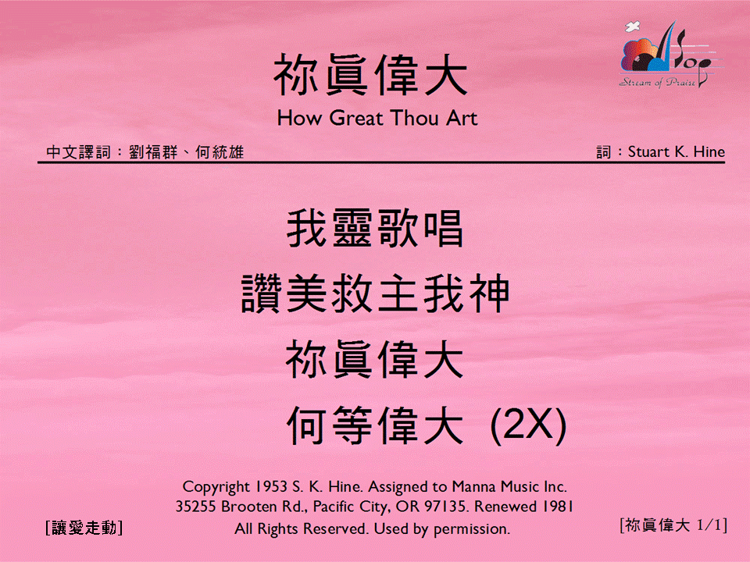

你真偉大 <1/1>
How Great Thou Art
[讓愛走動]

