Slide 1
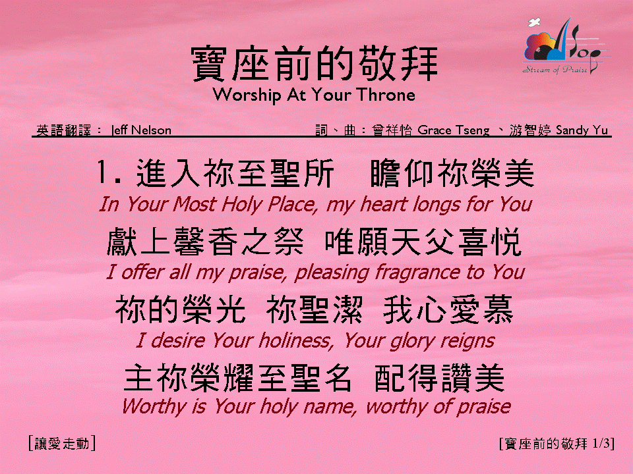

寶座前的敬拜 <1/3>
Worship At Your Throne

Slide 2
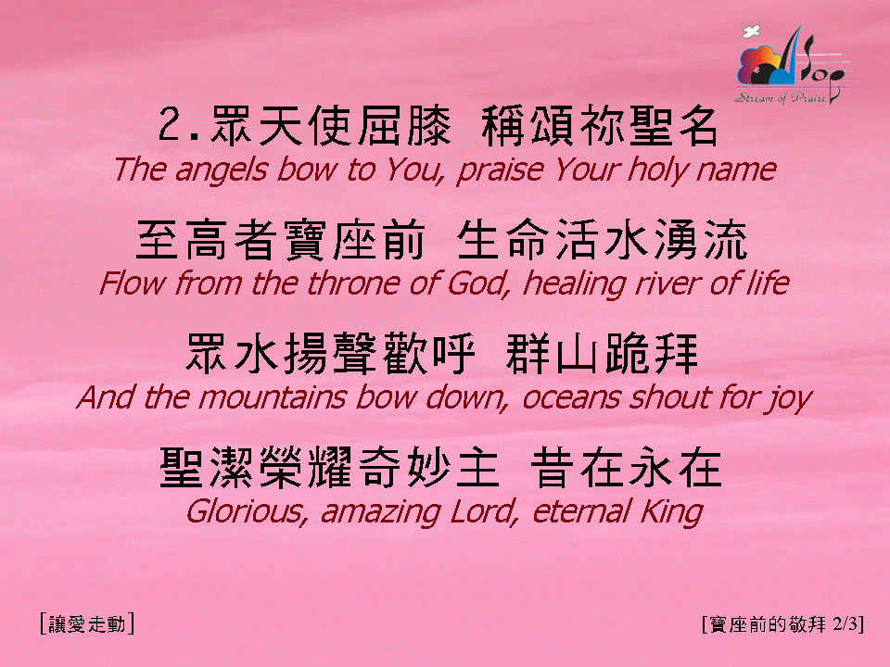
寶座前的敬拜 <2/3>
Worship At Your Throne

Slide 3
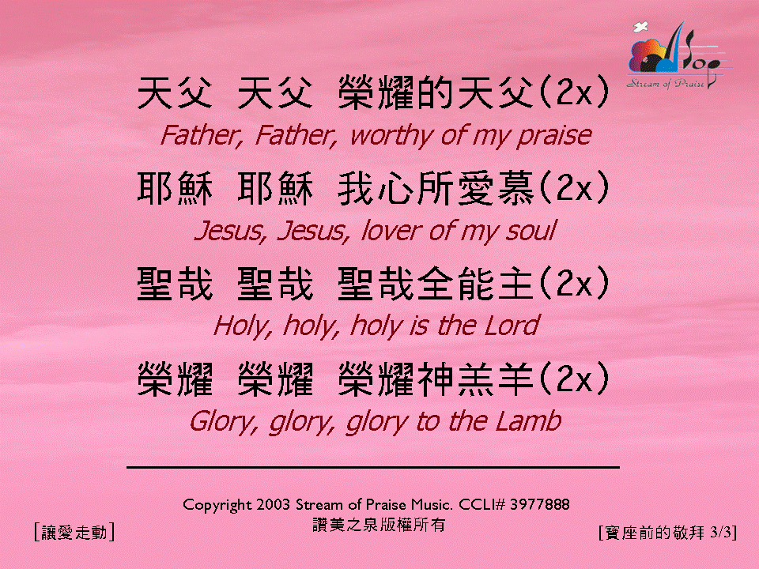
寶座前的敬拜 <3/3>
Worship At Your Throne

