Slide 1
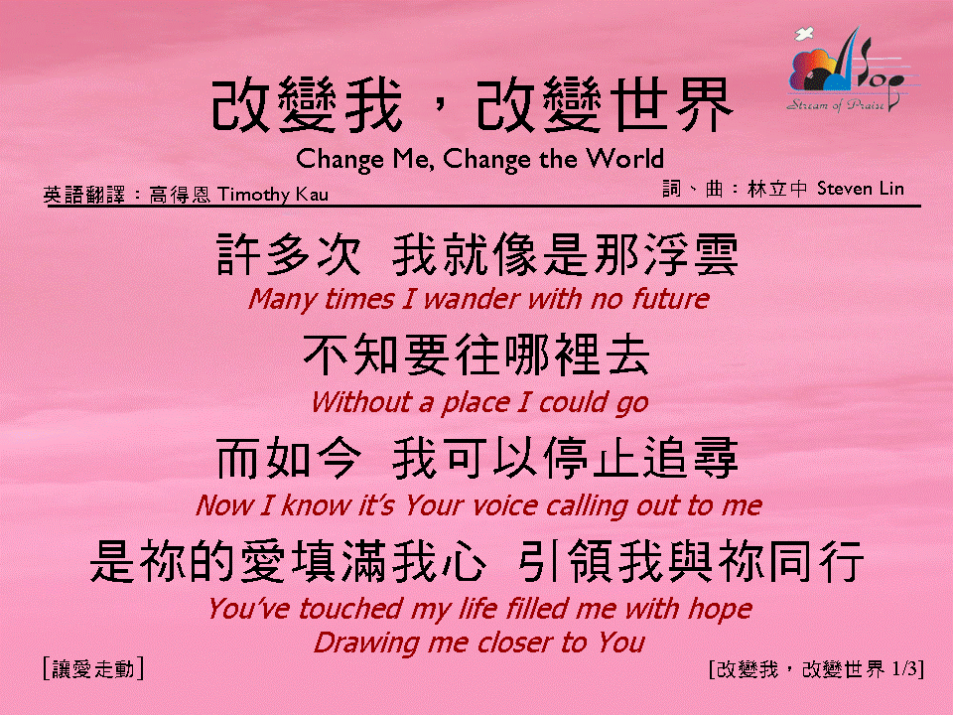

改變我，改變世界 <1/3>
Change Me, Change the World

Slide 2
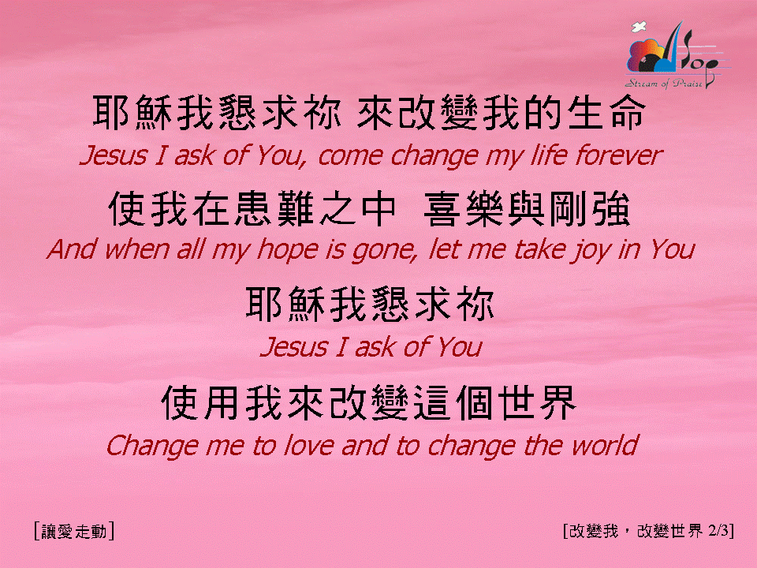
改變我，改變世界 <2/3>
Change Me, Change the World

Slide 3
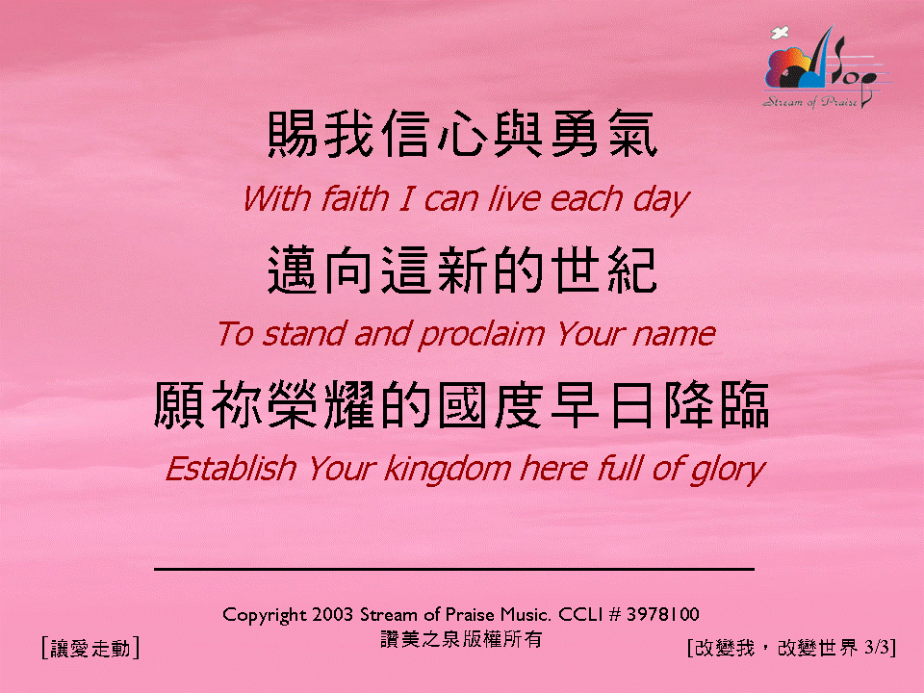
改變我，改變世界 <3/3>
Change Me, Change the World

