Slide 1
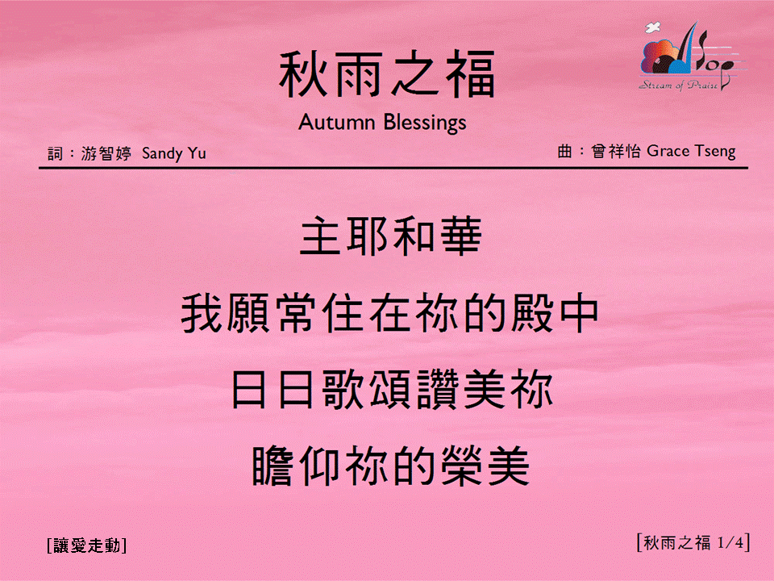

秋雨之福 <1/4>
Autumn Blessings
[讓愛走動]

Slide 2
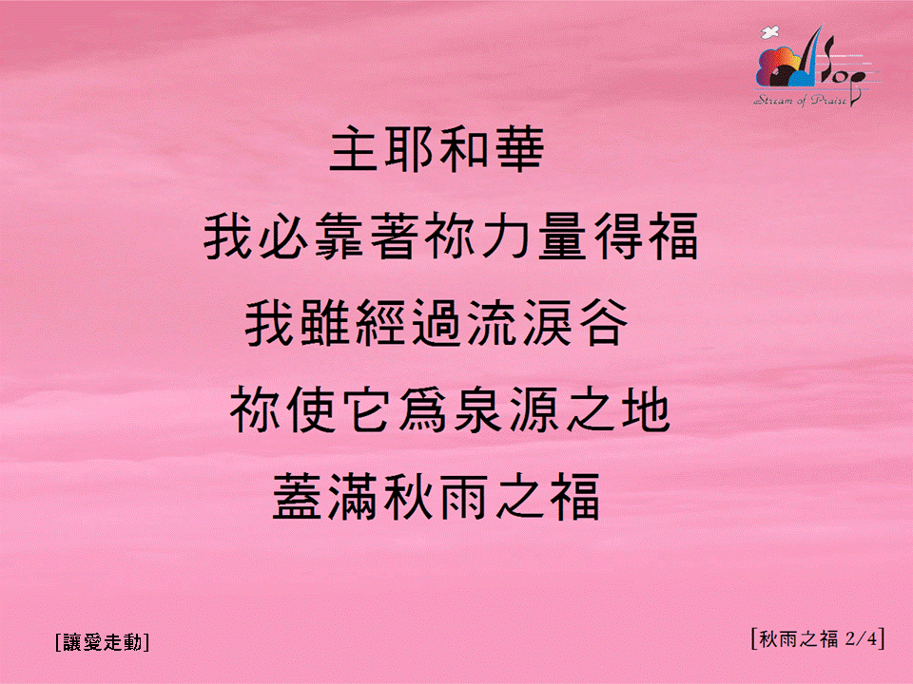
秋雨之福 <2/4>
Autumn Blessings
[讓愛走動]

Slide 3
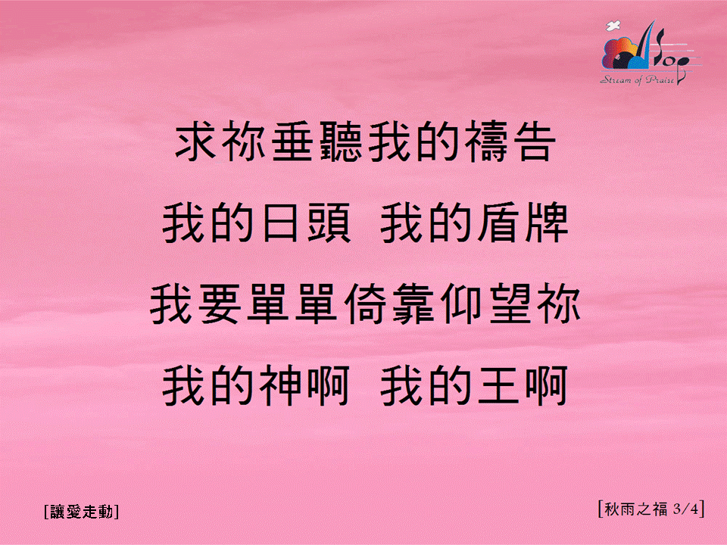
秋雨之福 <3/4>
Autumn Blessings
[讓愛走動]

Slide 4

秋雨之福 <4/4>
Autumn Blessings
[讓愛走動]

