Slide 1
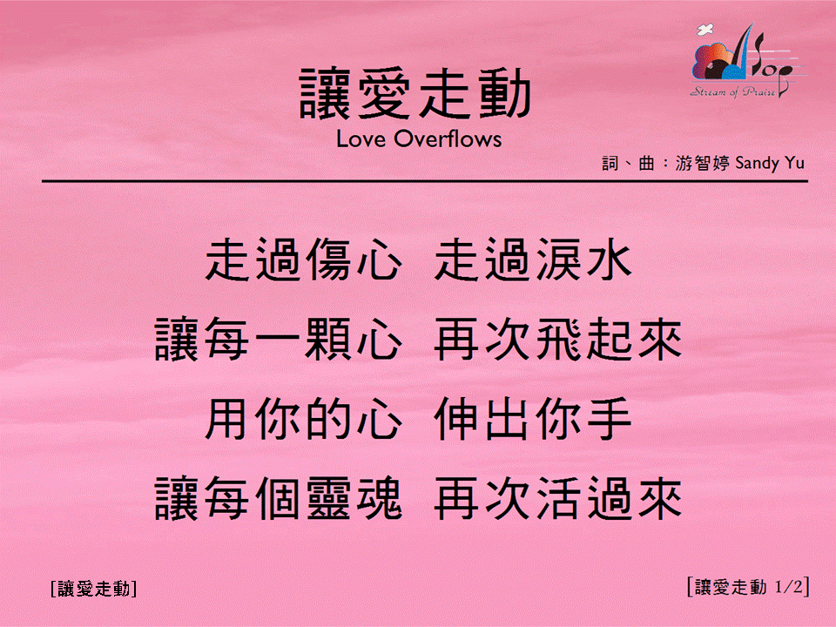
讓愛走動 <1/2>
Love Overflows
[讓愛走動]

Slide 2
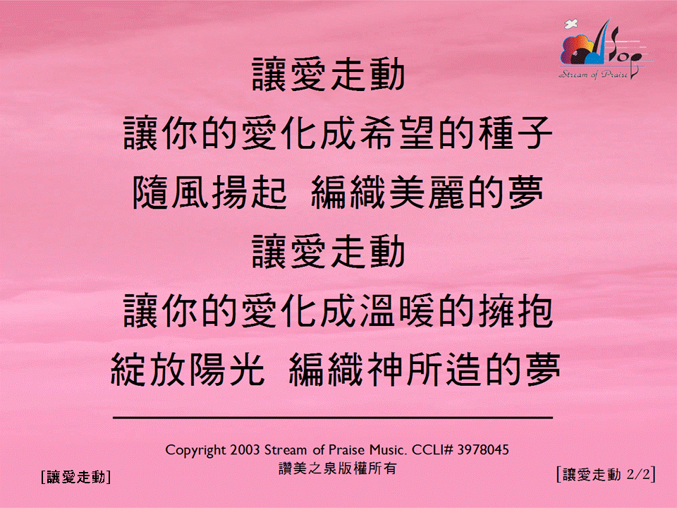

讓愛走動 <2/2>
Love Overflows
[讓愛走動]

