Slide 1


願為主閃亮 <1/3>
Shine For the Lord

Slide 2

願為主閃亮 <2/3>
Shine For the Lord

Slide 3
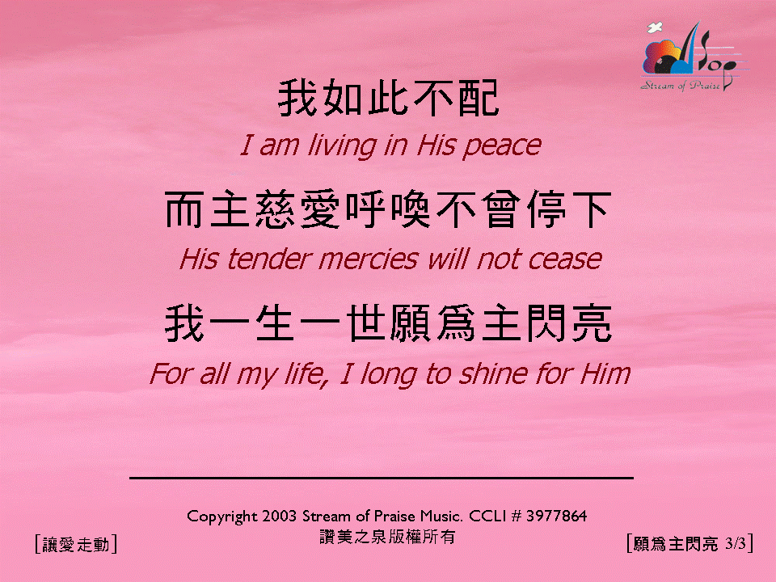
願為主閃亮 <3/3>
Shine For the Lord

