Slide 1
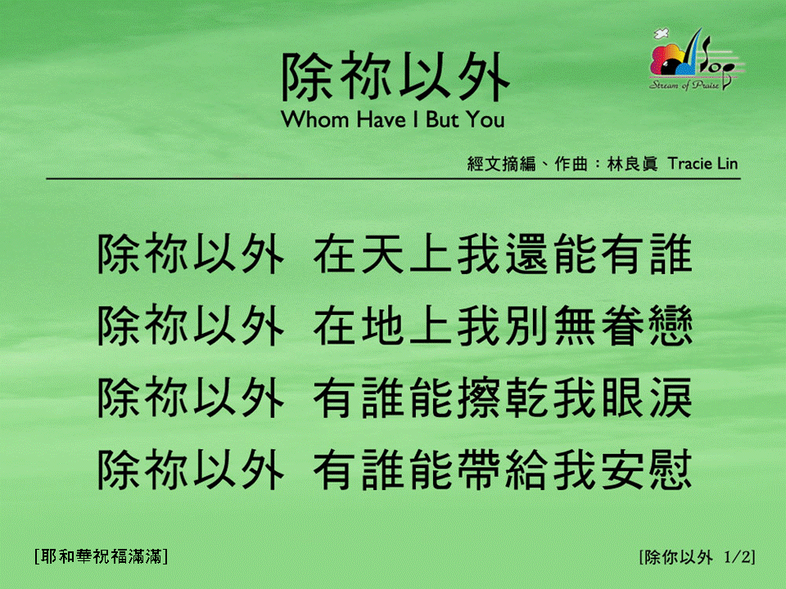
除你以外 (1/2)
[Whom Have I But You]

Slide 2
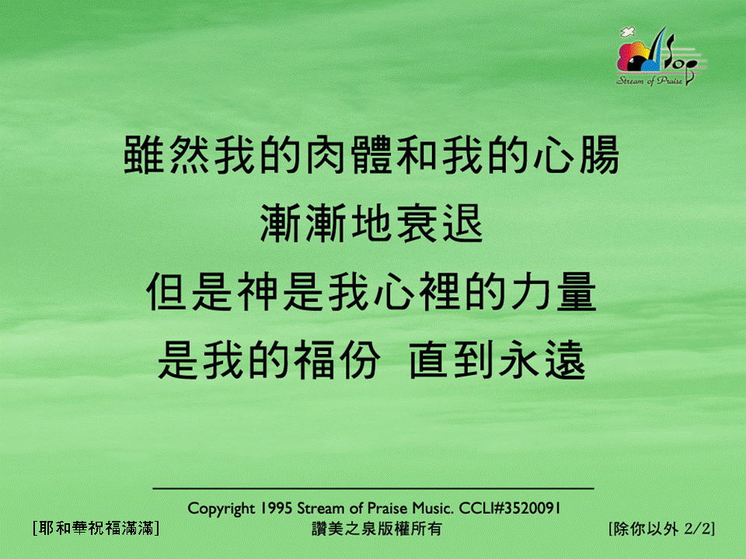
除你以外 (2/2)
[Whom Have I But You]

