Slide 1
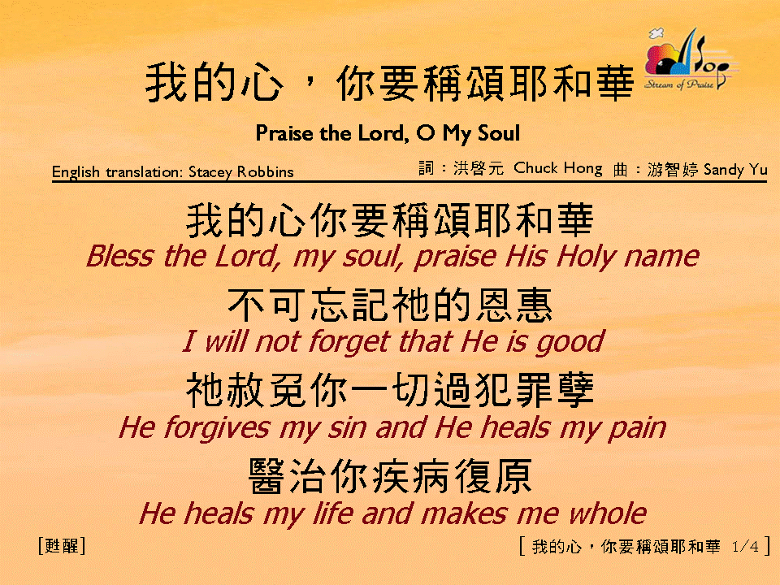
我的心，你要稱頌耶和華 (1/4) [Praise the Lord, O My Soul]

Slide 2
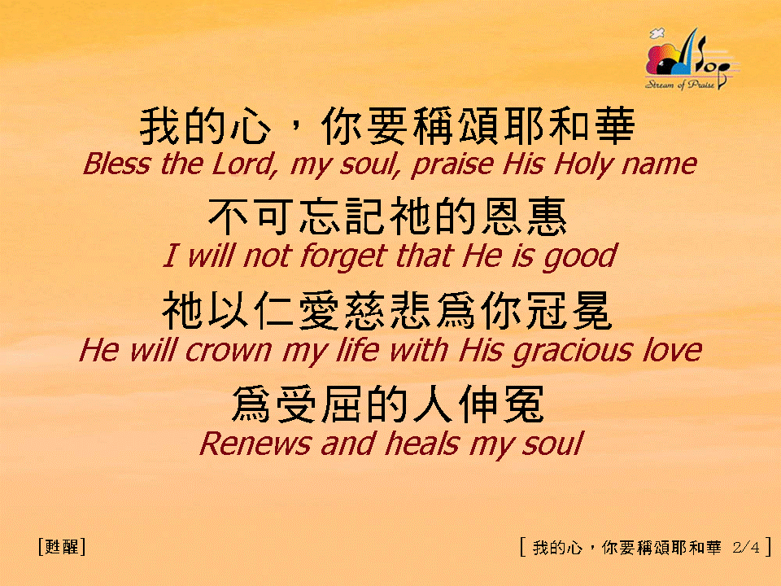
我的心，你要稱頌耶和華 (2/4) [Praise the Lord, O My Soul]

Slide 3
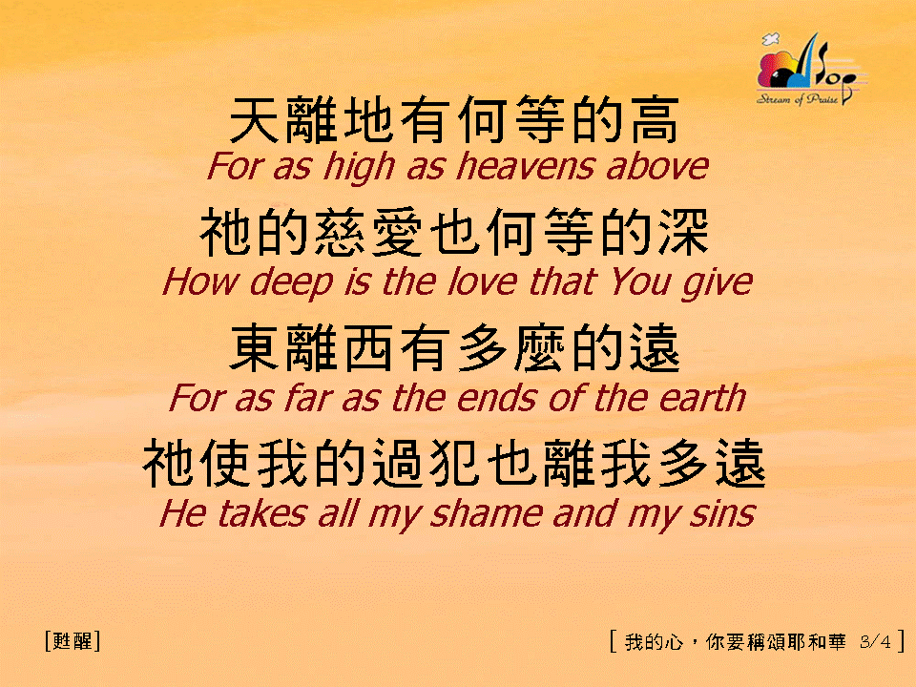
我的心，你要稱頌耶和華 (3/4) [Praise the Lord, O My Soul]

Slide 4
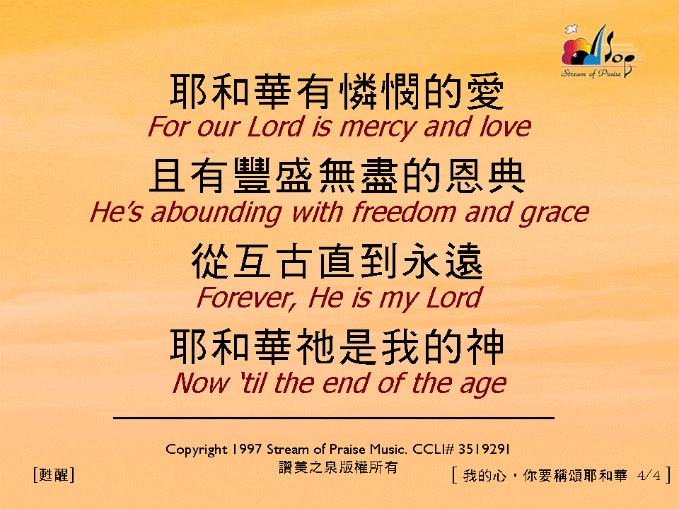

我的心，你要稱頌耶和華 (4/4) [Praise the Lord, O My Soul]
亙

Slide 5
我的心，你要稱頌耶和華 (1/4) [Praise the Lord, O My Soul]

Slide 6
我的心，你要稱頌耶和華 (2/4) [Praise the Lord, O My Soul]

Slide 7
我的心，你要稱頌耶和華 (3/4) [Praise the Lord, O My Soul]

Slide 8
我的心，你要稱頌耶和華 (4/4) [Praise the Lord, O My Soul]
亙

Slide 9
我的心，你要稱頌耶和華 (3/4) [Praise the Lord, O My Soul]

Slide 10
我的心，你要稱頌耶和華 (4/4) [Praise the Lord, O My Soul]
亙

Slide 11
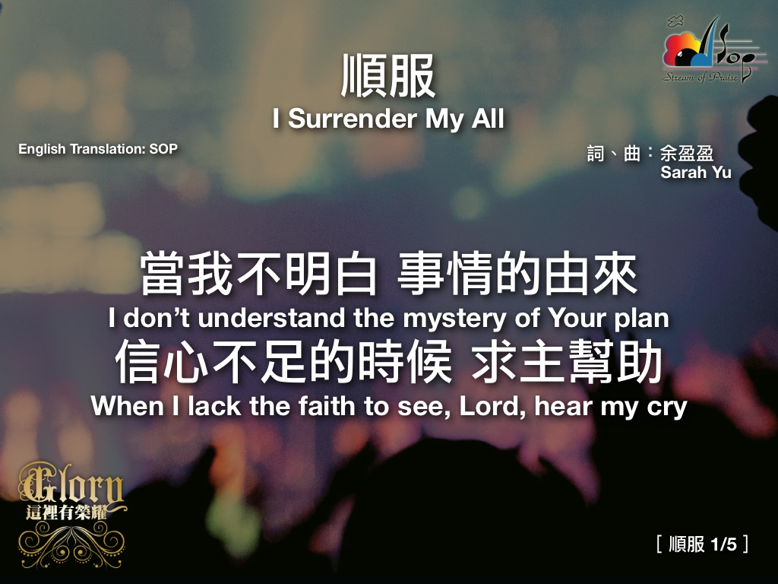

Slide 12
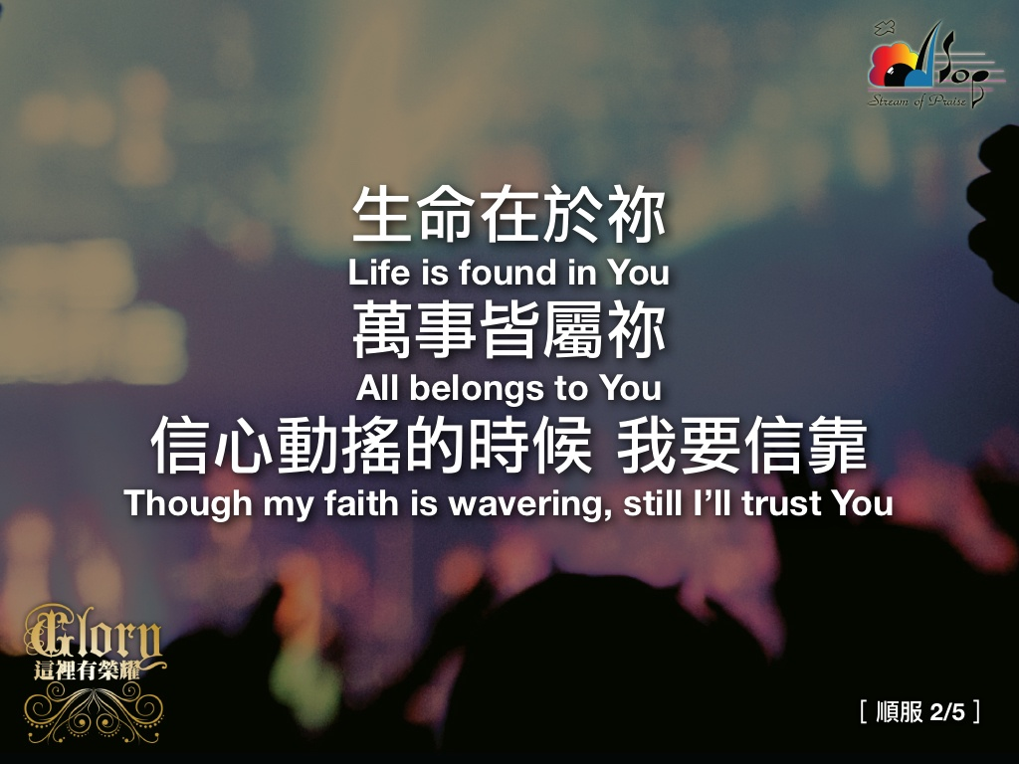

Slide 13


Slide 14
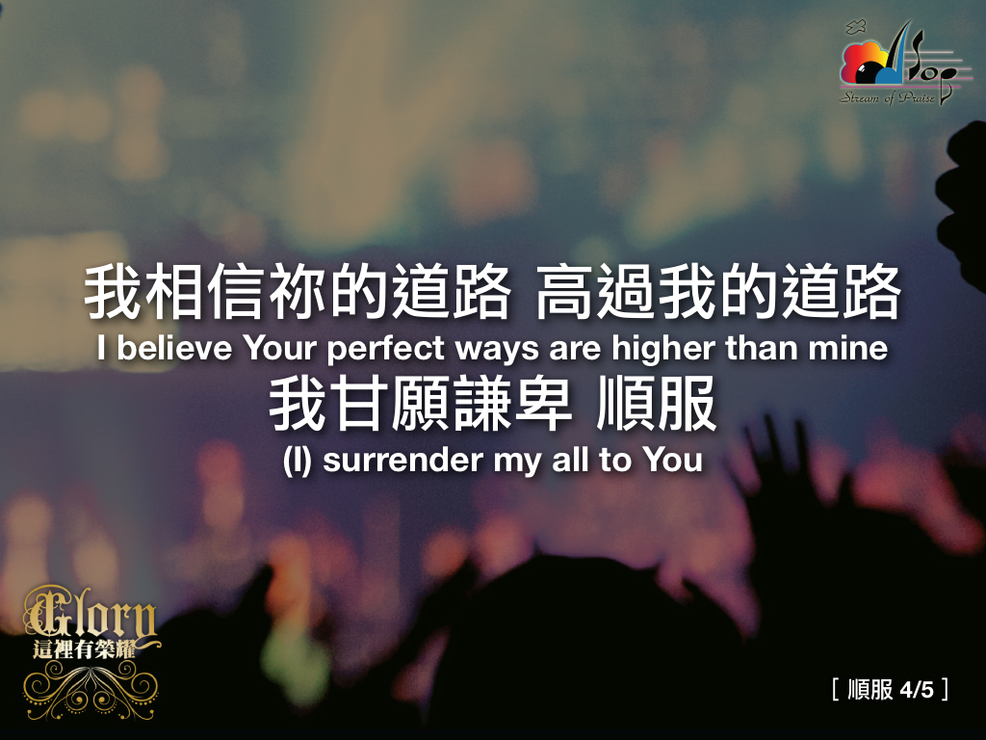

Slide 21
