Slide 1
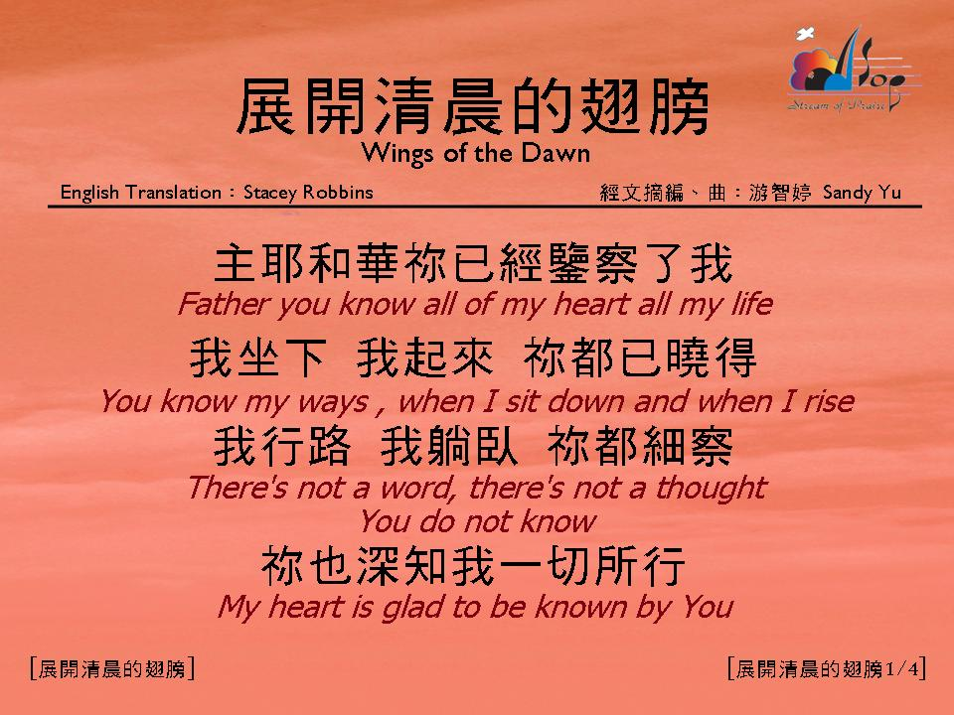

Slide 2
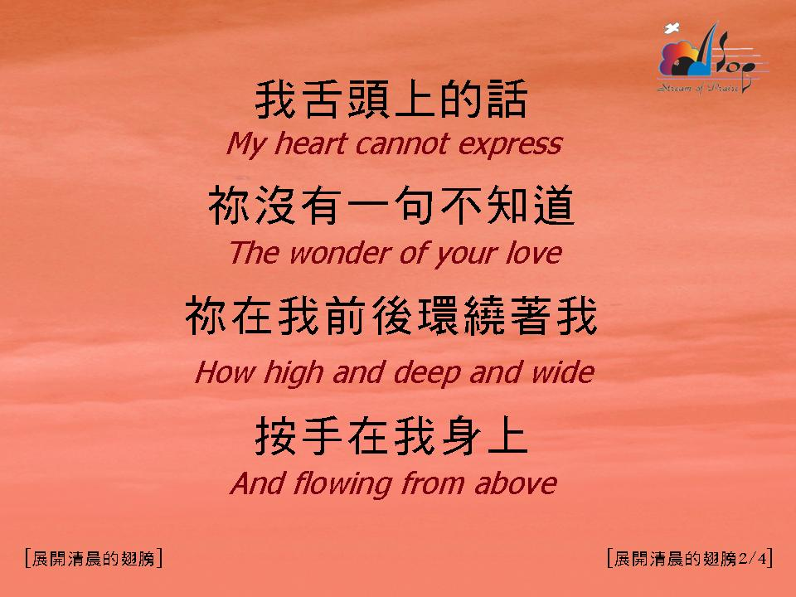

Slide 3
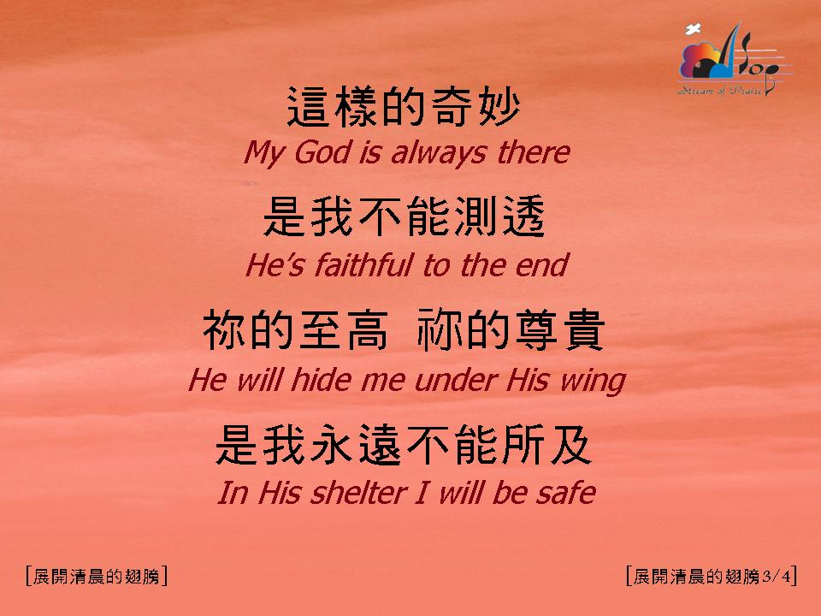

Slide 4


Slide 12
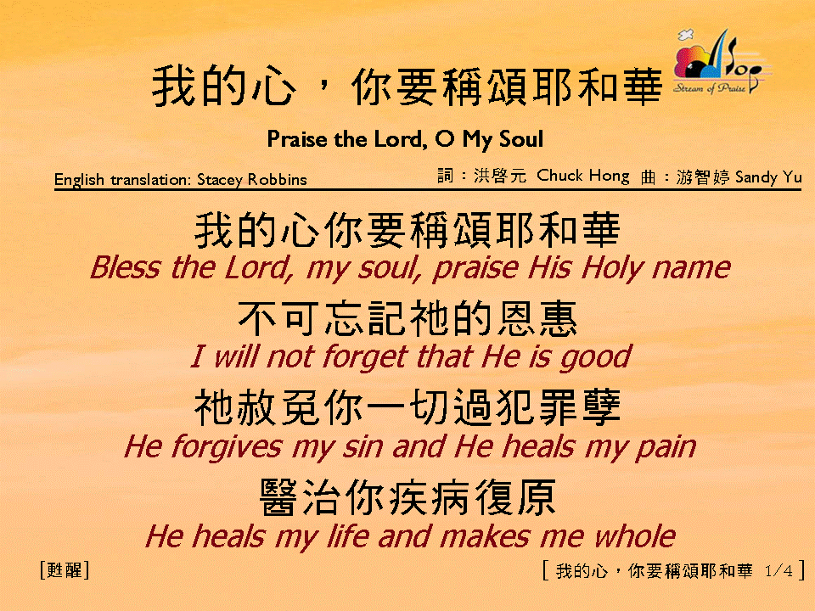
我的心，你要稱頌耶和華 (1/4) [Praise the Lord, O My Soul]

Slide 13
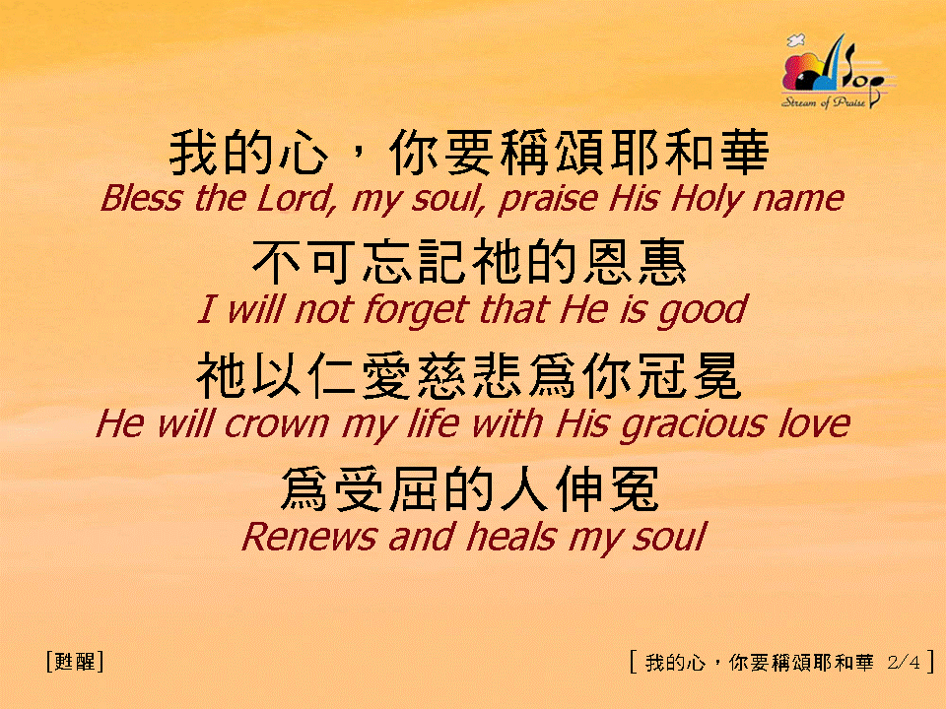
我的心，你要稱頌耶和華 (2/4) [Praise the Lord, O My Soul]

Slide 14
我的心，你要稱頌耶和華 (1/4) [Praise the Lord, O My Soul]

Slide 15
我的心，你要稱頌耶和華 (2/4) [Praise the Lord, O My Soul]

Slide 16
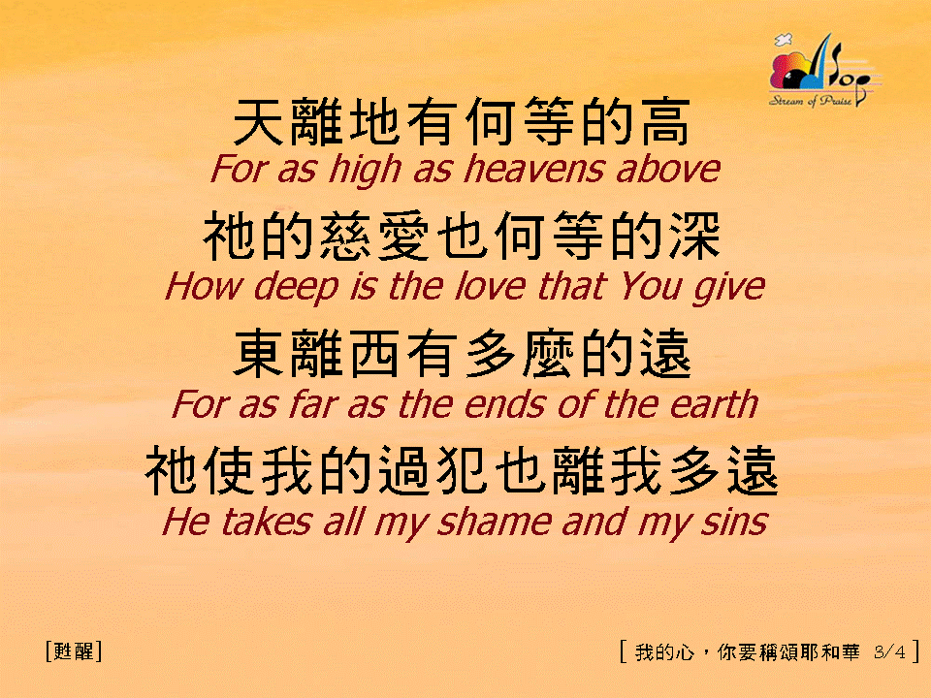
我的心，你要稱頌耶和華 (3/4) [Praise the Lord, O My Soul]

Slide 17
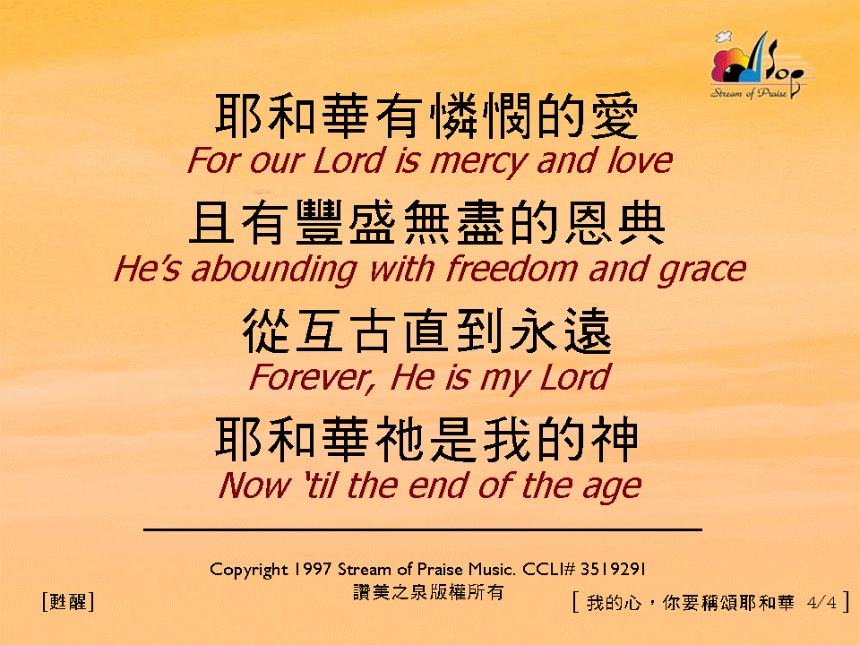

我的心，你要稱頌耶和華 (4/4) [Praise the Lord, O My Soul]
亙

Slide 18
我的心，你要稱頌耶和華 (1/4) [Praise the Lord, O My Soul]

Slide 19
我的心，你要稱頌耶和華 (2/4) [Praise the Lord, O My Soul]

Slide 20
我的心，你要稱頌耶和華 (3/4) [Praise the Lord, O My Soul]

Slide 21
我的心，你要稱頌耶和華 (4/4) [Praise the Lord, O My Soul]
亙

Slide 22
我的心，你要稱頌耶和華 (3/4) [Praise the Lord, O My Soul]

Slide 23
我的心，你要稱頌耶和華 (4/4) [Praise the Lord, O My Soul]
亙

