Slide 1

讓讚美飛揚 <1/4> Let Praise Arise

Slide 2
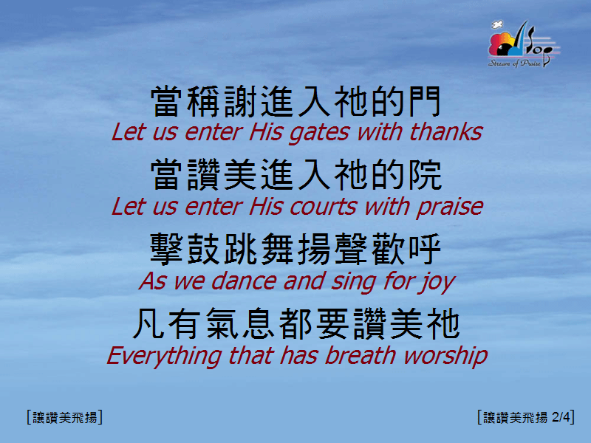
讓讚美飛揚 <2/4> Let Praise Arise

Slide 3
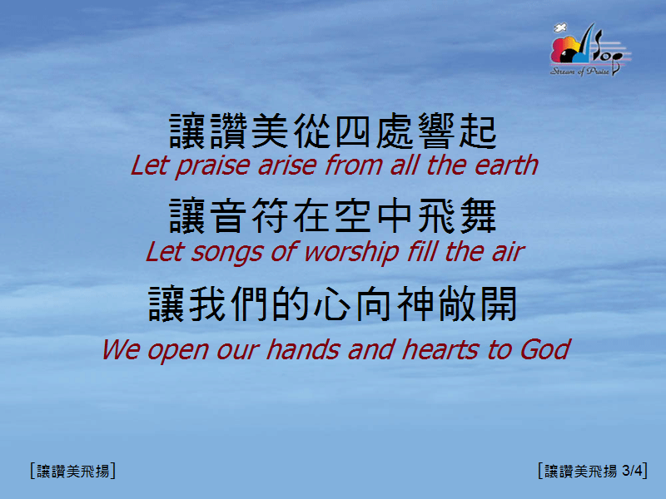
讓讚美飛揚 <3/4> Let Praise Arise

Slide 4

讓讚美飛揚 <4/4> Let Praise Arise

Slide 5

我對你的愛永不變 (1/2) [My Love To You Will Never Change]
[彩虹下的約定]

Slide 6

我對你的愛永不變 (2/2) [My Love To You Will Never Change]
[彩虹下的約定]

