Slide 1
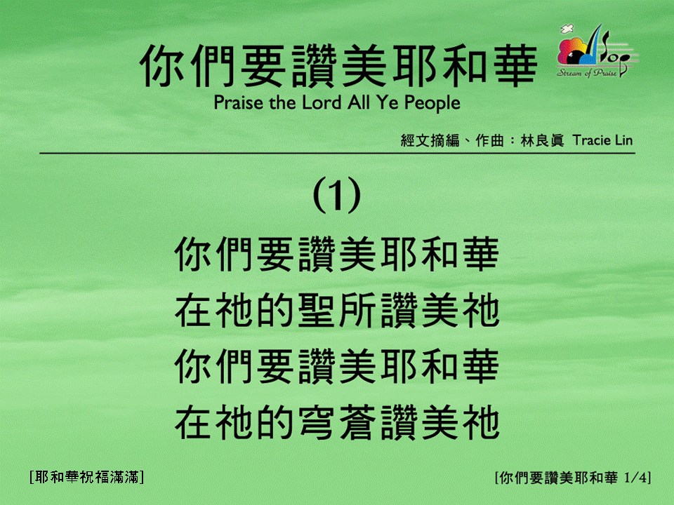
你們要讚美耶和華 (1/4) [Praise the Lord All Ye People]
[耶和華祝福滿滿]

Slide 2
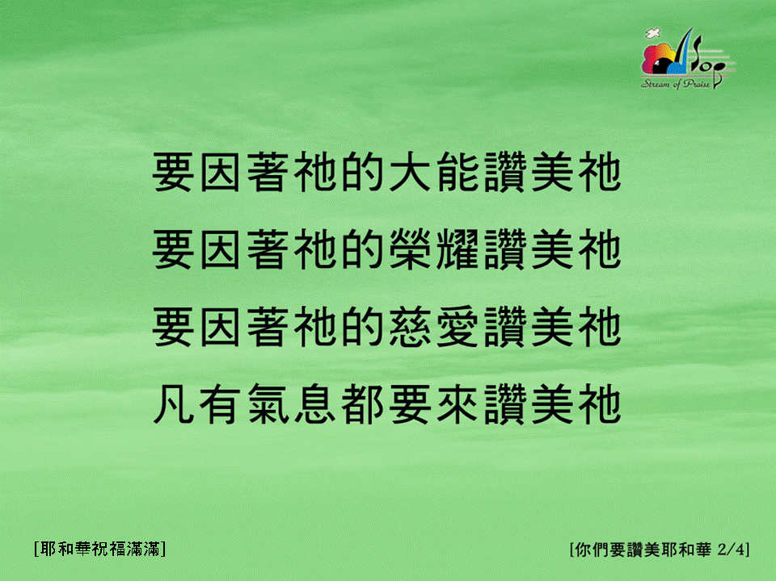
你們要讚美耶和華 (2/4) [Praise the Lord All Ye People]
[耶和華祝福滿滿]

Slide 3
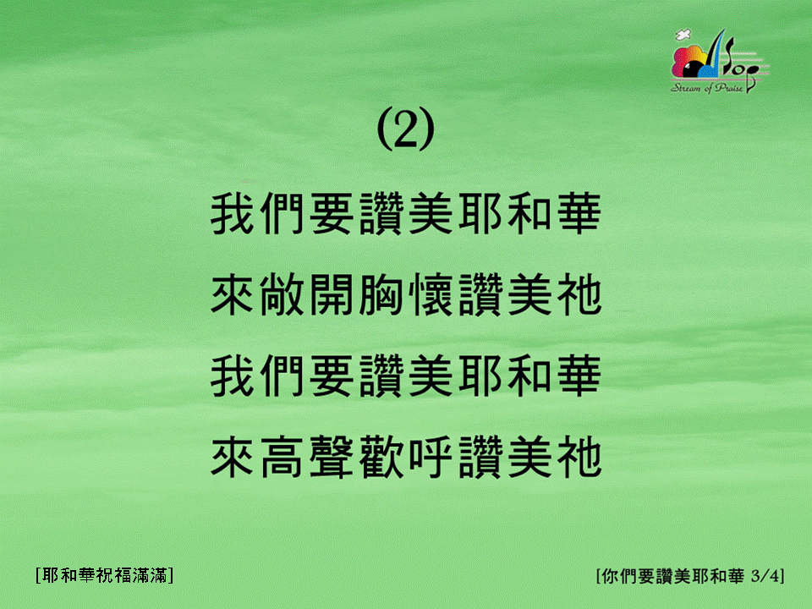
你們要讚美耶和華 (3/4) [Praise the Lord All Ye People]
[耶和華祝福滿滿]

Slide 4
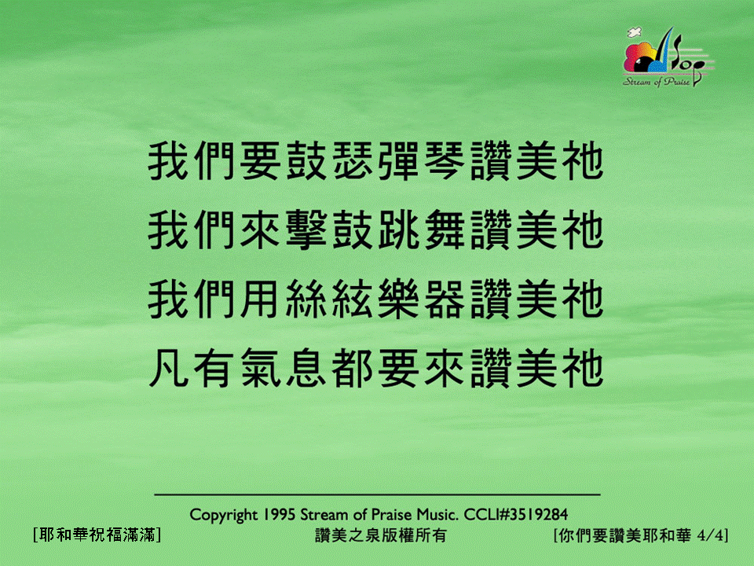
你們要讚美耶和華 (4/4) [Praise the Lord All Ye People]
[耶和華祝福滿滿]

Slide 5
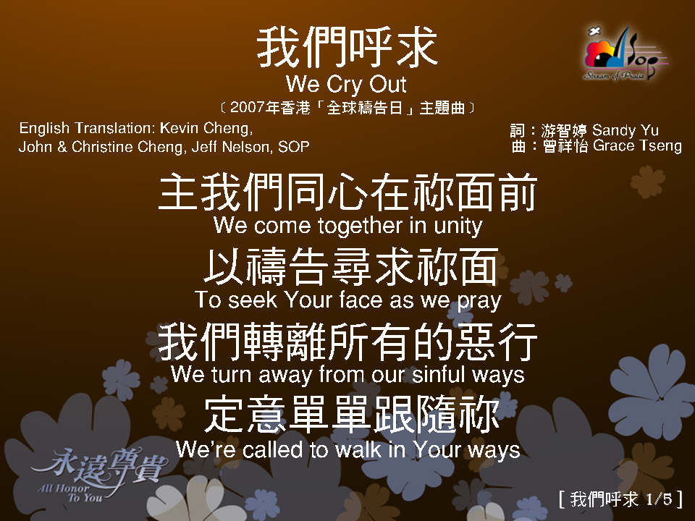
我們呼求 1/5

Slide 6
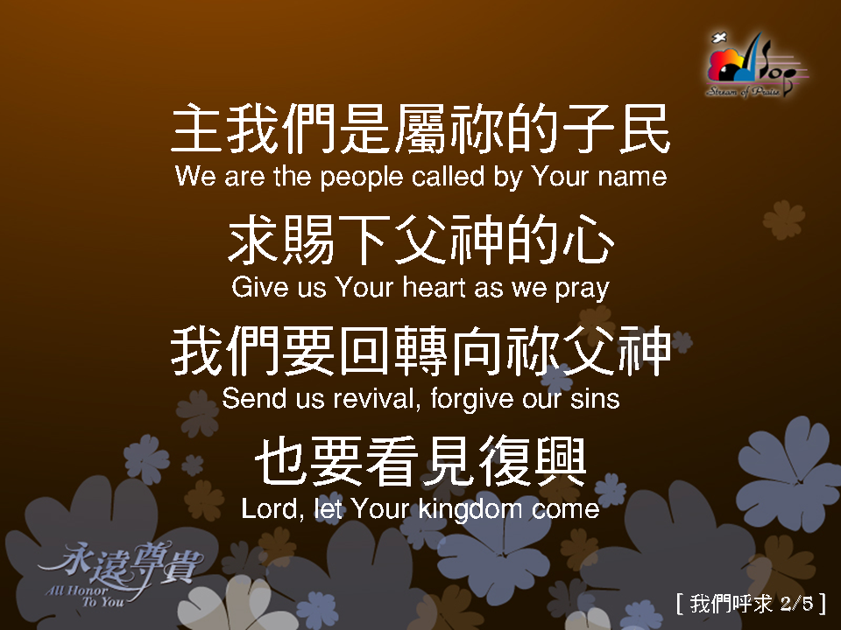
我們呼求 2/5

Slide 7
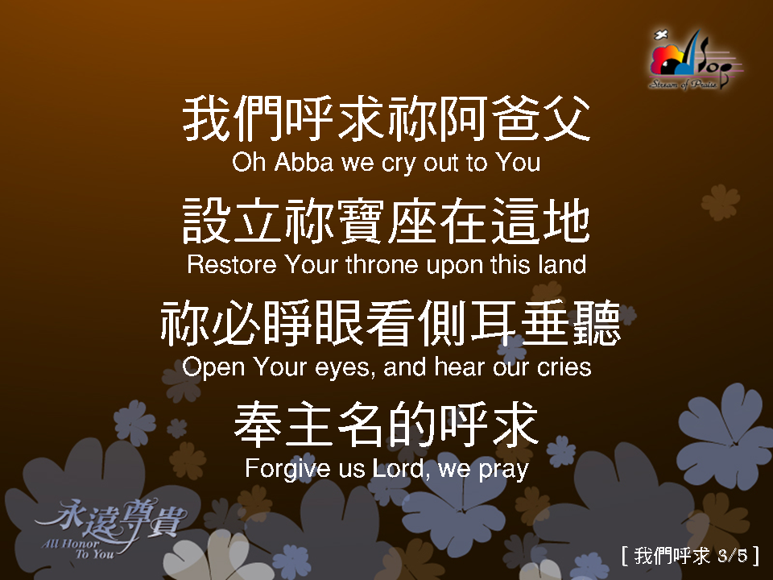
我們呼求 3/5

Slide 8
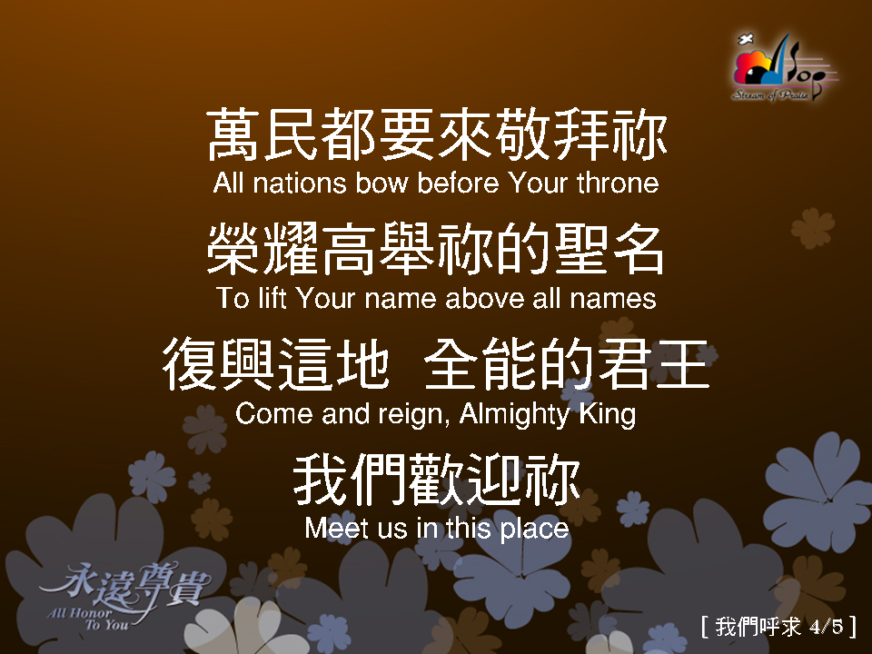
我們呼求 4/5

Slide 9
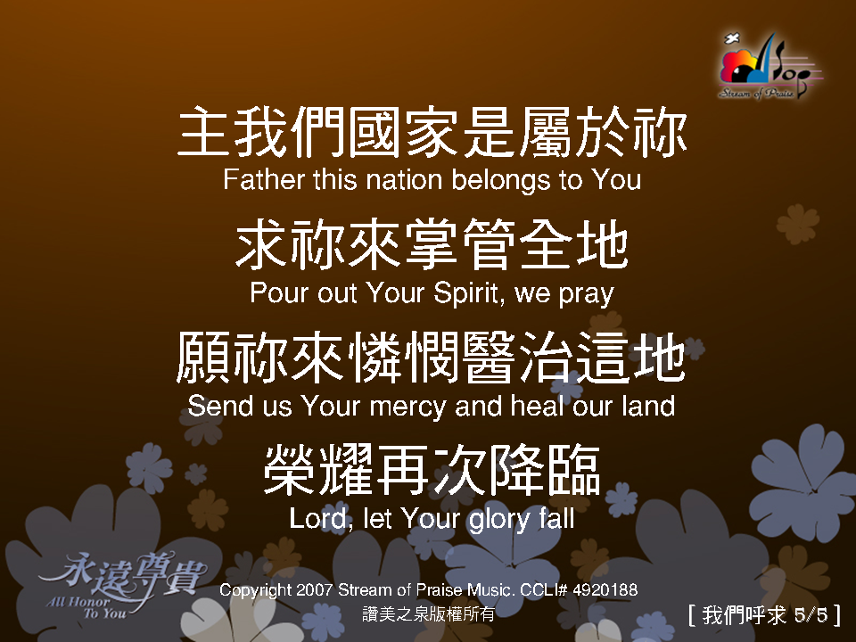
我們呼求 5/5

