Slide 1
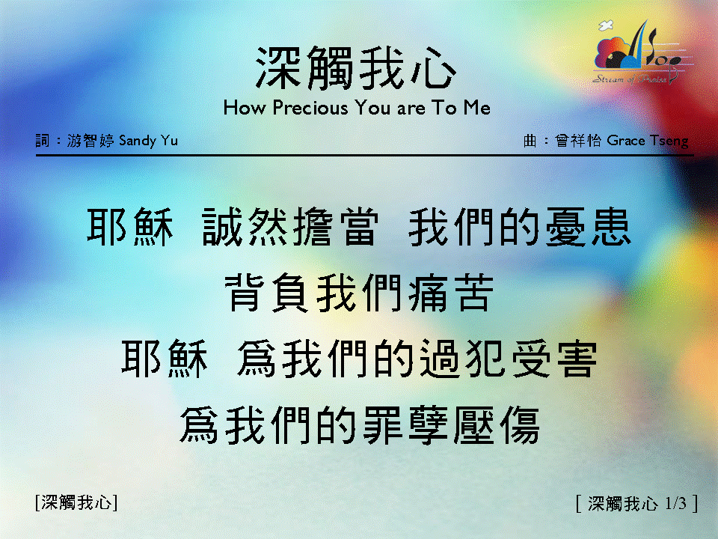
深觸我心 〈1/3 〉 How Precious You are To Me

Slide 2
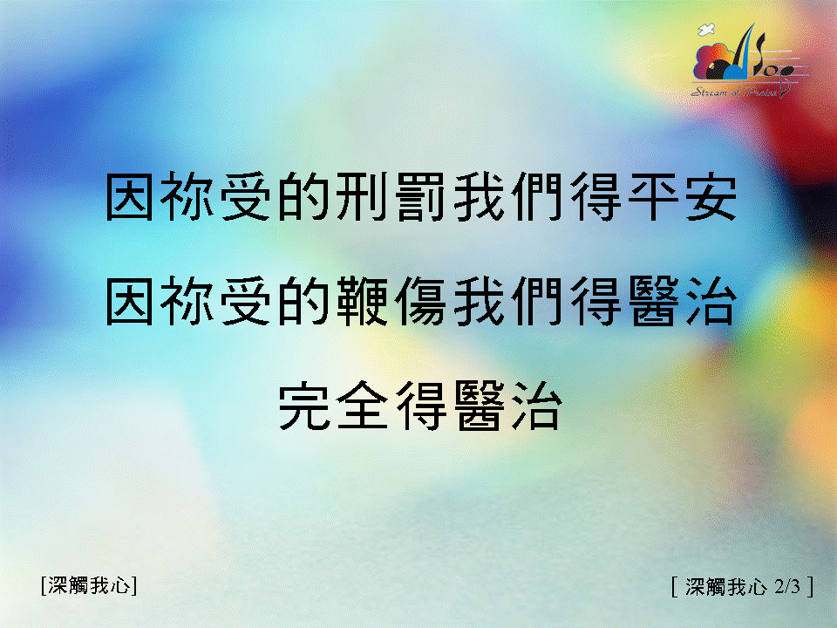
深觸我心 〈2/3 〉 How Precious You are To Me

Slide 3
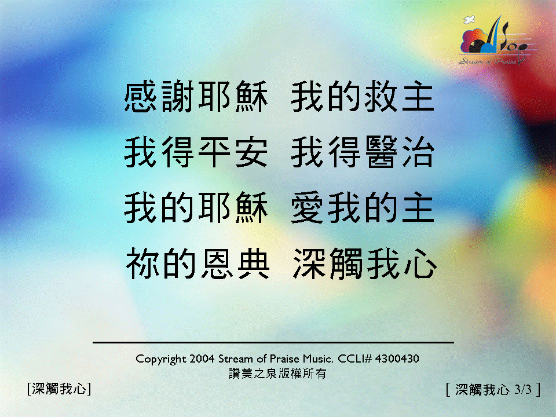
深觸我心 〈3/3 〉 How Precious You are To Me

Slide 4
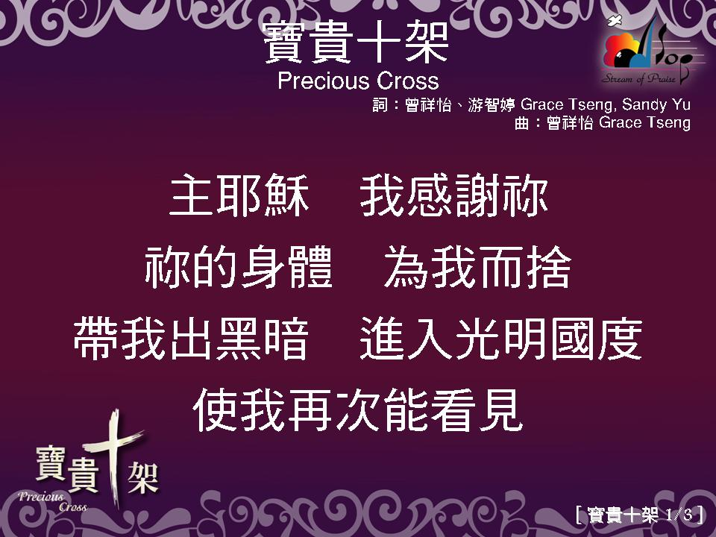

Slide 5
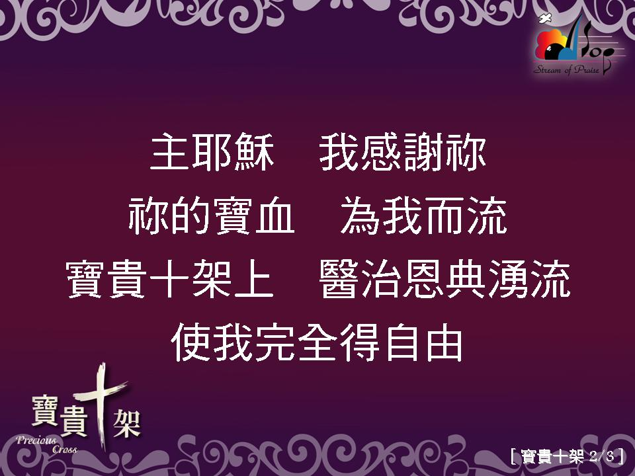

Slide 6
