Slide 1


Predicting Spotify Song Popularity
Ulziibat Tserenbat
Springboard Capstone Project 3

Slide 2
Contents
Introduction
Context of Data
Data Wrangling
EDA
Modeling
Summary

Slide 3
Introduction
Music streaming services have become the most popular method for consumers to listen to music. With over 36% market share among online music subscribers and having a base of over 100 million subscribers, Spotify occupies the top spot. Being able to predict that something might be popular beforehand is an important research for every industry. This project's goal is develop a model that predicts the popularity of the song.

Slide 4
Context of data
Dataset contains more than 160000 songs collected from Spotify Web API. The features include song, artist, release date as well as some characteristics of song such as acousticness, danceability, loudness, tempo and so on. Date range is from 1921 to 2020.

Slide 5
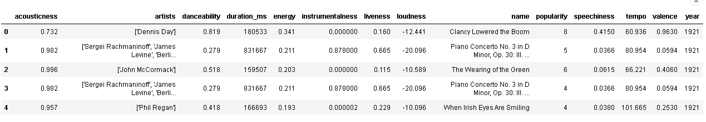
Data wrangling
There are 170653 rows There are (170653,) unique songs There are (34088,) unique artists There are (100,) popularity scores The mean popularity score is 31.431794342906365 There are 24909 songs with a popularity score > 55 There are 1736 songs with a popularity score > 75 Only 0.32 % of songs have a popularity score > 80
There are 170653 rows There are (170653,) unique songs There are (34088,) unique artists There are (100,) popularity scores The mean popularity score is 31.431794342906365 There are 24909 songs with a popularity score > 55 There are 1736 songs with a popularity score > 75 Only 0.32 % of songs have a popularity score > 80
Head of the dataset
170653 songs
34088 artists
15 features

Slide 6
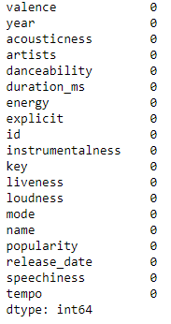
Data wrangling
There is no missing values in this dataset.

Slide 7
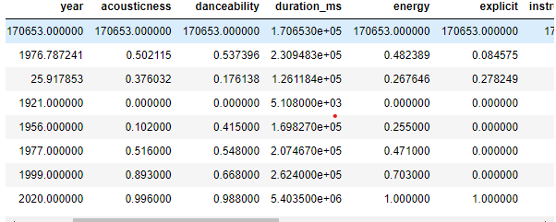
Data wrangling
Summary statistics
Mean popularity score 31.43
Min 0
Max 100
1921 to 2020

Slide 8
Exploratory data analysis

Slide 9
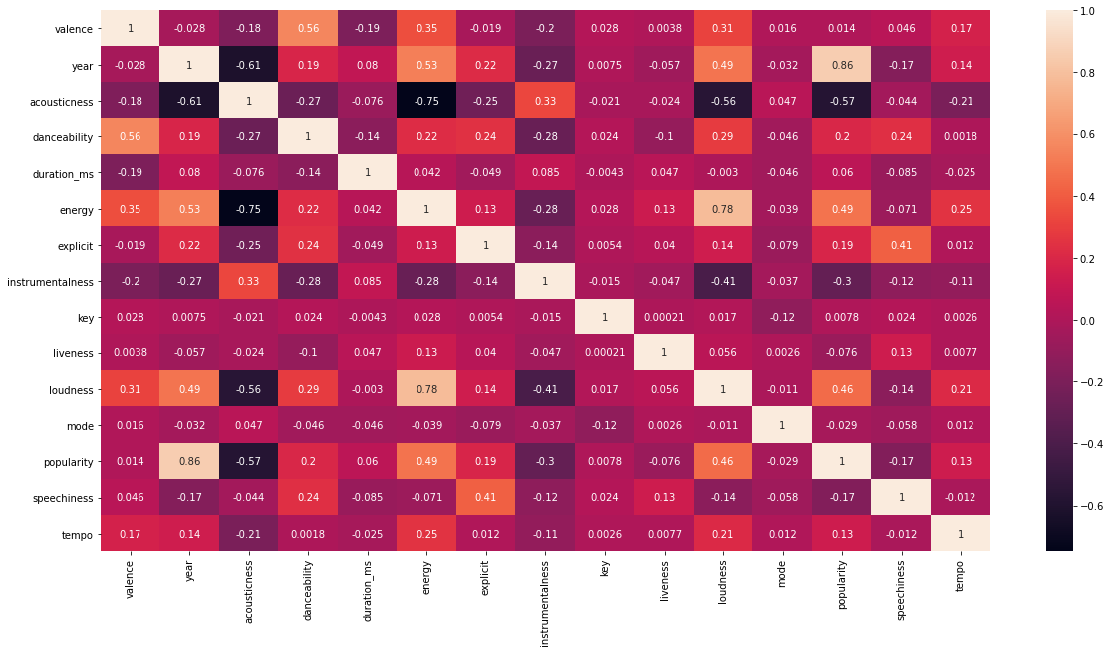
Exploratory data analysis (eda)
Correlation between features
Popularity score highly correlated with year
Energy has some influence
Loudness and Energy are highly correlated

Slide 10
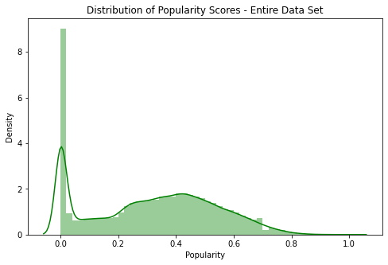
eda
Distribution plot for Popularity Score

Slide 11
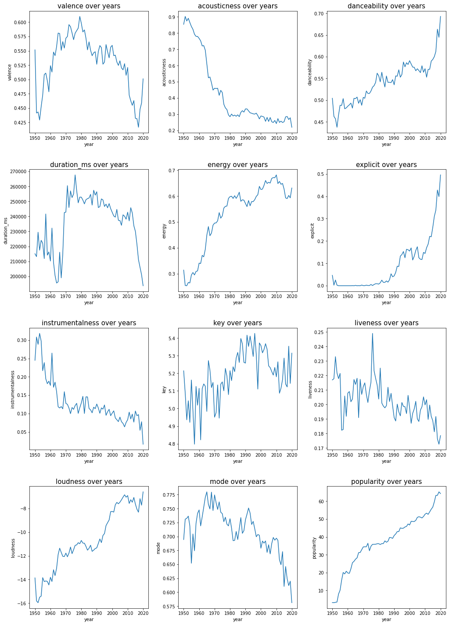
eda
Features over the year
Acoustiness has decreased significantly.
Danceability has varied significantly
Energy seems to be inversely related to Acoustiness

Slide 12
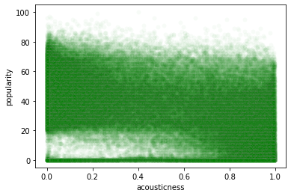
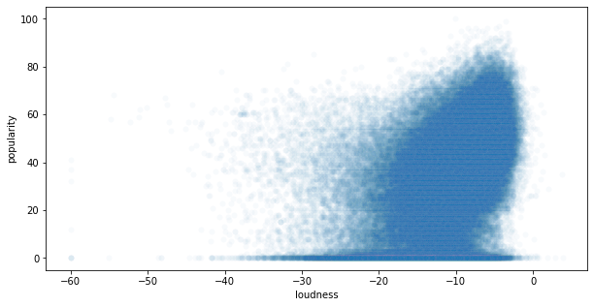
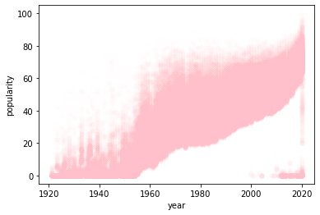
eda
Loudness vs Popularity : Most Popular songs have values between -20 and 0 db.
Year vs Popularity : Songs popularity is correlated with the year of the song. Newer songs have more popularity
Acousticness vs Popularity : More songs with popularity 60 or above tend to have low values of acousticness, 0 - 0.4 .

Slide 13
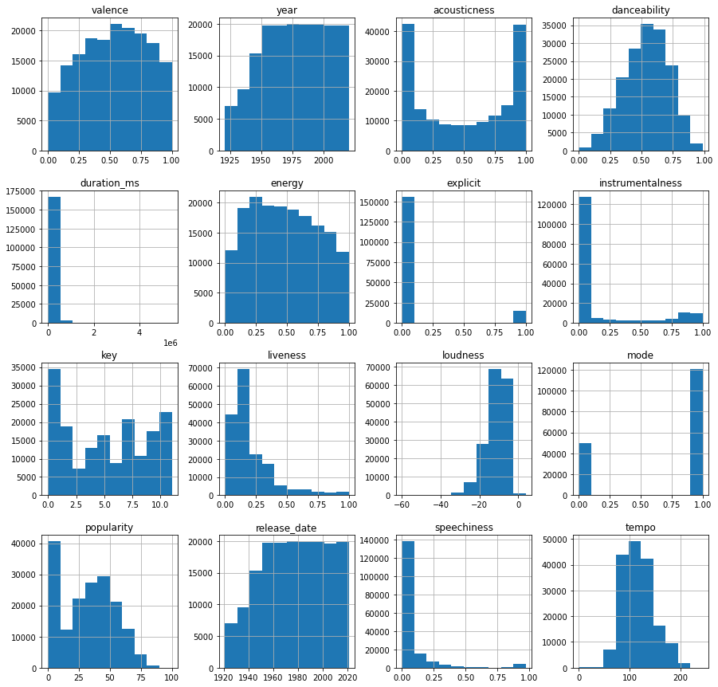
eda
Histogram
Most songs tend to have extreme values of acousticness
After 1945 songs in the dataset are almost the same count each year until 2020.
danceability histogram follows a normal distribution.
dataset are mostly non-instrumental.
In most songs there is probably not a live audience

Slide 14
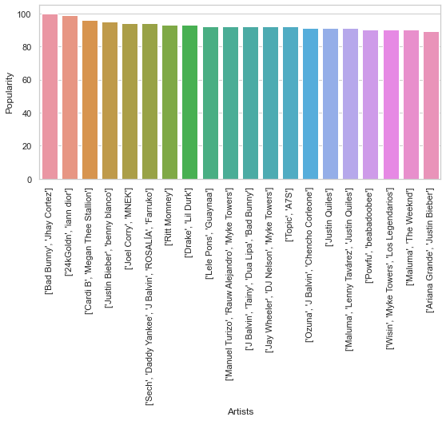
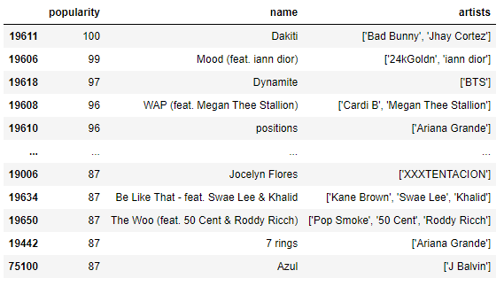
eda
Most popular songs and artists based on popularity score
Only 1 100 score song name is Dakiti by ‘Bad Bunny', 'Jhay Cortez'

Slide 15

modeling

Slide 16

modeling
Data was split into a training (80%) and a test set (20%). Using Sklearn classes, this split can be made and fitted to the following model types
Decision TreeRegressor
Random ForestRegressor
Linear Regression
GradientBoosting Regressor
Neural Network
The aim of these modelsis to fit and train the data and test the accuracy of fit. I used GridSearhCV and BayesianOptimization to find the optimal hyperparameters for all the models.

Slide 17
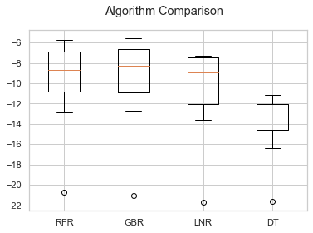
modeling
Model comparison
Gradient Boosting
Random forest
Linear Regression
Decision Tree
Neural Network
Neural Network RMSE = 11.5288 R2 = 0.7209

Slide 18
summary
Overall, this was a very fun dataset to work with, and I am pleasantly surprised that I actually obtained fairly accurate results, especially with Gradient Boosting model. It is quite difficult to determine if a song will be a popular or not, and there appear to be other factors at play that are not necessarily included in this dataset.Other factors that influence if a song will be popular or not could potentially be:
Does a particular artist have any current name recognition?
Has this artist had any previous hits?
What is this artist's genre of music?
Has this artist collaborated with other popular artists?
I assume that merging the data I have now with answers to some of the above questions would definitely allow for a much more accurate prediction of popularity scores.

