Slide 1

Online retail data prediction
Ulziibat Tserenbat
Springboard Capstone Project 2

Slide 2
Contents
Who might care?
Context of Data
Data cleaning
EDA
Modeling
Results
Conclusion
Introduction

Slide 3

Introduction
The project aims to extract insights with business value for an online retailer using Jupiter Notebook and Sklearn library. A large part of the analysis consists of data cleaning and fundamental exploratory analysis, as usually is the case with data science projects. After those basic steps, I employ machine learning algorithms to predict the total sales of the company.

Slide 4
Who might care?
It is helpful for sellers because it tells you what features of the item matter for the sale price. Sometimes certain features don't cost too much but can be a game-changer in the negotiation and bring much more profit than its cost.

Slide 5
Context of data
The dataset consists of transactional data with customers in different countries who make purchases from an online retail company based in the UK that sells unique all-occasion gifts.
Company: the UK based and registered non-store online retail
Products for selling: Mainly all occasion gifts
Customers: Most are wholesalers around the world
Transactions Period: 12/1/2010 to 12/9/2011

Slide 6
Data wrangling
Understanding each variable means:
InvoiceNo: A number assigned to each transaction
StockCode: Product code
Description: Product name
Quantity: Number of products purchased for each transaction
Invoice date: Timestamp for each transaction
UnitPrice: Product price per unit
CustomerID: Unique identifier each customer
Country: Country name

Slide 7
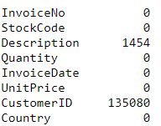
Data wrangling
Missing values
There are about 13600 missing values in our dataset

Slide 8
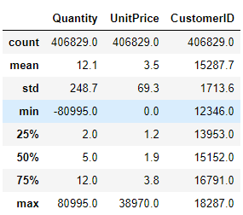
Data wrangling
Descriptive statistics
There are two things are interesting.
Quantity has negative values
Unit price has zero values
If unit price is zero, is this item FREE?

Slide 9

Exploratory data analysis

Slide 10
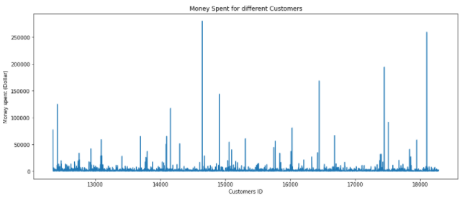
Exploratory data analysis (EDA)
Now we want to see how much money is spent for different customers.

Slide 11
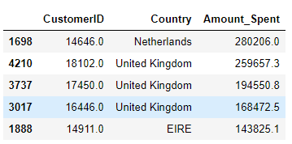
EDA
Money spent by Country

Slide 12
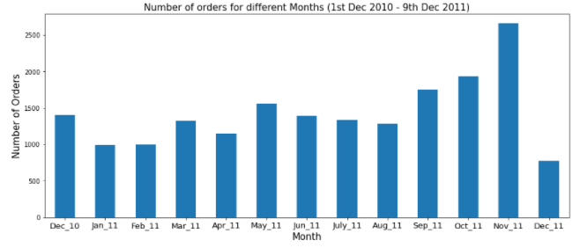
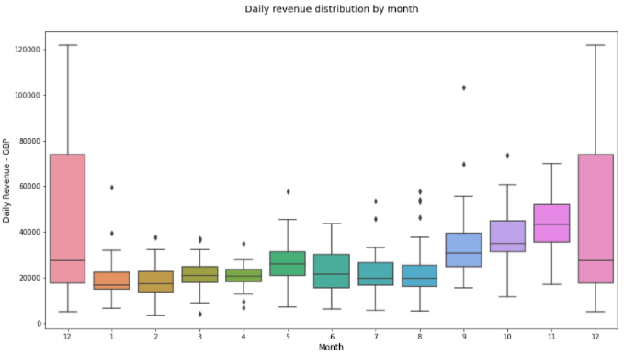
EDA
Number of orders by month Money spent by month

Slide 13
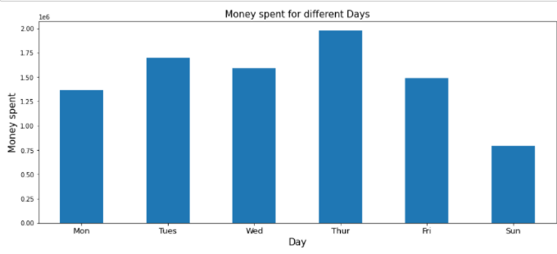
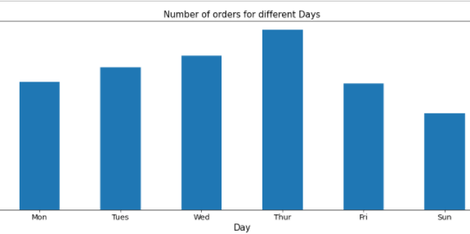
EDA
Money spent by day
Number of orders by day

Slide 14
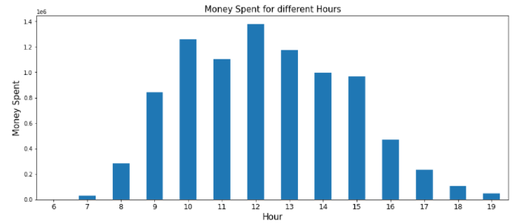
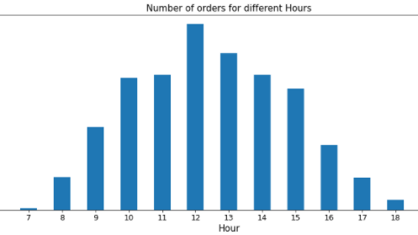
EDA
Money spent by hour
Number of orders by hour

Slide 15
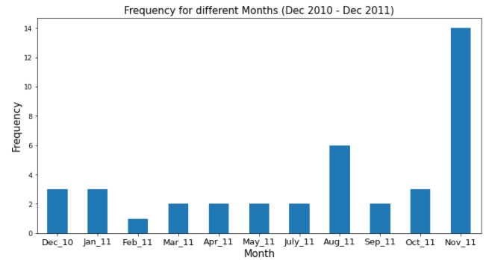
EDA
Free items

Slide 16
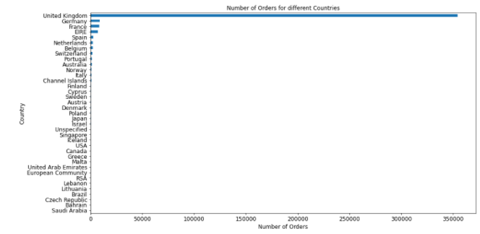
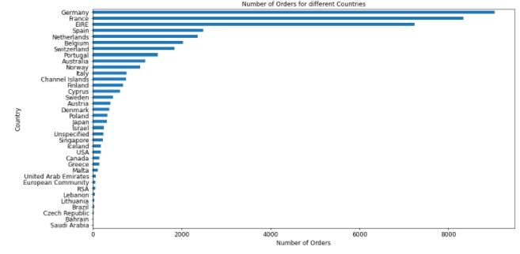
EDA
With UK Orders for different countries Without UK

Slide 17
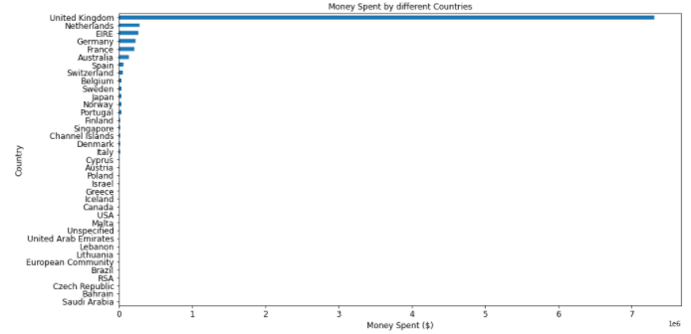
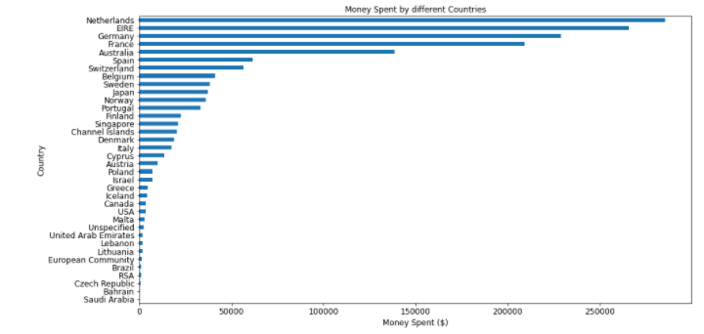
EDA
With UK Money spent by different Countries Without UK

Slide 18

Modeling

Slide 19
Models
ARIMA
Linear Regression
Random Forest regressor

Slide 20
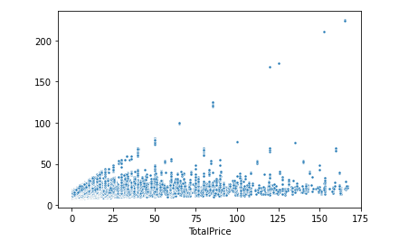
Linear regression
Linear regression model’s output.
Mean Squared Error: 329.623112
R Squared: -0.084346721

Slide 21
Random forest regressor
Random forest model output.
Mean Squared Error: 329.62311233205
R squared: -0.08434672177180

Slide 22
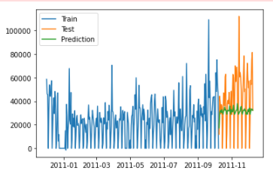
Arima
Arima model output.
R squared: -0.19728854830

Slide 23
Result
The customer with the highest number of orders comes from the United Kingdom (UK)
The customer with the highest money spent on purchases comes from Netherlands
TOP 5 countries (including UK) that place the highest number of orders are as follow → United Kingdom, Germany, France, Ireland (EIRE), Spain
As the company receives the highest number of orders from customers in the UK (since it is a UK-based company), customers in the UK spend the most on their purchases. Therefore, the TOP 5 countries (including UK) that spend the most money on purchases are as follow → United Kingdom, Netherlands, Ireland (EIRE), Germany, France
November 2011 has the highest sales. The month with the lowest sales is undetermined as the dataset consists of transactions until 9th December 2011 in December
There are no transactions on Saturday between 1st Dec 2010 — 9th Dec 2011
The number of orders received by the company tends to increases from Monday to Thursday and decrease afterward
The company receives the highest number of orders at 12:00pm. Possibly most customers made purchases during lunch hour between 12:00pm — 2:00pm
The company tends to give out FREE items for purchases occasionally each month (Except June 2011). However, it is not clear what factors contribute to giving out the FREE items to the particular customers

Slide 24
Conclusion
Based on performance, LinearRegression, Arima, and RandomForest models perform not well. The biggest reason is features are doesn’t have any effect on the total sales except for the quantity. The next step is to focus on the customers and countries more. Which country can buy more products and work on customers are in the middle of the pack and bring them up to top buyers. Also, investigate more on why there are many cancellations

