Slide 1
Module 2 – Free space optical communication and imaging
Week 8 report Thomas and Anny

Slide 2
Cross Correlation Matrix
Main goal for this week was to improve on last week’s brightness algorithm by finding and including a cross talk coefficient matrix.
By setting intensity of one channel to 255 and seeing the bleed into other colors, the following matrix was determined
0.995782564877803 0.187050683312930 0.0423889555822329
0.456669023164822 0.651571567698484 0.176187200806248
0.131296029522920 0.226844926819069 0.997239014124168

Slide 3
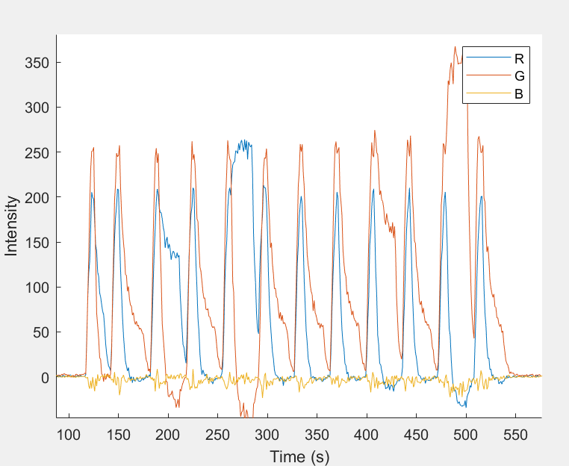
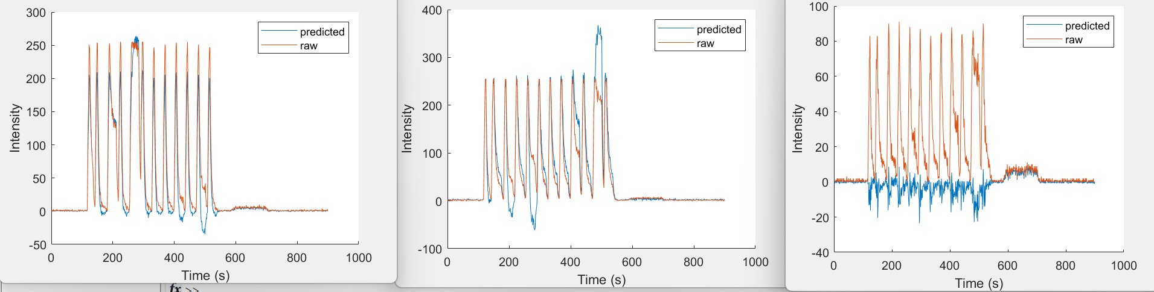
Output vector with cross talk
Lights with the following brightness was sent
0 100
100 0
0 175
100 0
0 255
100 0
100 0
100 0
175 0
100 0
255 0
100 0
Levels were more distinct, should make brightness encoded bits more recognizable.

Slide 4
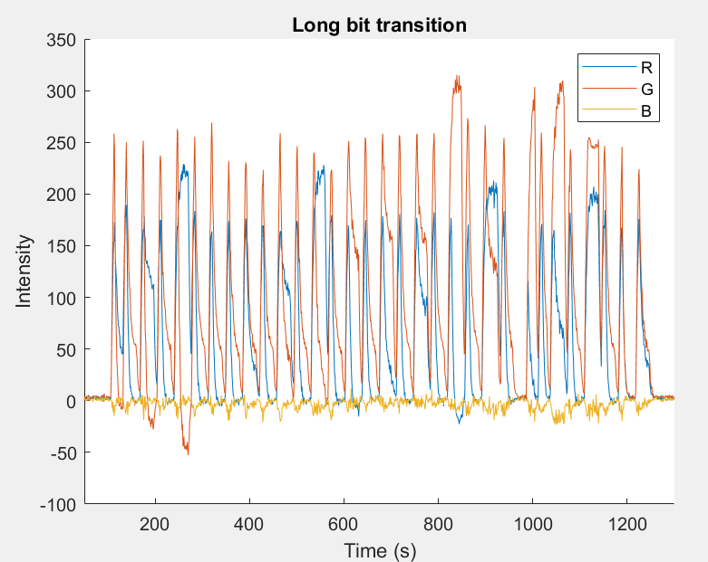
Longer message
0 100
100 0
0 175
100 0
0 255
100 0
100 0
100 0
100 100
100 0
100 175
100 0
100 255
100 0
175 0
100 0
175 100
100 0
175 175
100 0
255 0
100 0
175 255
100 0
255 100
100 0
255 175
100 0
255 255
100 0
0 0
100 100
ABCDEFGHIJLKMNOP

Slide 5
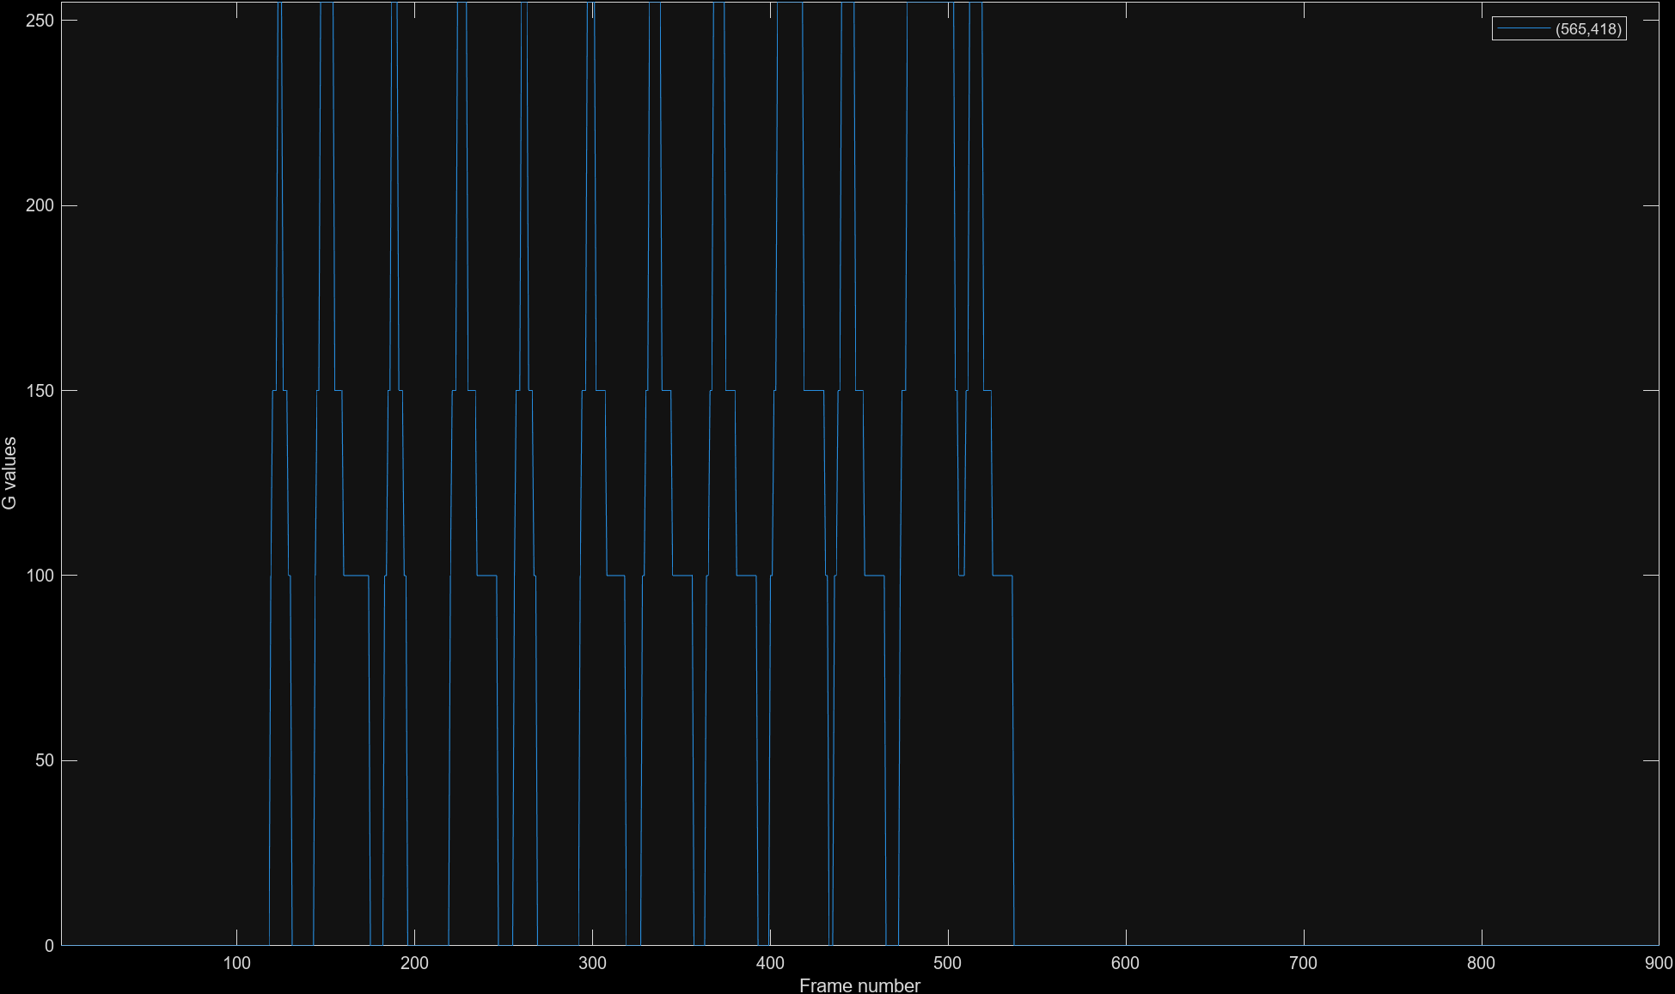
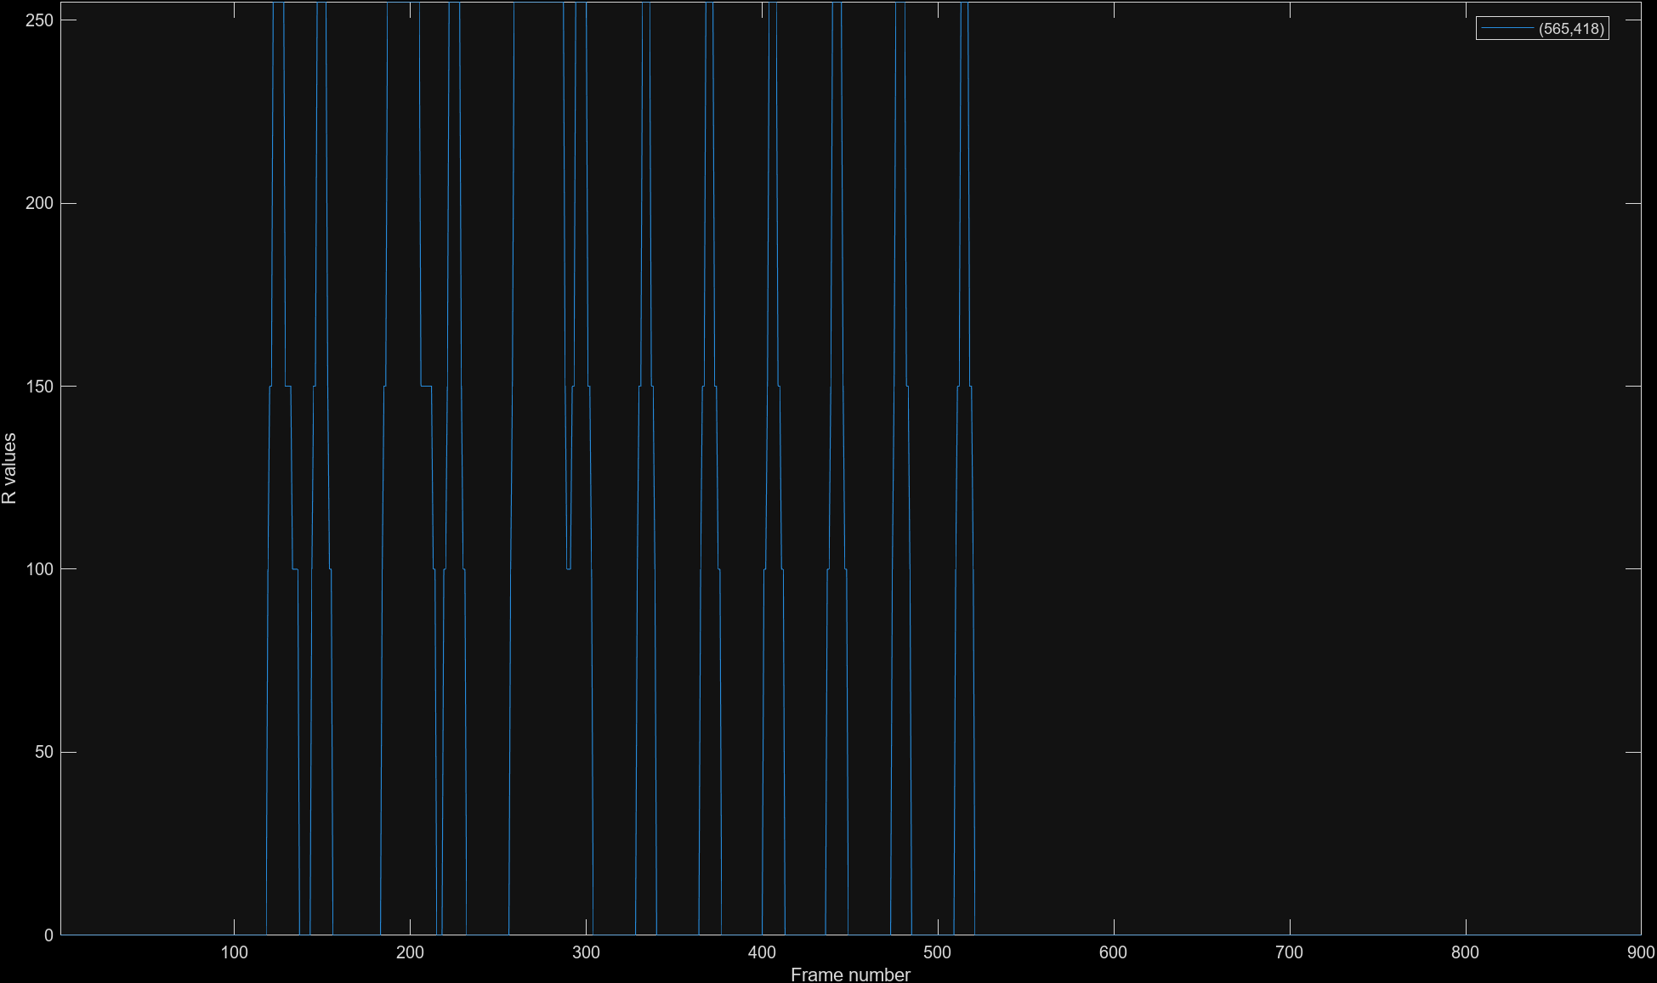
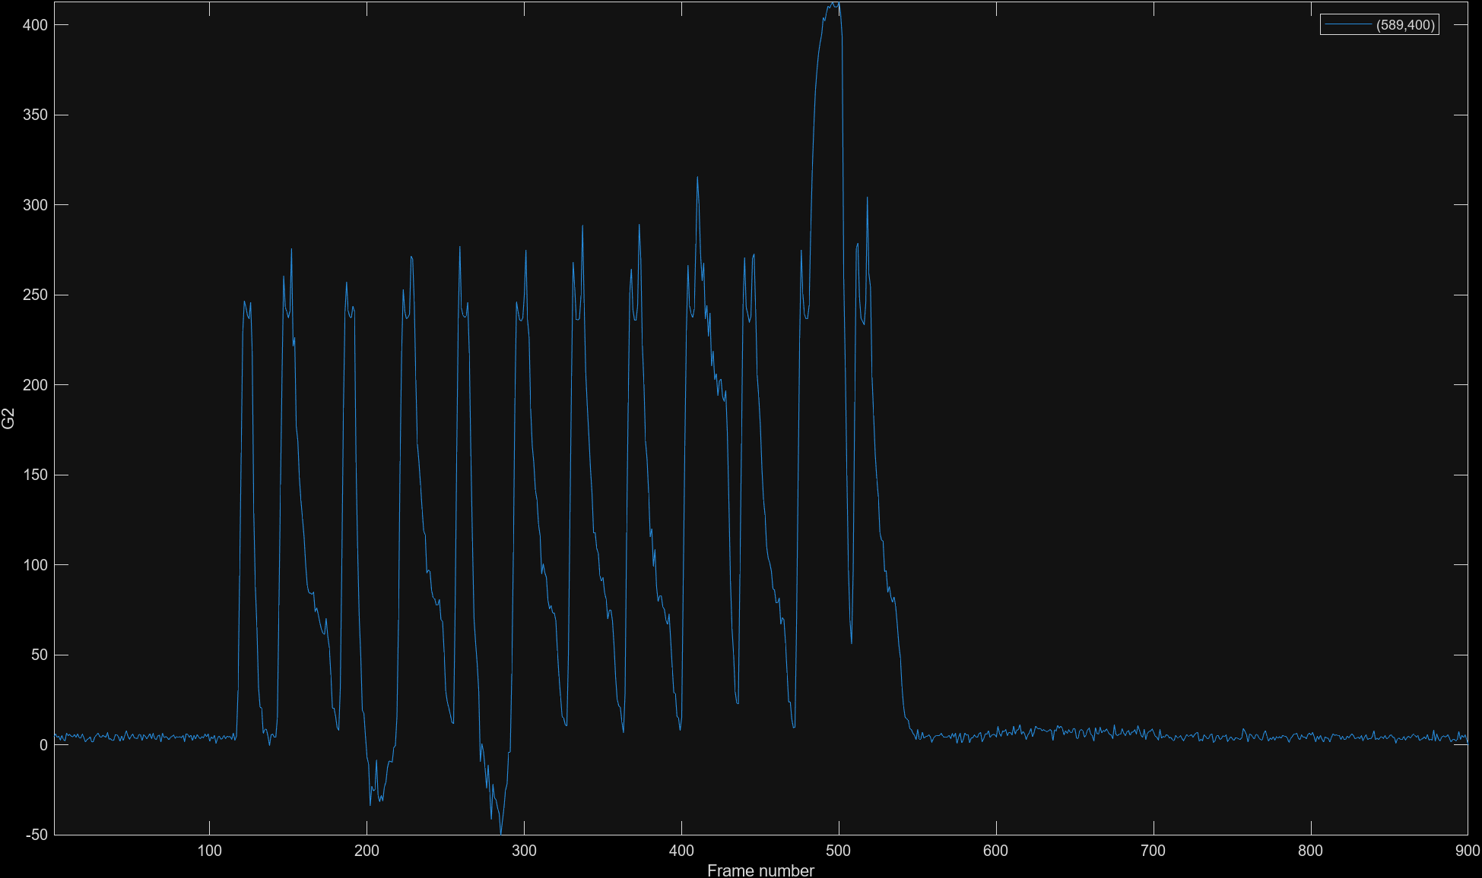
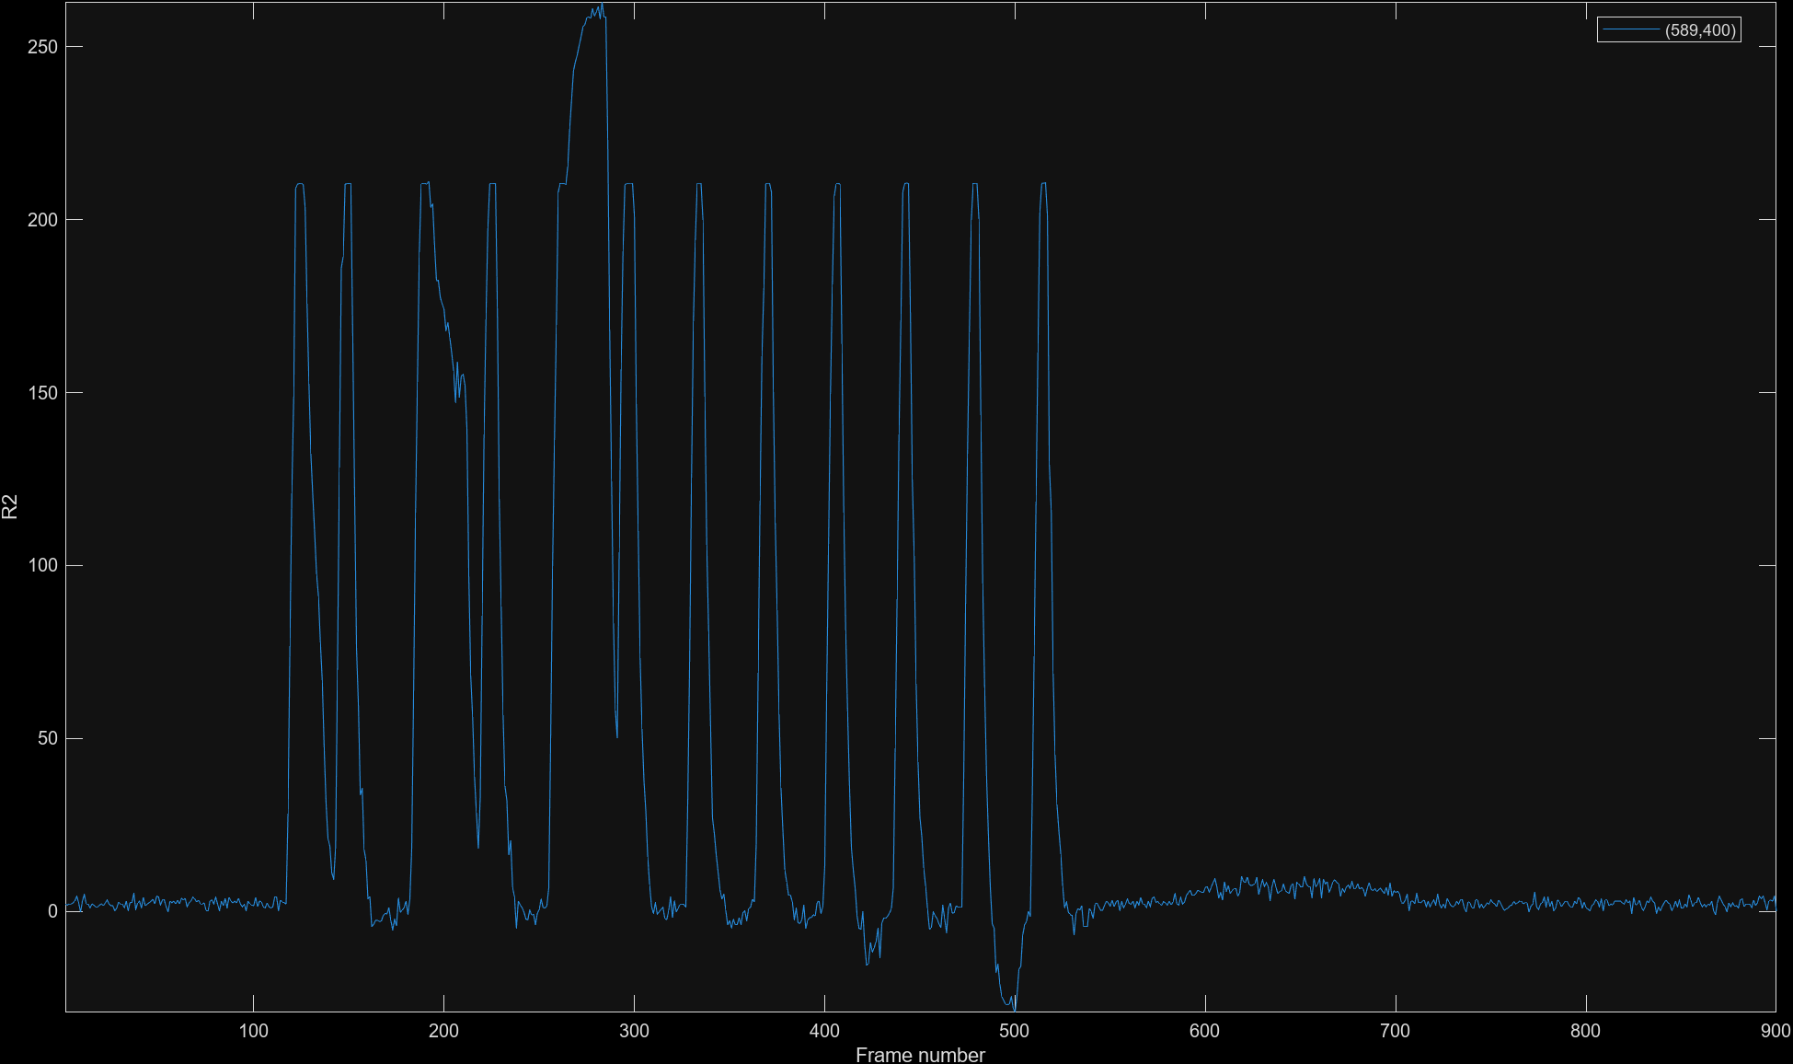
Updated Thresholding graphs
Some of the signal went above 255/ below 0.
All signal was rounded to closest segment (100, 175, 255)

Slide 6
Updated decoder
Decoder success was basically chance.
Tried to identify peaks, then identify the length value
Based on graphs from previous slide, thresholds are human identifiable, so decoder needs fixing

Slide 7
Extension
Need to fix decoder and implement spatial encoding and decoding
Likely to add barcode decoder

