Slide 1
Welcome to the PowerPoint UI Toolkit
This toolkit is intended for non-designers. Use it to create wireframes built with standard controls and patterns.
Toolkits in Adobe Photoshop and Adobe Illustrator are also available.
For questions or feedback on this toolkit, contact uwpappdesignfeedback@microsoft.com
CONTENTS
Slide 1: Intro
Slide 2-3: How-to
Slide 4: Resources
Slide 5: Type
Common type styles.
Slide 6-7: Colors
Common colors. This toolkit was created for light theme.
Slide 8: Device Frame
The device frames represent the three snap points that the design team is targeting (phone, tablet, desktop). Within each frame, the dotted lines indicate the standard page margins.

Slide 2
How to use the Toolkit
Save a copy of this deck. Don’t save over the original!
Make sure you have Visual Studio 2013 Premium or Ultimate installed.
Go to the Storyboarding tab and open the Storyboard Shapes panel.
Click Import Shapes and add the latest shapes (*.sbsx) file, located in the Storyboard shapes folder.
“Controls shapes for UWP apps” should now appear in your Storyboard Shapes panel.
Use the device frames. Most universal apps will need to show UI across all three.
Turn on Guides from the View tab. Your UI should fit within these bounds, though it can scroll off the bottom.
Drag controls and patterns from Storyboard Shapes into the device frames.
Be sure to keep the device frame on the top of the layers so that controls do not overlap. (Labeled “KEEP ON TOP (XXXXX Frame)”)
After you’ve created your screens, you can export individual slides by choosing “save as”, selecting PNG as the type, and choosing “just this one” when prompted.

Slide 3
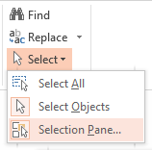
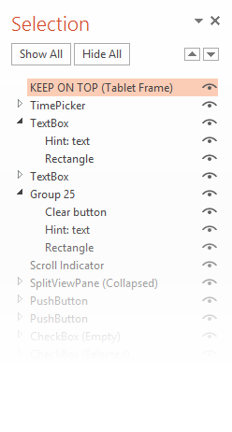
Helpful tip
Did you know PowerPoint had a layer panel? You can find it under the Editing group in the Home tab.

Slide 4
Resources
Use the type styles and color swatches on Slides 6-7.
For guidance on how to put together Windows UI, see https://developer.microsoft.com/en-us/windows/design
A NOTE ABOUT CONTROLS & PATTERNS
Controls are pieces of UI that are supplied for free by the platform.
Patterns are common elements provided as guidance from design and are not built into the XAML framework.

Slide 5
Type Styles
Copy and paste these styles into your comps to conform to the standard type styles.
Header
Subheader
Title
Subtitle
SubtitleAlt
Base
BaseAlt
Body
CaptionAlt
Caption

Slide 6
Color Swatches
Use these colors for your text and UI elements. Note: These are light theme values.
BaseLow
ListLow
BaseMediumLow
ListMedium
BaseMedium
ListAccentLow
BaseMediumHigh
ListAccentMedium
BaseHigh
ListAccentHigh
AltLow
AccentLight3
AltMediumLow
AccentLight2
AltMedium
AccentLight1
AltMediumHigh
Accent
AltHigh
AccentDark1
AccentDark2
AccentDark3

Slide 7
Color Swatches (continued)
Use these colors for your text and UI elements. Note: These are light theme values.
ChromeLow
ChromeBlackLow
ChromeMediumLow
ChromeBlackMediumLow
ChromeMedium
ChromeBlackMedium
ChromeHigh
ChromeBlackHigh
ChromeAltLow
ChromeWhite
ChromeDisabledLow
ChromeDisabledHigh

Slide 8
