Slide 1
ทดลองปฏิบัติ

Slide 2
Outline
ทดลองใช้งาน DHT 11 Module
ทดลองใช้งาน BH1750 Module
ทดลองใช้งาน Ultra Sonic Module HC-SR04+
ทดลองใช้งาน LCD 16x2 i2c Display Module
ประยุกต์การใช้งานลักษณะ IoT

Slide 3
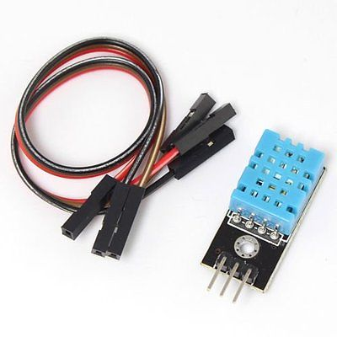
DHT 11 Module
โมดูลวัดอุณหภูมิ และ ความชื้น
3 to 5V power and I/O
วัดความชื้นระดับ 20-80% โดยมีความผิดพลาดในการวัดไม่เกิน 5%
วัดอุณหภูมิ 0-50°C โดยมีความผิดพลาดในการวัดไม่เกิน ±2°C
วามถี่ในการวัด 1 Hz (อ่านค่าได้วินาทีละครั้ง)
ที่มา : https://goo.gl/E2XeRu

Slide 4
NodeMCU DHT11 Wiring Diagram

Slide 5
WeMos DHT11 Wiring Diagram

Slide 6
esp8266_dht11_lib_demo-1
#include "DHT.h" // -> https://github.com/adafruit/DHT-sensor-library
// define the DHT sensor type to be used (tested: DHT11 and DHT22)
#define DHT_TYPE DHT11
//#define DHT_TYPE DHT22
#define DHT_PIN (2) // use the D4 pin (GPIO-2)
// note: use Vcc=3.3V for the DHTxx sensor
DHT dht( DHT_PIN, DHT_TYPE );
// global variable used for sprintf()
char sbuf[32];

Slide 7
esp8266_dht11_lib_demo-1
void setup() {
Serial.begin( 115200 );
Serial.println( F("\n\n\n\n") );
delay(1000);
Serial.println( F("ESP8266 DHTxx Demo...") );
dht.begin();
}

Slide 8
esp8266_dht11_lib_demo-1
void loop() {
float humid = dht.readHumidity(); // read the humidity
float temp = dht.readTemperature(); // read temperature as Celsius
// Check if any reads failed and exit early (to try again).
if ( isnan(humid) || isnan(temp) ) {
Serial.println( F("Failed to read from DHT sensor!") );
delay(1000);
return;
}
Serial.print( F("Humidity: ") );
dtostrf( humid, 3, 1, sbuf );
Serial.print( sbuf );
Serial.print( F(" %RH, ") );
Serial.print( F("Temperature: ") );
dtostrf( temp, 3, 1, sbuf );
Serial.print( sbuf );
Serial.println( F(" deg.C") );
// wait a few seconds between measurements.
delay(2000);
}

Slide 9
esp8266_dht11_lib_demo-2
#include <ESP8266WiFi.h>
#include "PubSubClient.h"
#include "DHT.h"
#define DHTPIN D4 // what pin we're connected to
// Uncomment whatever type you're using!
#define DHTTYPE DHT11 // DHT 11
//#define DHTTYPE DHT22 // DHT 22 (AM2302)
//#define DHTTYPE DHT21 // DHT 21 (AM2301)
DHT dht(DHTPIN, DHTTYPE);

Slide 10
esp8266_dht11_lib_demo-2
void setup() {
Serial.begin(115200);
Serial.println("DHTxx test!");
setup_wifi();
client.setServer(mqtt_server, mqtt_port);
dht.begin();
sprintf(temperature_topic, "/esp8266/%d/temperature", esp_id);
sprintf(humidity_topic, "/esp8266/%d/humidity", esp_id);
}

Slide 11
esp8266_dht11_lib_demo-2
void loop() {
if (!client.connected()) {
reconnect();
}
client.loop();
long now = millis();
if (now - lastMsg > 5000) {
lastMsg = now;
// Reading temperature or humidity takes about 250 milliseconds!
// Sensor readings may also be up to 2 seconds 'old' (its a very slow sensor)
float newHum = dht.readHumidity();
float newTemp = dht.readTemperature();
Serial.print("New temperature:"); Serial.println(String(newTemp).c_str());
client.publish(temperature_topic, String(newTemp).c_str(), true);
Serial.print("New humidity:"); Serial.println(String(newHum).c_str());
client.publish(humidity_topic, String(newHum).c_str(), true);
}
}

Slide 12
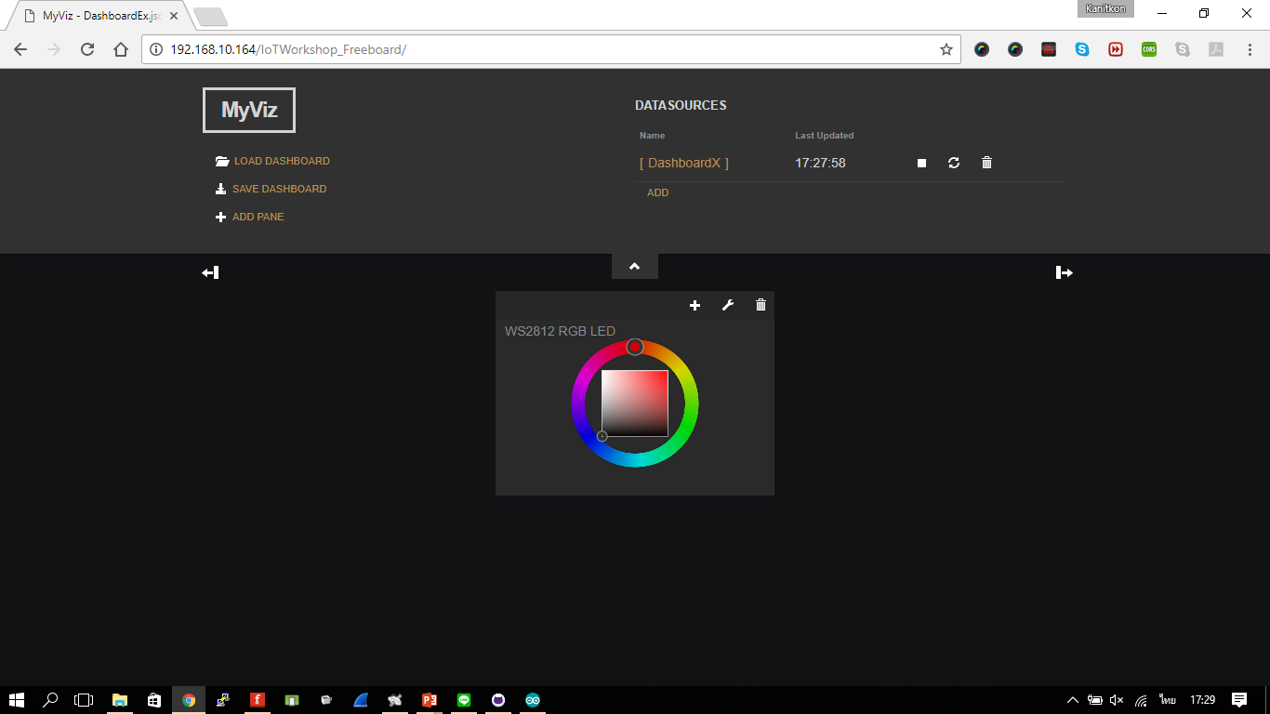
ใช้งาน Freeboard เรียกดูค่า DHT11

Slide 13
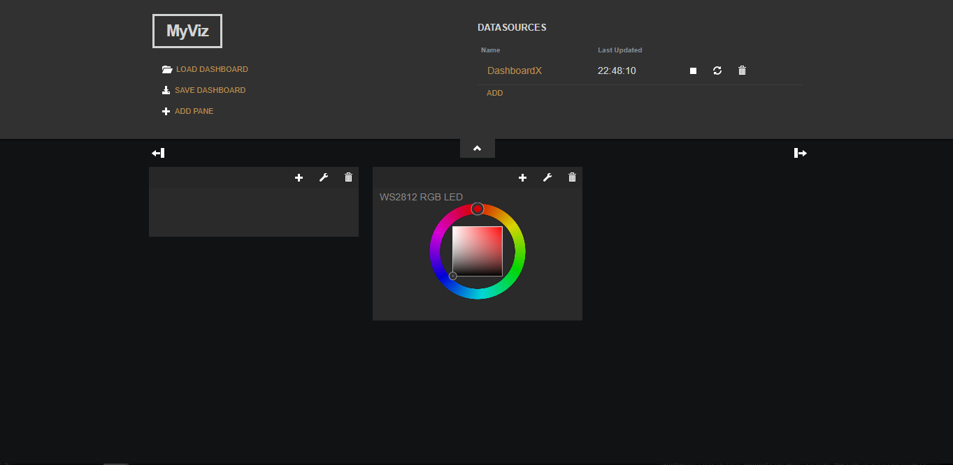
ใช้งาน Freeboard เรียกดูค่า DHT11

Slide 14
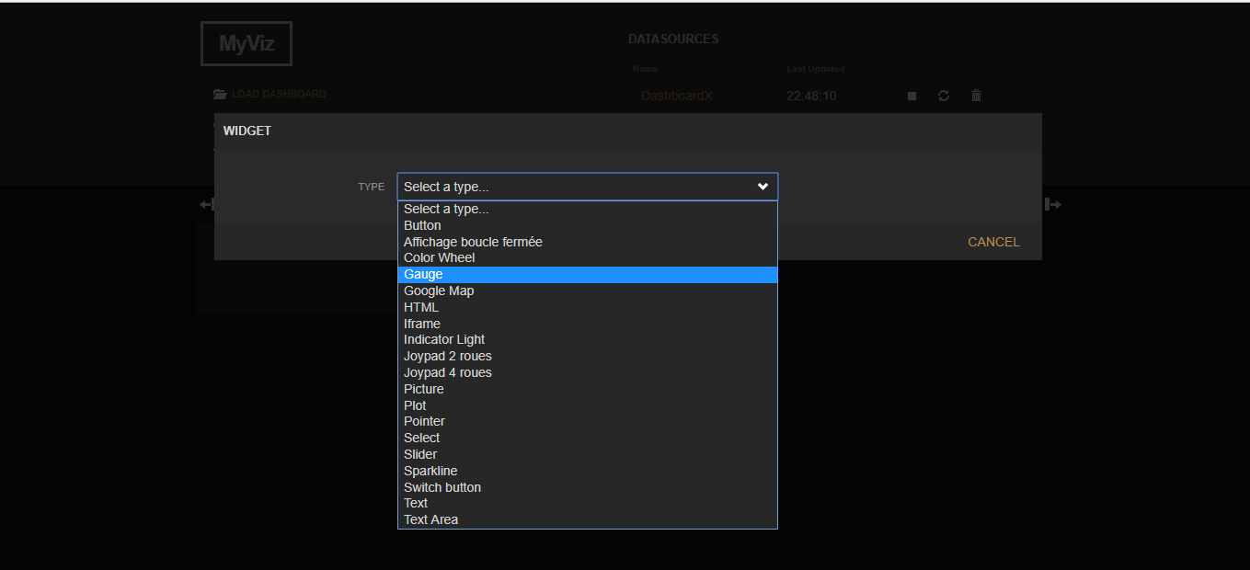
ใช้งาน Freeboard เรียกดูค่า DHT11

Slide 15
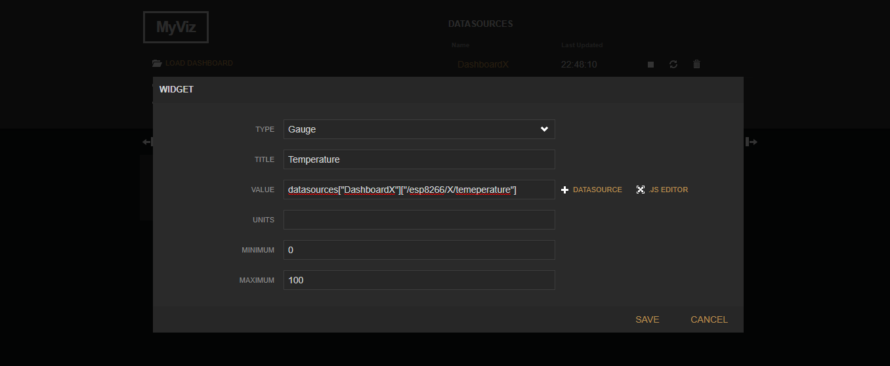
ใช้งาน Freeboard เรียกดูค่า DHT11

Slide 16
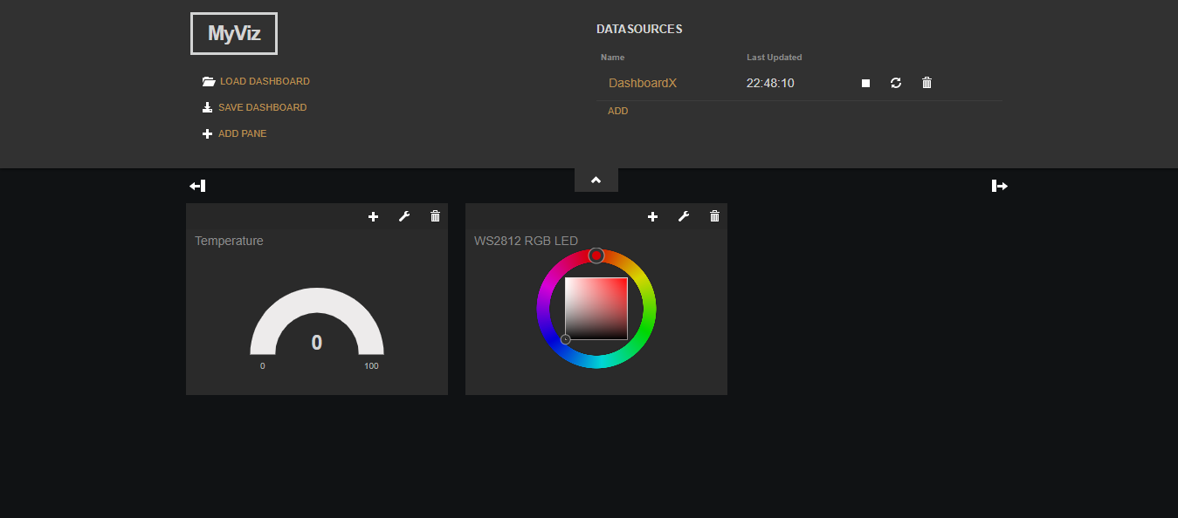
ใช้งาน Freeboard เรียกดูค่า DHT11

Slide 17
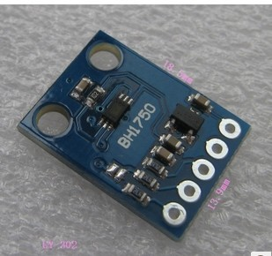
BH1750 Module
โมดูลวัดความเข้มแสง
เชื่อมต่อแบบ I2C
แรงดันไฟเลี้ยงในช่วง 2.4V - 3.6V
ความละเอียด: 16 บิต ได้ค่า 1-65536 หน่วยเป็น Lux (step: 0.5 Lux, 1 Lux, หรือ 4 Lux ขึ้นอยู่กับโหมดการวัดที่เลือก)
ระยะเวลาในการวัดแต่ละครั้ง: ประมาณ 120 msec (สำหรับ 0.5 Lux หรือ 1 Lux), 16 msec (สำหรับ 4 Lux) ขึ้นอยู่กับโหมดการวัดที่เลือก
ที่มา : https://goo.gl/G74yWP

Slide 18
NodeMCU BH1750 Wiring Diagram

Slide 19
WeMos BH1750 Wiring Diagram

Slide 20
esp8266_bh1750_lib_demo-1
#include <Wire.h>
#include "BH1750.h" // -> https://github.com/claws/BH1750
#define LED_PIN (D4) // D4 pin (GPIO-2)
#define SDA_PIN (D2) // D2 pin (GPIO-4)
#define SCL_PIN (D1) // D1 pin (GPIO-5)
#define DEV_ADDR (0x23) // set the I2C device address (BH1750)
#define INTERVAL_MSEC (1000) // update interval: 1 sec
BH1750 bh( DEV_ADDR ); // create BH1750 object
// global variables
char sbuf[64]; // char buffer for sprintf()
uint32_t ts; // used to save timestamp

Slide 21
esp8266_bh1750_lib_demo-1
void setup() {
pinMode( LED_PIN, OUTPUT );
digitalWrite( LED_PIN, LOW );
Serial.begin( 115200 );
for ( int i=0; i < 10; i++ ) {
delay(100);
Serial.println();
}
Serial.flush();
Serial.println( F("BH1750 Sensor Reading...") );
bh.begin( BH1750_CONTINUOUS_HIGH_RES_MODE,
SDA_PIN, SCL_PIN, 400000 /* set I2C frequency */ );
ts = millis();
}

Slide 22
esp8266_bh1750_lib_demo-1
void process() {
uint16_t lux = bh.readLightLevel(); // read the sensor value
String str;
str += "Light: ";
dtostrf( lux, 6, 1, sbuf );
str += sbuf;
str += " Lux";
Serial.println( str.c_str() );
}
void loop() {
if ( millis() - ts >= INTERVAL_MSEC ) {
ts += INTERVAL_MSEC;
digitalWrite( LED_PIN, HIGH );
process();
digitalWrite( LED_PIN, LOW );
}
delay(1); // delay for 1 msec
}

Slide 23
esp8266_bh1750_lib_demo-2
#include <Wire.h> // use the Wire library
#include "BH1750.h" // https://github.com/claws/BH1750
#include <ESP8266WiFi.h>
#include "PubSubClient.h"
#define I2C_SCL_PIN (D1) // D1 pin (GPIO-5
#define I2C_SDA_PIN (D2) // D2 pin (GPIO-4
#define I2C_BH1750_ADDR (0x23)
BH1750 bh( I2C_BH1750_ADDR );
char sbuf[64];
uint32_t ts;

Slide 24
esp8266_bh1750_lib_demo-2
void setup() {
// put your setup code here, to run once:
Serial.begin( 115200 );
Serial.println( "\n\n\n" );
setup_wifi();
client.setServer(mqtt_server, mqtt_port);
Wire.begin( I2C_SDA_PIN, I2C_SCL_PIN );
delay(1000);
i2c_scan();
delay(1000);
bh.begin( BH1750_CONTINUOUS_HIGH_RES_MODE, I2C_SDA_PIN, I2C_SCL_PIN, 400000 );
Serial.print( "Light Intensity" );
ts = millis();
}

Slide 25
esp8266_bh1750_lib_demo-2
void loop() {
// put your main code here, to run repeatedly:
if (!client.connected()) {
reconnect();
}
client.loop();
if ( millis() - ts >= INTERVAL_MSEC ) {
char val_str[8];
ts += INTERVAL_MSEC;
uint16_t lux = bh.readLightLevel();
dtostrf( lux, 6, 1, val_str );
char light_topic[64];
sprintf(light_topic, "/esp8266/%d/light", esp_id);
sprintf( sbuf, " %s Lux", val_str ); Serial.println( sbuf );
client.publish(light_topic, val_str, true);
}
delay(1);
}

Slide 26
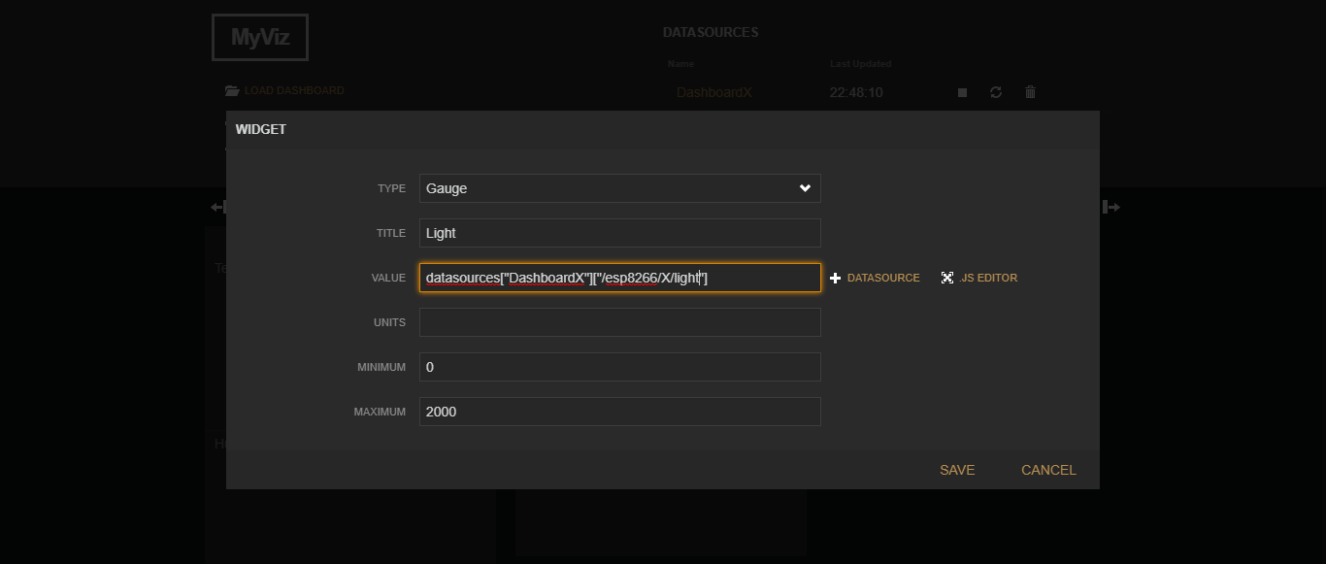
ใช้งาน Freeboard เรียกดูค่า BH1750

Slide 27
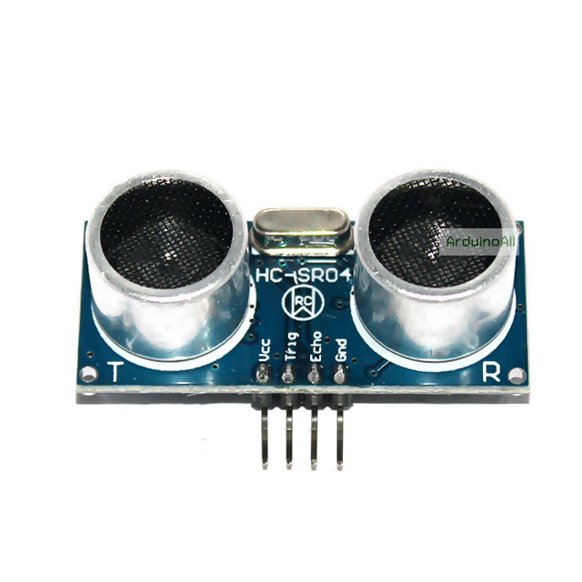
Ultrasonic Module HC-SR04+
โมดูลวัดระยะห่างโดยใช้คลื่นเสียง
3.3V power and I/O
ช่วงในการวัดที่ 2-400 cm
ที่มา : https://goo.gl/5tUDuq

Slide 28
NodeMCU Ultrasonic Wiring Diagram

Slide 29
WeMos Ultrasonic Wiring Diagram

Slide 30
esp8266_ultrasonic_sr04p_demo-1
#define TRIG_PIN 5 // GPIO-5 / D1 pin
#define ECHO_PIN 4 // GPIO-4 / D2 pin
const uint32_t timeout_usec = 40000; // timeout in microseconds
const uint32_t sound_speed = 34300; // in centimeters/second
String str;
void setup() {
Serial.begin( 115200 );
Serial.println( F("\n\n\n") );
delay(100);
Serial.println( F("ESP8266 Ultrasonic SR04+ Demo...") );
pinMode( ECHO_PIN, INPUT );
pinMode( TRIG_PIN, OUTPUT );
}

Slide 31
esp8266_ultrasonic_sr04p_demo-1
void loop() {
// send a PING signal (a short-pulse signal on TRIG pin)
digitalWrite( TRIG_PIN, HIGH );
delayMicroseconds( 20 );
digitalWrite( TRIG_PIN, LOW );
// see: https://www.arduino.cc/en/Reference/pulseIn
uint32_t duration = pulseIn( ECHO_PIN, HIGH, timeout_usec );
str = F("Duration: ");
str += duration;
str += F(" usec, ");
str += F("Distance: ");
str += (sound_speed * duration / 1000000) / 2;
str += F(" cm");
Serial.println( str );
delay(500);
}

Slide 32
esp8266_ultrasonic_sr04p_demo-2
void setup() {
Serial.begin(115200);
pinMode( ECHO_PIN, INPUT );
pinMode( TRIG_PIN, OUTPUT );
setup_wifi();
client.setServer(mqtt_server, mqtt_port);
}
uint32_t read_distance() {
// send a PING signal (a short-pulse signal on TRIG pin)
digitalWrite( TRIG_PIN, HIGH );
delayMicroseconds( 20 );
digitalWrite( TRIG_PIN, LOW );
// see: https://www.arduino.cc/en/Reference/pulseIn
// measure pulse width of the ECHO signal
uint32_t duration = pulseIn( ECHO_PIN, HIGH, timeout_usec );
uint32_t distance_cm = (sound_speed * duration / 1000000) / 2;
return distance_cm;
}

Slide 33
esp8266_ultrasonic_sr04p_demo-2
void loop() {
if (!client.connected()) {
reconnect();
}
client.loop();
long now = millis();
if (now - lastMsg > 500) {
lastMsg = now;
char distance[64];
sprintf(distance, "/esp8266/%d/distance", esp_id);
uint32_t newDistance = read_distance();
Serial.print("New distance:"); Serial.println(String(newDistance).c_str());
client.publish(distance, String(newDistance).c_str(), true);
}
}

Slide 34
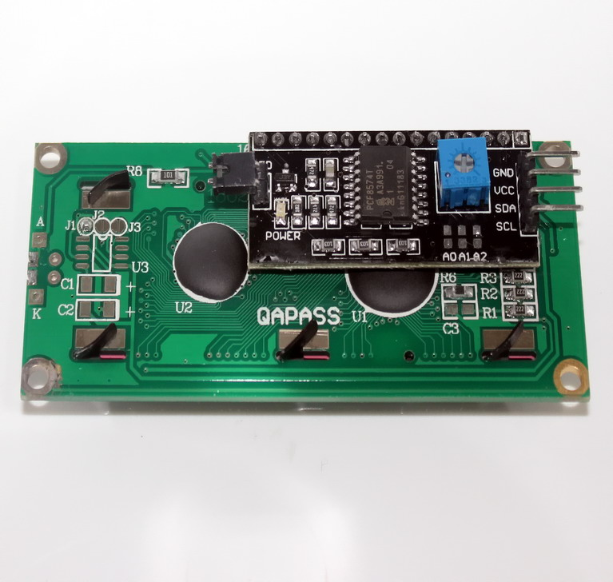
LCD 16x2 i2c Display Module
โมดูลแสดงข้อความขนาด 16 ตัวอักษร 2 แถว
มีการเชื่อมต่อแบบ i2c โดยใช้โมดูลที่ใช้ไอซี PCF8574
ที่มา : https://goo.gl/EcD6p2

Slide 35
NodeMCU LCD Wiring Diagram

Slide 36
WeMos LCD Wiring Diagram

Slide 37
esp8266_pcf8574a_lcd_lib_demo-2
#include <Wire.h> // use the Wire library
#include "LiquidCrystal_I2C.h" // -> https://github.com/fdebrabander/Arduino-LiquidCrystal-I2C-library
#define I2C_SCL_PIN (4) // D2 pin (SCL / GPIO-4)
#define I2C_SDA_PIN (0) // D3 pin (SDA / GPIO-0)
#define I2C_ADDR (0x3F) // set the I2C address for PCF8574 LCD adapter (0x27 or 0x3F)
LiquidCrystal_I2C lcd( I2C_ADDR, 16, 2 ); // 16x2 LCD display, set I2C address
// global variables
char sbuf[64]; // used for sprintf()
uint32_t ts; // used to save timestamp value
#define INTERVAL_MSEC (1000)

Slide 38
esp8266_pcf8574a_lcd_lib_demo-1
void setup() {
Serial.begin( 115200 );
Wire.begin( I2C_SDA_PIN, I2C_SCL_PIN );
delay(1000);
i2c_scan();
delay(1000);
lcd.begin( I2C_SDA_PIN, I2C_SCL_PIN, 400000 );
lcd.backlight();
lcd.clear();
lcd.setCursor(0,0); // set cursor at top-level position on the first row
lcd.print( F("ESP8266 Demo") );
lcd.setCursor(0,1); // set cursor at the start position on the second row
lcd.print( F("ESL KMUTNB") );
lcd.clear();
lcd.setCursor(0,0); // set cursor at top-level position on the first row
lcd.print( F("16x2 LCD Adapter") );
delay(1000);
ts = millis();
}

Slide 39
esp8266_pcf8574a_lcd_lib_demo-1
uint16_t count = 0;
void loop() {
if ( millis() - ts >= INTERVAL_MSEC ) {
ts += INTERVAL_MSEC;
sprintf_P( sbuf, PSTR("Count: %04u"), count );
count = (count+1) % 10000;
lcd.setCursor(0 /*col*/, 1 /*row*/);
lcd.print( sbuf );
Serial.println( sbuf );
}
delay(1);
}

Slide 40
esp8266_pcf8574a_lcd_lib_demo-2
#include <ESP8266WiFi.h>
#include "PubSubClient.h"
#include <Wire.h> // use the Wire library
#include "LiquidCrystal_I2C.h" // -> https://github.com/fdebrabander/Arduino-LiquidCrystal-I2C-library
#define I2C_SCL_PIN (4) // D2 pin (SCL / GPIO-4)
#define I2C_SDA_PIN (0) // D3 pin (SDA / GPIO-0)
#define I2C_ADDR (0x3F) // set the I2C address for PCF8574 LCD adapter (0x27 or 0x3F)
LiquidCrystal_I2C lcd( I2C_ADDR, 16, 2 ); // 16x2 LCD display, set I2C address
// global variables
char sbuf[64]; // used for sprintf()
uint32_t ts; // used to save timestamp value
#define INTERVAL_MSEC (1000)

Slide 41
esp8266_pcf8574a_lcd_lib_demo-2
void setup() {
Serial.begin( 115200 );
setup_wifi();
client.setServer(mqtt_server, mqtt_port);
client.setCallback(callback);
Wire.begin( I2C_SDA_PIN, I2C_SCL_PIN );
delay(1000);
i2c_scan();
delay(1000);
lcd.begin( I2C_SDA_PIN, I2C_SCL_PIN, 400000 );
lcd.backlight();
lcd.clear();
lcd.setCursor(0,0); // set cursor at top-level position on the first row
lcd.print( F("IoT Workshop") );
delay(1000);
ts = millis();
}

Slide 42
esp8266_pcf8574a_lcd_lib_demo-2
void loop() {
connectCloudMQTT();
if( millis() - ts >= INTERVAL_MSEC){
ts += INTERVAL_MSEC;
if (count_scroll%(text.length()+16) == 0){
lcd.clear();
lcd.setCursor(16,0); // set cursor at top-level position on the first row
lcd.print(text);
}else{
lcd.scrollDisplayLeft();
}
count_scroll++;
}
}

Slide 43
esp8266_pcf8574a_lcd_lib_demo-2
void callback(char* topic, byte* payload, unsigned int length) {
const char s[2] = "/";
char *token;
token = strtok(topic, s);
token = strtok(NULL, s);
token = strtok(NULL, s);
if(!strcmp(token, "text")){
payload[length] = '\0';
text = String((char*)payload);
Serial.println(text);
}
}

Slide 44
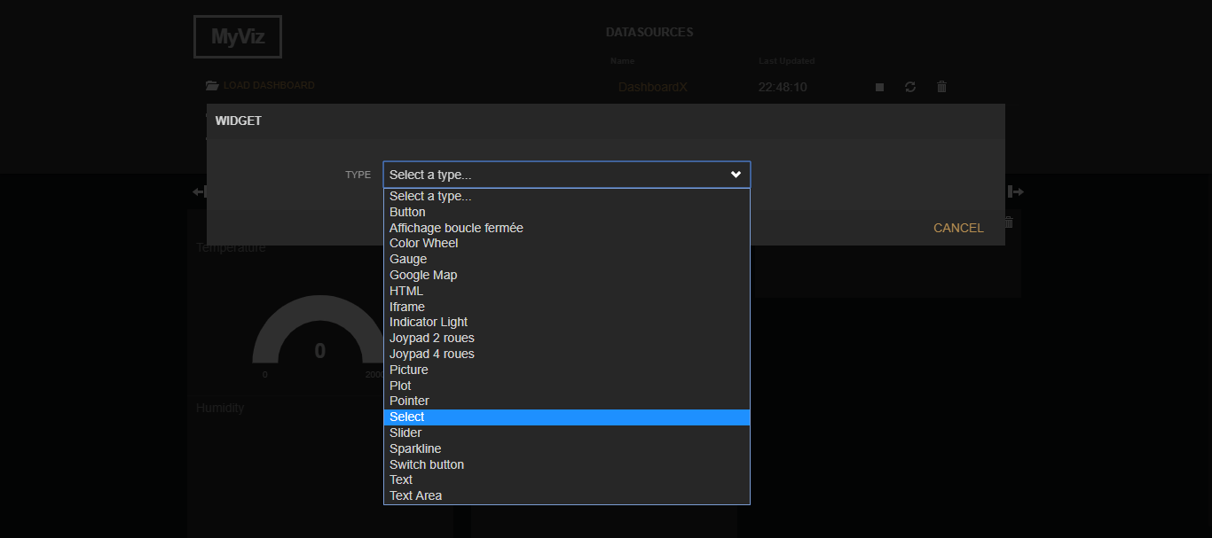
ใช้งาน Freeboard ส่งข้อความแสดงที่ LCD

Slide 45
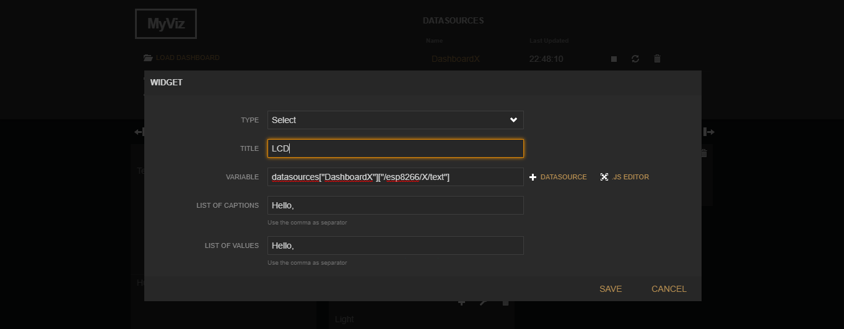
ใช้งาน Freeboard ส่งข้อความแสดงที่ LCD

Slide 46
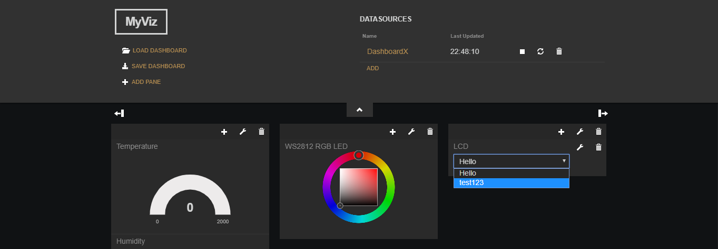
ใช้งาน Freeboard ส่งข้อความแสดงที่ LCD

