Slide 1

Docker for Developers
Karthikeyan VK
Ravindra Kumar
Palani Vel
Sivaarumugam
Amit
Notes:
https://www.facebook.com/aspiringDotnetArchitects/

Slide 2
Agenda
Understanding Windows Containers on Windows 2016 OS
Creating different containers ( IIS , MS SQL , dot net )
Deploying the applications
Future Projects

Slide 3
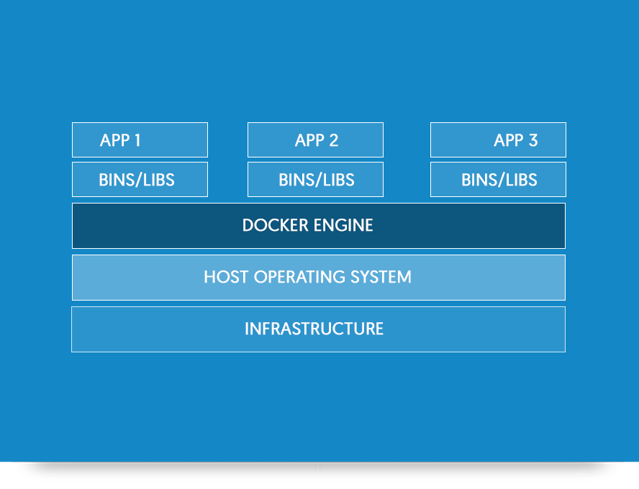
What is a Container?
Windows Containers provide operating system virtualization that allows multiple isolated applications to be run on a single system.

Slide 4
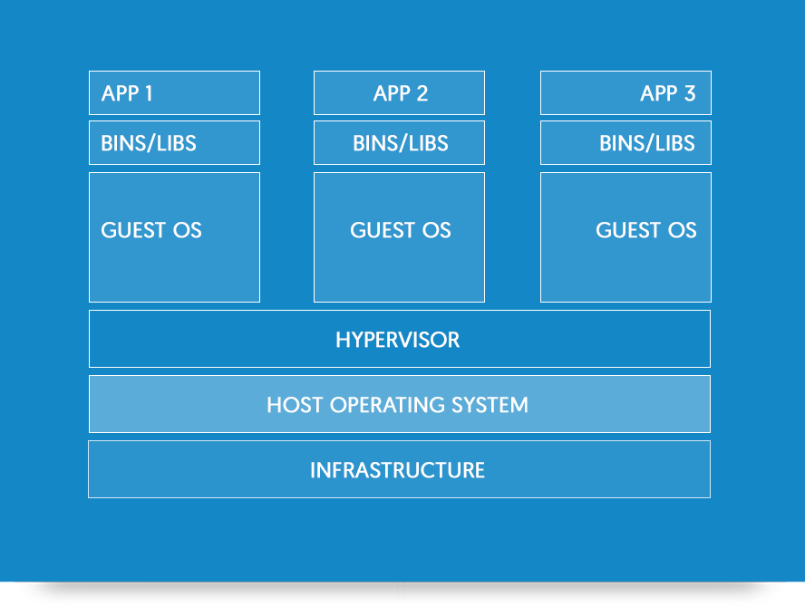
Difference between Containers and VMs

Slide 5
Difference between Containers and VMs
Notes:
Containers :
Containers include the application and all of its dependencies– but share the kernel with other containers, running as isolated processes in user space on the host operating system. Containers are not tied to any specific infrastructure: they run on any computer, on any infrastructure and in any cloud.
Virtual Machines :
Virtual Machines include the application, the necessary binaries and libraries, and an entire operating system.

Slide 6
Why Containers ?

Slide 7
Why Containers?
Transforming existing applications into cloud Is Hard!
Building Hybrid Cloud applications Is Hard!

Slide 8
How do Containers make it easier?
1) Consistency
- Rapid Deployment
- Fast Iterations
- Reproducibility
- on any Cloud
- Immutability

Slide 9
How do Containers makes it easier?
2) Efficiency
- Service Separation
- High Availability
- Scalability
- Test at Scale
- Reduced costs

Slide 10
Types of Containers
Windows Server Containers
Hyper- V Containers

Slide 11
Windows Server Containers
Provide application isolation through process and namespace isolation technology. A windows server container shares a kernel with the container host and all containers running on the host. Maximum speed and density.
CONTAINER
CONTAINER
CONTAINER
Kernel

Slide 12
Hyper-V Containers
Expand on the isolation provided by windows server containers by running each container in a highly optimized virtual machine. In this configuration the kernel of the container host is not shared with the Hyper-V Containers. Isolation plus performance.
CONTAINER
CONTAINER
CONTAINER
Kernel
Kernel
Kernel
Hyper-V

Slide 13
How do Containers work?
Docker Universal Control Plane
Docker Client
Docker PowerShell
Docker Compose
Docker Registry
Docker Swarm
Container
Development and
Management Toolset
Docker Engine
Operating System
Container Runtime

Slide 14
Architecture
Host User Mode
Virtual Machine Specifically Optimized To Run a Container
System Processes
Container Management
Session Manager
Hyper-V Container
Docker Engine
Local Security Authority
Windows Server Container
Windows Server Container
Compute Services
Etc…
System Processes
Application Process(es)
System Processes
Application Process(es)
Windows Kernel
Windows Kernel
Hyper-V Hypervisor

Slide 15
What is Docker ?
Docker is an open platform for developing, shipping, and running applications

Slide 16
Container Vocabulary
Docker Engine : Creates, Ships and runs Docker containers on a physical or virtual host.
Docker Image : The basis of a Docker container. Represents a full application. A Docker image is a read-only template with instructions for creating a Docker container.
Docker Container : The standard unit in which the application service resides and execute.
Registry Service ( Docker Hub ) : Cloud or server based storage and distribution service.
Container Host : Physical or Virtual Computer system configured with the windows Container feature. The container host will run one or more Windows Containers.
Notes:
Instance of an image is a container
Registry service, place where your image lies

Slide 17
Container Vocabulary -- (Contd..)
Sand Box : Once a container has been started, all write actions such as file system modifications, registry modifications or software installations are captured in this sandbox layer.
Container OS Image : Containers are deployed from images. The container OS image is the first layer in potentially many image layers that make up a container. This image provides the operating system environment. A container OS Image is Immutable, it cannot be modified.
Docker Compose : Compose is a tool for defining and running multi-container Docker applications. With compose you use a compose file to configure your application’s services. Then using a single command, you create and start all the services from your configuration. Compose is great for development, testing and staging environments, as well as CI workflows.
Docker Client : The Docker client, in the form of the Docker binary, is the primary user interface to Docker. It accepts commands and configurations flags from the user and communicates with a Docker daemon. One client can even communicate with multiple unrelated daemons.

Slide 18
Container Vocabulary -- ( Contd....)
Docker Daemon : The Docker daemon runs on a host machine. The user uses the Docker client to interact with the daemon.
Docker Swarm : is a clustering and scheduling tool for Docker containers. Docker Swarm provides native clustering capabilities to turn a group of Docker engines into a single, virtual Docker engine.
Docker Universal Control Plane : Enables teams to manage and deploy dockerized applications, and can run on any private infrastructure or public cloud.
Notes:
https://github.com/karthikeyanVK/DockerSample

Slide 19
Containers for Developers
From a developer’s desktop to a testing machine to a set of production machines, a Docker image can be created that will deploy identically across any environment in seconds.
We can also use an image as a baseline to create another image, making image creation even faster.
Multiple containers can share same image, which means containers start very quickly and use fewer resources.
With containers, developers can build an app and can run from anywhere – laptop, desktop, server, private cloud, public cloud or service provider – without any code changes.
Containers helps developers build and ship higher-quality applications, faster.

Slide 20
Containers for IT Infra Professionals
IT Professionals can use containers to provide standardized environments for their development, QA and production teams.
No longer have to worry about complex installation and configuration steps.
By using containers, systems administrators abstract away differences in OS installation and underlying infrastructure.

Slide 21
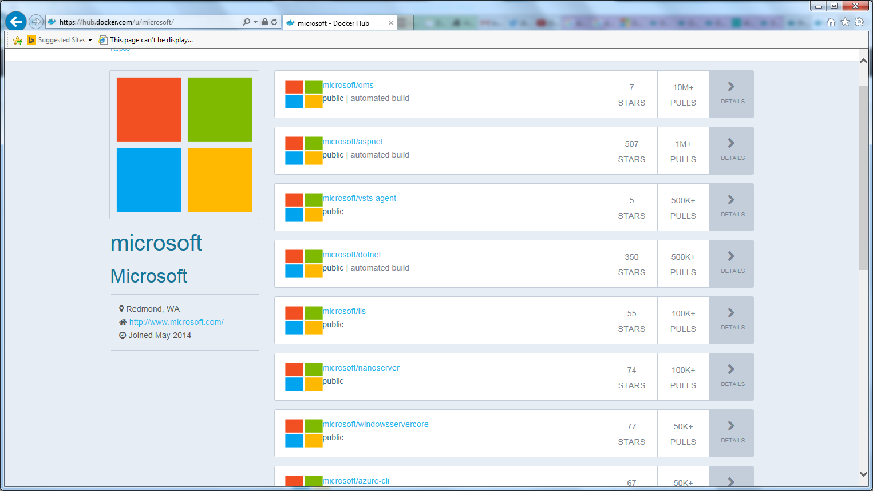
Docker Images Download the images by using Docker pull ps

Slide 22
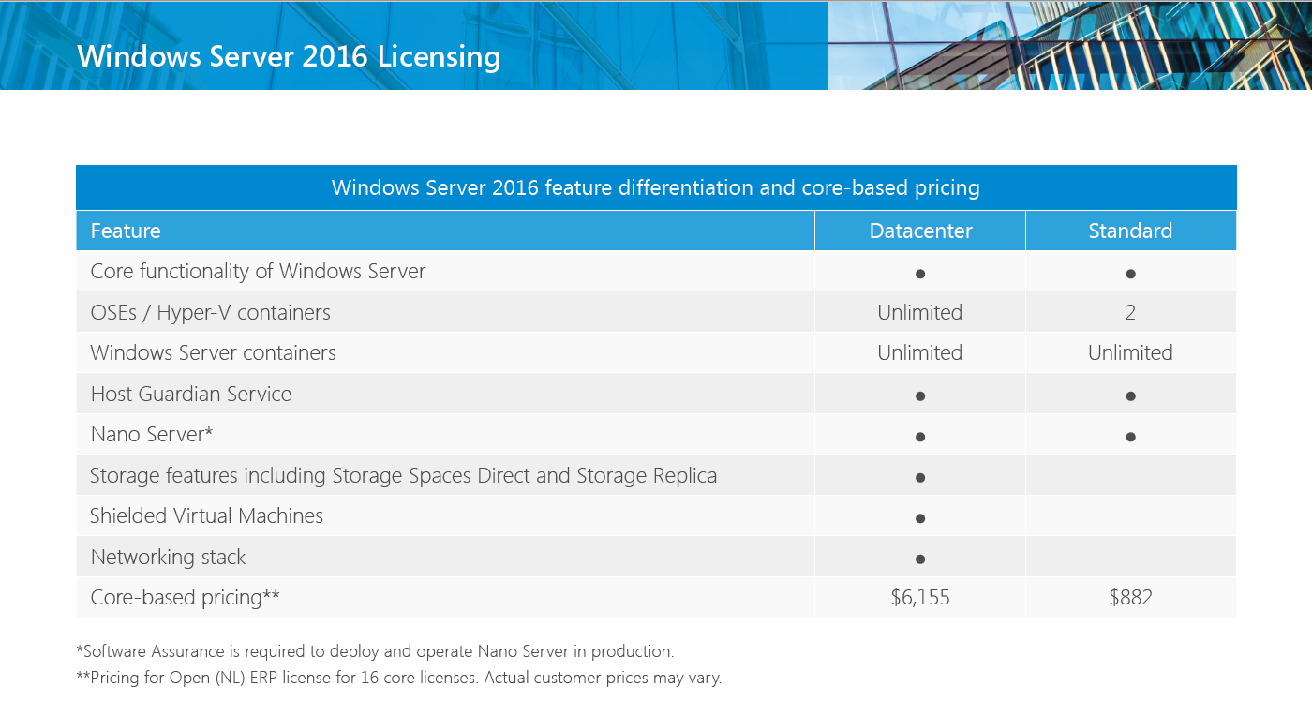
Licensing

Slide 23
Future Projects
SQL 2016 Containers with Clustering
Application ( dot net ) Containers with NLB

Slide 24
DEMO !!!

Slide 25
Questions
?

