Slide 1
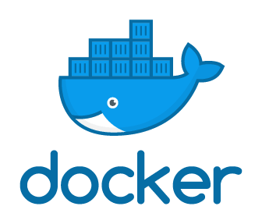
DOCKER NOVEMBER MEETUP
Docker Basics & Dockerizing your Micro services
By
Dinesh S

Slide 2
What You Can Expect
How containers gets isolated
What & How - Docker
Brush up with Basic commands
Break
Microservices + Docker – a match made in Heaven
Hands – on: Dockerize apps and test
Networking
Get Goodies and post phots

Slide 3
What a process can be
“A process is a running program that depends on the Host machine’s Memory, user & permissions and File system”
A Process gets minimal isolation support from the Operating system.
You cannot run two process with the same port in a host at the same time.
A process gets the same privileges as the user who created the process.
PID: 1290
Permissions: User
Memory: 56MB
P2
PID: 1653
Permissions: User
Memory: 12MB
P1
OS
KERNEL

Slide 4
How containers gets isolated
“ Containers are group of processes with some cool kernel features which makes the processes to pretend that they’re running on their own separate machine. “
Namespaces: Isolates global resources for process – E.g.: A PID namespace isolates PID feature which can allocate same PID to different process in the same host.
Cgroups: Monitors & Limits Memory, CPU, Disk to your container process.
P1,P2
NAMESPACE
P1 – 1290
P2 – 2178
Cgroup
Mem – 70MB
P1,P2
NAMESPACE
P1 – 1290
P2 - 2170
Cgroup
Mem – 300MB
Container
1
Container 2
OS
KERNEL

Slide 5
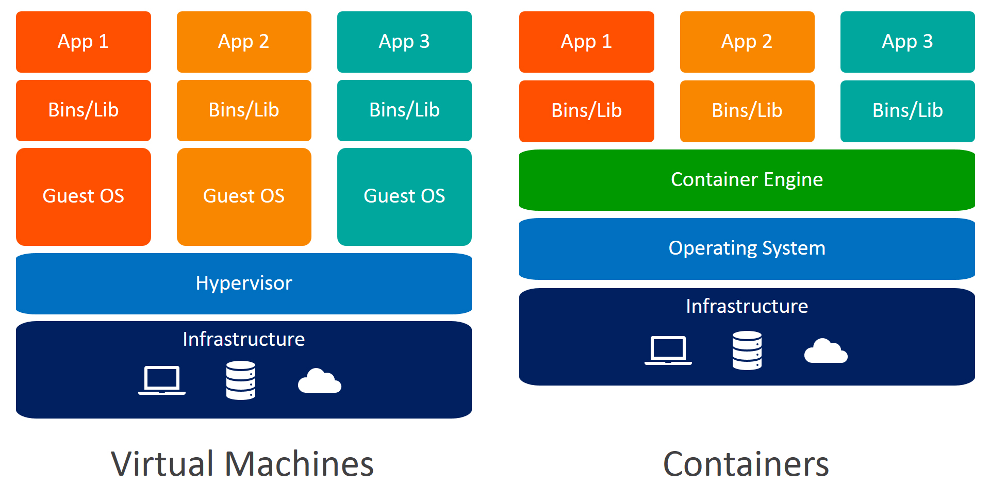
How containers make a difference

Slide 6
What is Docker
“Docker is a tool that automates the deployment of your application in Lightweight containers so that the application can work in different environments”
Package your apps with required libraries, Configurations and dependencies as images.
Makes use of Namespaces , Cgroups & Union File system to bring isolation of your apps.
Docker Engine helps in
Running Multiple Containers on the same hardware
Maintaining each container in an isolated environment
Easy and fast ways to build, configure & deploy.

Slide 7
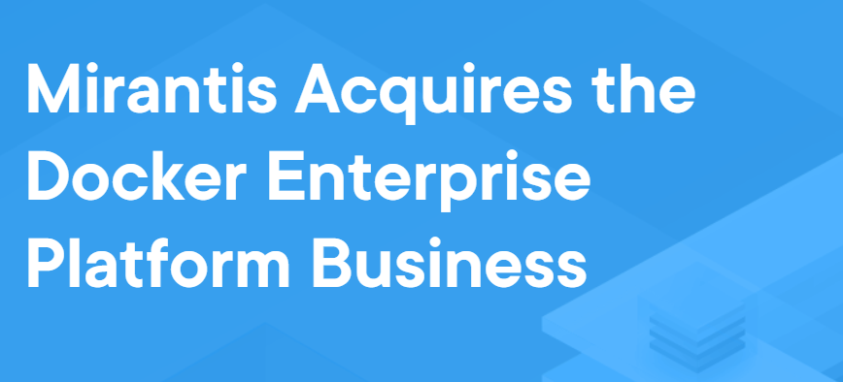
Recent Updates
Latest version: 19.03
Recent update

Slide 8
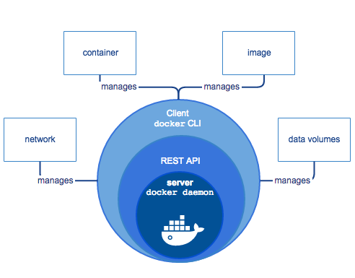
Components of Docker Engine

Slide 9
Docker image
A Docker image is a package with the set of instructions and dependencies that are needed for your app
to run as docker container.
A Docker image includes system libraries, tools, and other files and dependencies for the executable code.
How to create a docker image:
Write a Dockerfile with a set of instructions for your application to run
Run a Docker build
docker build -t <image_name>:<Tag> <dockerfile location>

Slide 10
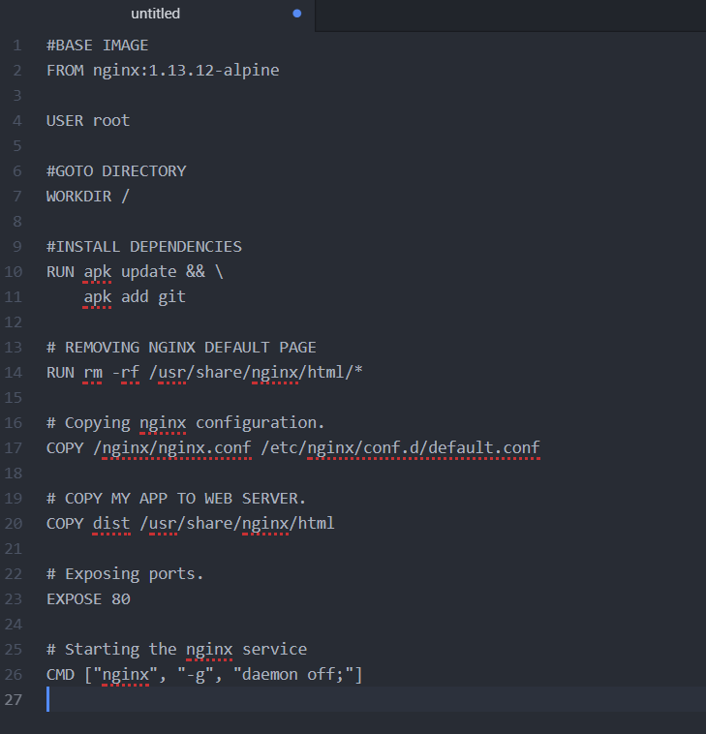
A Docker file
Choose your base image
Install your dependencies
Copy your app
Expose your app connection port
Start your service

Slide 11
Docker Networks
By Default docker creates its own network called docker0.
Containers in the same Docker network can talk to each other by their names.
Docker by Default provides 3 network drivers -
Host Network – Uses the network of the Host machine.
Bridge Network – Creates an isolated network where the only a container inside the
Created bridge network can talk with one another.
None – Disables the network on the container.
Others:
Overlay network – Distributed network between multiple docker daemons running on
different machines.
Macvlan – Assigns mac address to each and every containers making it look like
a physical machine.

Slide 12
Volumes
Volumes help the containers to maintain persistent data.
This is because by default docker containers are stateless.
Two types of Volumes
Host volumes also know as Bind mounts
Uses the host machines storage location and directory structure
Docker volumes
Managed volumes by docker daemon.
Acts like a separate volume space

Slide 13
Docker Volumes
Docker volumes are isolated storage volume created inside the docker layer.
While bind mounts are dependent on the directory structure of the host machine,
Volumes are completely managed by docker.
Benefits
Works on both Linux & windows
Volumes can be shared by different containers
Volumes can use external storage locations
Attaching an NFS to docker container
docker volume create --driver local \
--opt type=nfs \
--opt o=addr=192.168.1.1,rw \
--opt device=:/path/to/dir \
mynfsvolume

Slide 14

Where does Docker really help
It works in my Environment
It does not work in my environment
We followed the deployment document
DEVELOPER
QA
Wait, I just found the problem,
Dev has openjdk-10 and QA has openjdk-8
IT OPS

Slide 15



Deployment made easy
Build & Deploys docker image to QA
Application1
IT OPS
It Works!!
Provides the app with
Bins/dependencies
As a Docker file
DEVELOPER
TESTER

Slide 16

Efficient use of Infrastructure
Create Jenkins Slaves on the Fly for Building projects
Use Nodejs slave Template for Node builds
Use OpenJDK slave template for Spring builds
Use custom templates
Single Build machine for Jenkins Environment

Slide 17

Other Benefits
Faster Build cycles and deployments which reduces Mean time to Release.
Faster Rollbacks in case of issues which reduces Mean time to Recover.

Slide 18
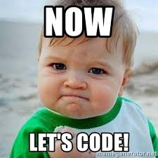
Lets start the hands on

Slide 19
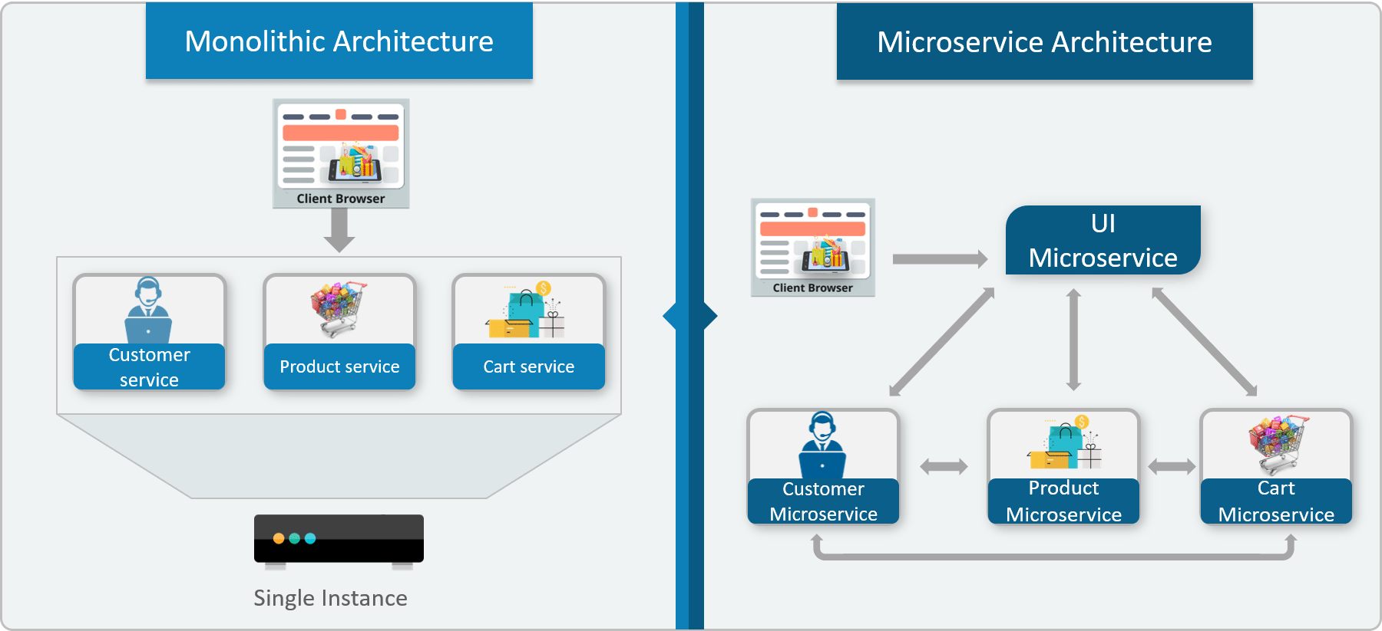
What are Microservices
Microservice is a Development methodology.
In Microservice Architecture, each service is self-contained and implements a single business capability.

Slide 20
But the Problem is….
What will happen if you create a dozen microservices for your app?.
And what if you decide to build several microservices with different technology stacks?.
E.g. Spring boot, Django, Angular app.
Your team will soon be in trouble as Operations have to manage even more environments
than they would with a traditional monolithic application.

Slide 21
How Containers can help
Packaging each of your application as Docker containers would make things easier in terms of Deployment, Infrastructure.
Each App microservice must have a separate Dockerfile with specific instructions for each image.
Micro service development helps you to find loop-holes in your applications is easily and provides isolation of business functionalities.
On the same hand Containerizing your micro service helps you in releasing your fixes and features of your Business apps with ease
App2
App3
App1
App2
App4

Slide 22

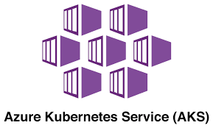
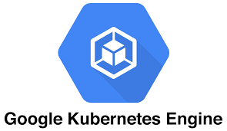

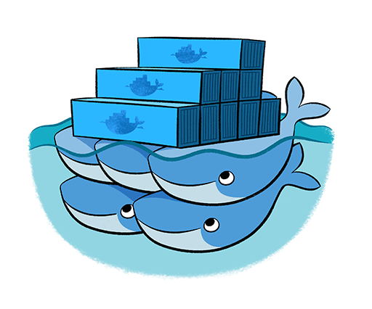
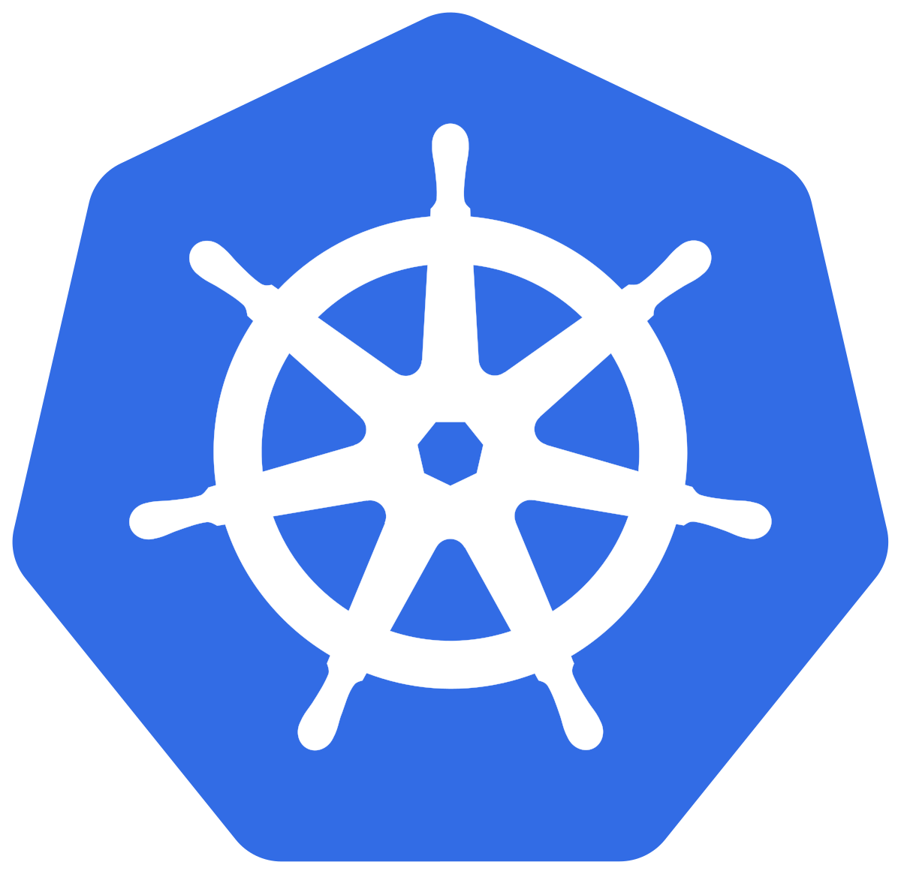
Container Management system
Kubernetes
Docker Swarm

Slide 23





Other Impressive tools for Kubernetes deployments
Other Interesting tools

Slide 24
Lets start the hands on

Slide 25
THANK YOU

