Slide 1

CODEARENA '26 · TOPIC 04: DISASTER RESPONSE
FENDER
Next-Gen National Disaster Risk Reduction &
Emergency Management System · Kelani River Basin & Beyond
5-CHECK AI
EARLY WARNING
ANTI-GHOST
REUNIFICATION
Gemini Vision + PostGIS
spatial clustering
Autonomous rainfall &
river gauge triggers
Mandatory photo proof
before road clearance
I'm Safe registry &
live shelter telemetry
LIVE ON VERCEL · Next.js 16.3 + Supabase PostGIS + Google Gemini 2.5 + Expo SDK 57
https://backend-chi-gilt-80.vercel.app
FENDER Engineering Team · CodeArena '26 · Slide 1 / 10
Notes:
Good morning, judges. My name is Mohan. Today, we present FENDER—an intelligent, multi-tier disaster response ecosystem engineered for the Colombo flood corridor and ready for nationwide deployment. During seasonal monsoons, the Kelani River breaches its banks in Nagalagam Street, Sedawatta, and Kolonnawa. The real tragedy is the information void: dispatchers take 45 minutes to verify a single incident while ambulances navigate into submerged dead ends.

Slide 2
THE CRISIS IN COLOMBO
The Deadly 45-Minute Information Void
Why traditional disaster response collapses when the Kelani overflows
Verification delay & spam
KELANI BASIN RISK SNAPSHOT
01
Nagalagam Street gauge · 88%
117 / 1990 lines are paralyzed by unstructured panic calls. Dispatchers take 30–45 minutes to confirm a single incident.
TRADITIONAL CYCLE
Incident → 45+ min delay → Triage
Duplicate ticket avalanche
02
Unstructured phone calls, paper logs, and unverified radio reports.
One fallen tree in Sedawatta triggers 50 duplicate reports, pulling crews away from life-threatening floods nearby.
WITH FENDER AI PIPELINE
Ghost clearances
Photo + GPS → < 3 seconds → Auto-triage
03
Field units radio that a road is clear with no proof. Ambulances then drive into submerged culverts and dead ends.
Vision scoring, spatial clustering, and autonomous ward escalation.
The missing evacuee void
“In a flood, a 15-minute verification delay is the difference between safe evacuation and stranded casualties.”
04
Children and elderly citizens are scattered across temples and schools with no unified shelter roster.
FENDER · CodeArena '26 · Topic 04: Disaster Response
2 / 10
Notes:
Every year, torrential monsoon downpours flood Sedawatta, Nagalagam Street, and Kolonnawa. People assume response fails because of a lack of rescue boats. In reality, it fails because of information paralysis. When 117 receives 5,000 unverified calls, dispatchers spend critical hours confirming rumors, duplicate tickets flood the queue, and rescue units operate completely blind.

Slide 3
THE FENDER ECOSYSTEM
One Unified Platform. Zero Information Silos.
Citizens, command, field units, and relief camps — synchronized in real time
PORTAL 1 · FRONTLINE
PORTAL 2 · MUNICIPAL HQ
PORTAL 3 · FIELD OPS
PORTAL 4 · HUMANITARIAN
Citizen Lifeline PWA
Command Console
Crew Clearance Desk
Relief & Safe Registry
▸ Trilingual: English, Sinhala, Tamil
▸ Live incident triage queue
▸ Navy, DMC, CMC ticket queue
▸ Live shelter bed counters
▸ One-tap geotagged camera report
▸ PostGIS split-screen spatial sync
▸ One-tap turn-by-turn navigation
▸ I'm Safe family search
▸ Live 5-check AI verdict modal
▸ Autonomous river / rainfall triggers
▸ Mandatory after-repair photo
▸ Missing persons NIC lookup
▸ Offline QR SOS + 117 / 1990 dialer
▸ AI threshold slider + audit trail
▸ Instant public-map unblock
▸ Medical / infant aid matching
/report · /
/dashboard/officer
/crew
/safe · /relief
UNIFIED REALTIME DATA FABRIC
Every action reflects across
all 4 screens in < 200ms
Supabase PostGIS + WebSocket subscriptions + Edge replication
FENDER · CodeArena '26 · Topic 04: Disaster Response
3 / 10
Notes:
Fender solves this by connecting all four crisis stakeholders into a single, real-time data fabric. When a citizen reports an incident, it is verified in seconds, prioritized on the municipal command desk, dispatched to on-ground crews, and updated on the public safe map—all synchronized via Supabase WebSockets in under 200 milliseconds.

Slide 4
THE SECRET SAUCE
The Multi-Modal 5-Check AI Engine
How Fender scores hazard credibility and severity in under 3 seconds
01
02
03
04
05
Input & Multilingual AI
Gemini 2.5 Vision
Weather & River Telemetry
PostGIS Cluster Check
Topology & Risk Score
Sanitizes Sinhala / Tamil / English. Flags distress terms like “elderly trapped” and “water rising fast”.
Estimates flood depth, detects live wires and submerged vehicles, rejects stock or fake photos.
Cross-checks Kelani gauges at Nagalagam Street and 24h ward rainfall radar.
ST_DWithin 150–200m groups 50 duplicate calls into 1 master incident.
Ward elevation, drainage risk, and arterial-road blockage set the final urgency badge.
WEIGHT 15%
WEIGHT 35%
WEIGHT 20%
WEIGHT 20%
WEIGHT 10%
AGGREGATOR · COMPOSITE SCORE
Score = Σ (Check_i × Weight_i) Example: 0.80
≥ 0.75 AUTO-PUBLISH
0.50–0.74 NEED INFO
< 0.50 PENDING
Officers can retune the threshold live during a storm surge.
FENDER · CodeArena '26 · Topic 04: Disaster Response
4 / 10
Notes:
Rather than using a generic chatbot, we engineered a deterministic 5-check evaluation pipeline. Gemini Vision confirms visual hazard veracity; PostGIS groups nearby calls to kill 90% of duplicate spam; and river telemetry checks environmental plausibility. Within 3 seconds, the report is mathematically scored and routed without human bottleneck.

Slide 5
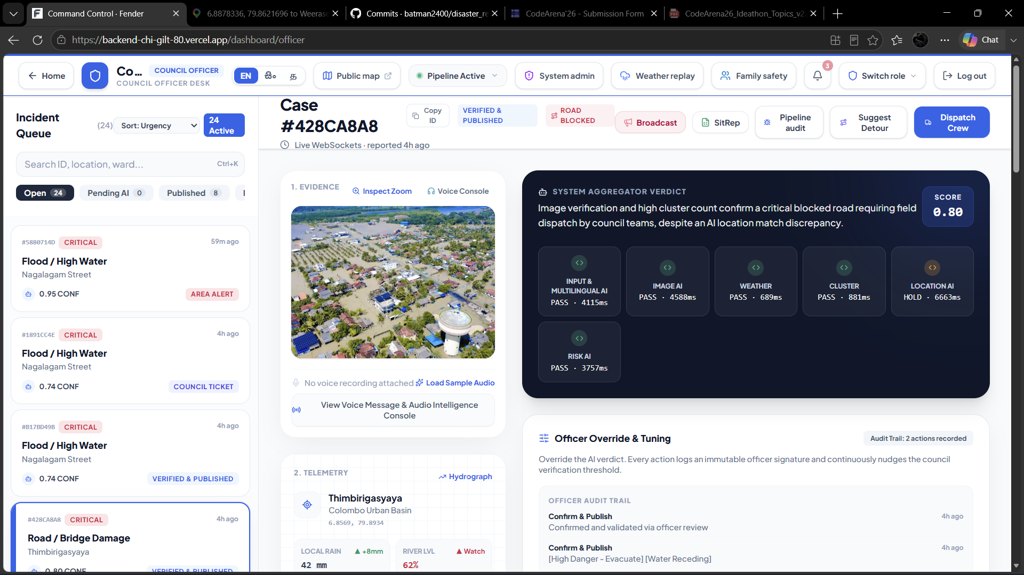
LIVE PLATFORM TOUR · SCREEN 1
Municipal Officer Command & Triage Console
Real-time spatial awareness, 5-check telemetry, and autonomous weather triggers
AI sensitivity slider
Throttle auto-publish from 0.50 to 0.90 during peak storm volume.
Deep telemetry
Inspect Input 0.85 · Vision 0.90 · Weather 0.70 · Cluster 1.00 · Risk 0.75.
One-click override
Publish · Need Info · Area Alert · Council Ticket — every action is audited.
River gauge alarm
Kelani at 88% auto-raises ward banners without waiting for a dispatcher.
Incident #428CA8A8 · Flood · Ward 01 Nagalagam
Verdict 0.80 CONFIRMED
FENDER · CodeArena '26 · Topic 04: Disaster Response
5 / 10
Notes:
This is what municipal commanders see at CMC headquarters. Incident #428CA8A8 in Nagalagam Street was submitted with a photo. The system automatically assigned an 0.80 verdict score. The officer can inspect the exact Gemini reasoning, view clustered nearby reports, adjust AI sensitivity thresholds, or escalate an entire ward with one click.

Slide 6
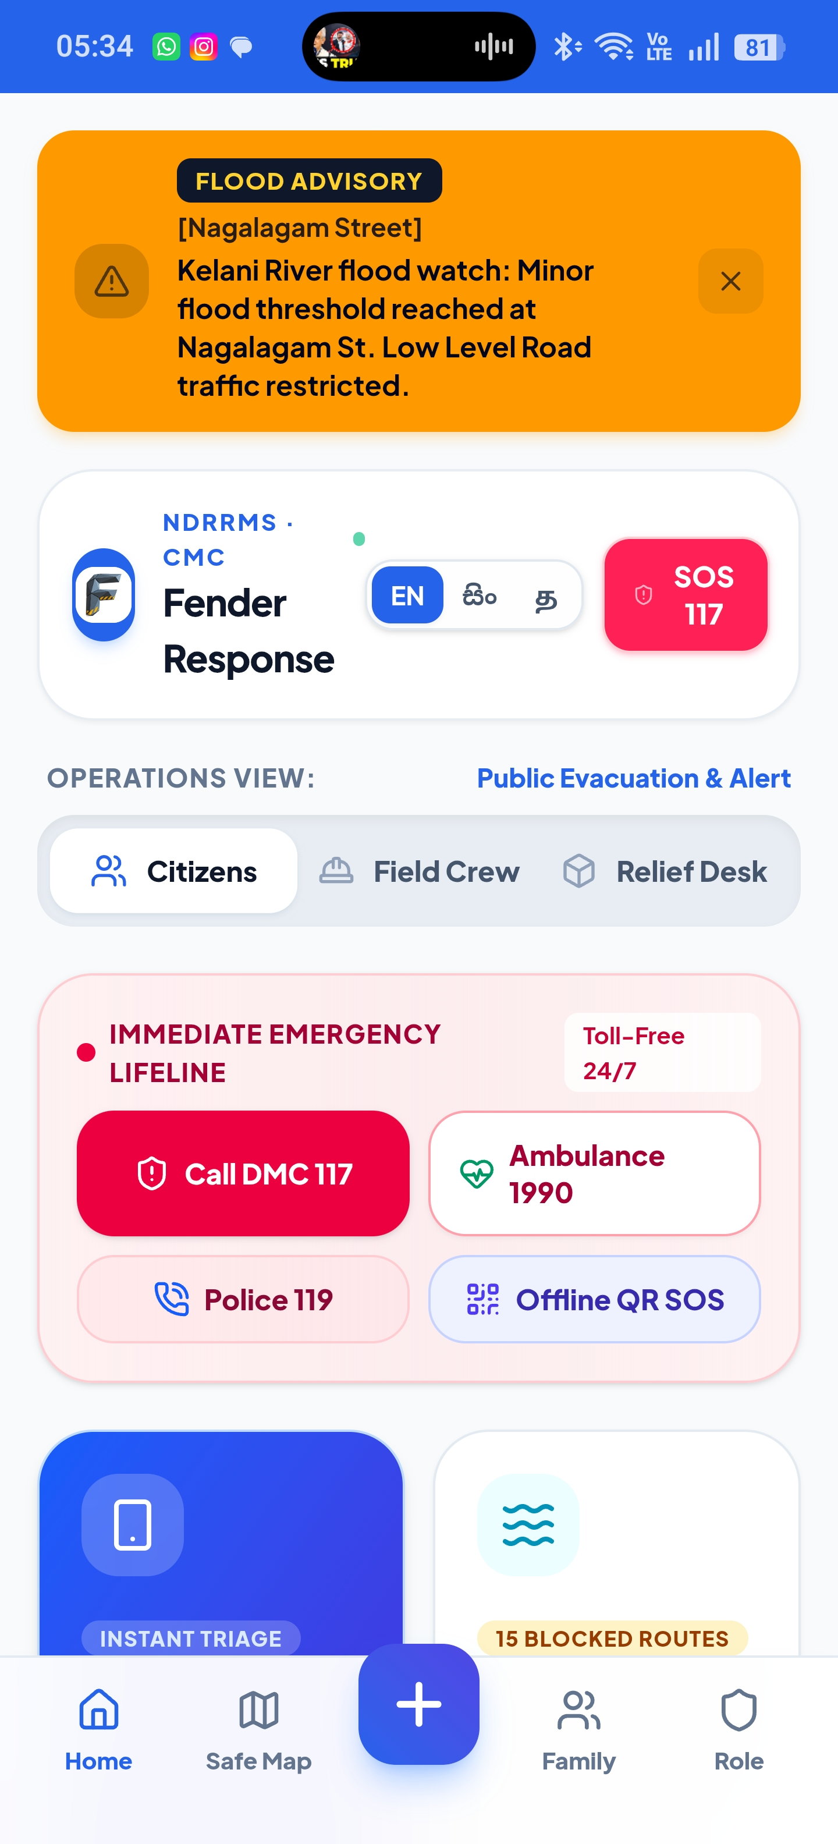
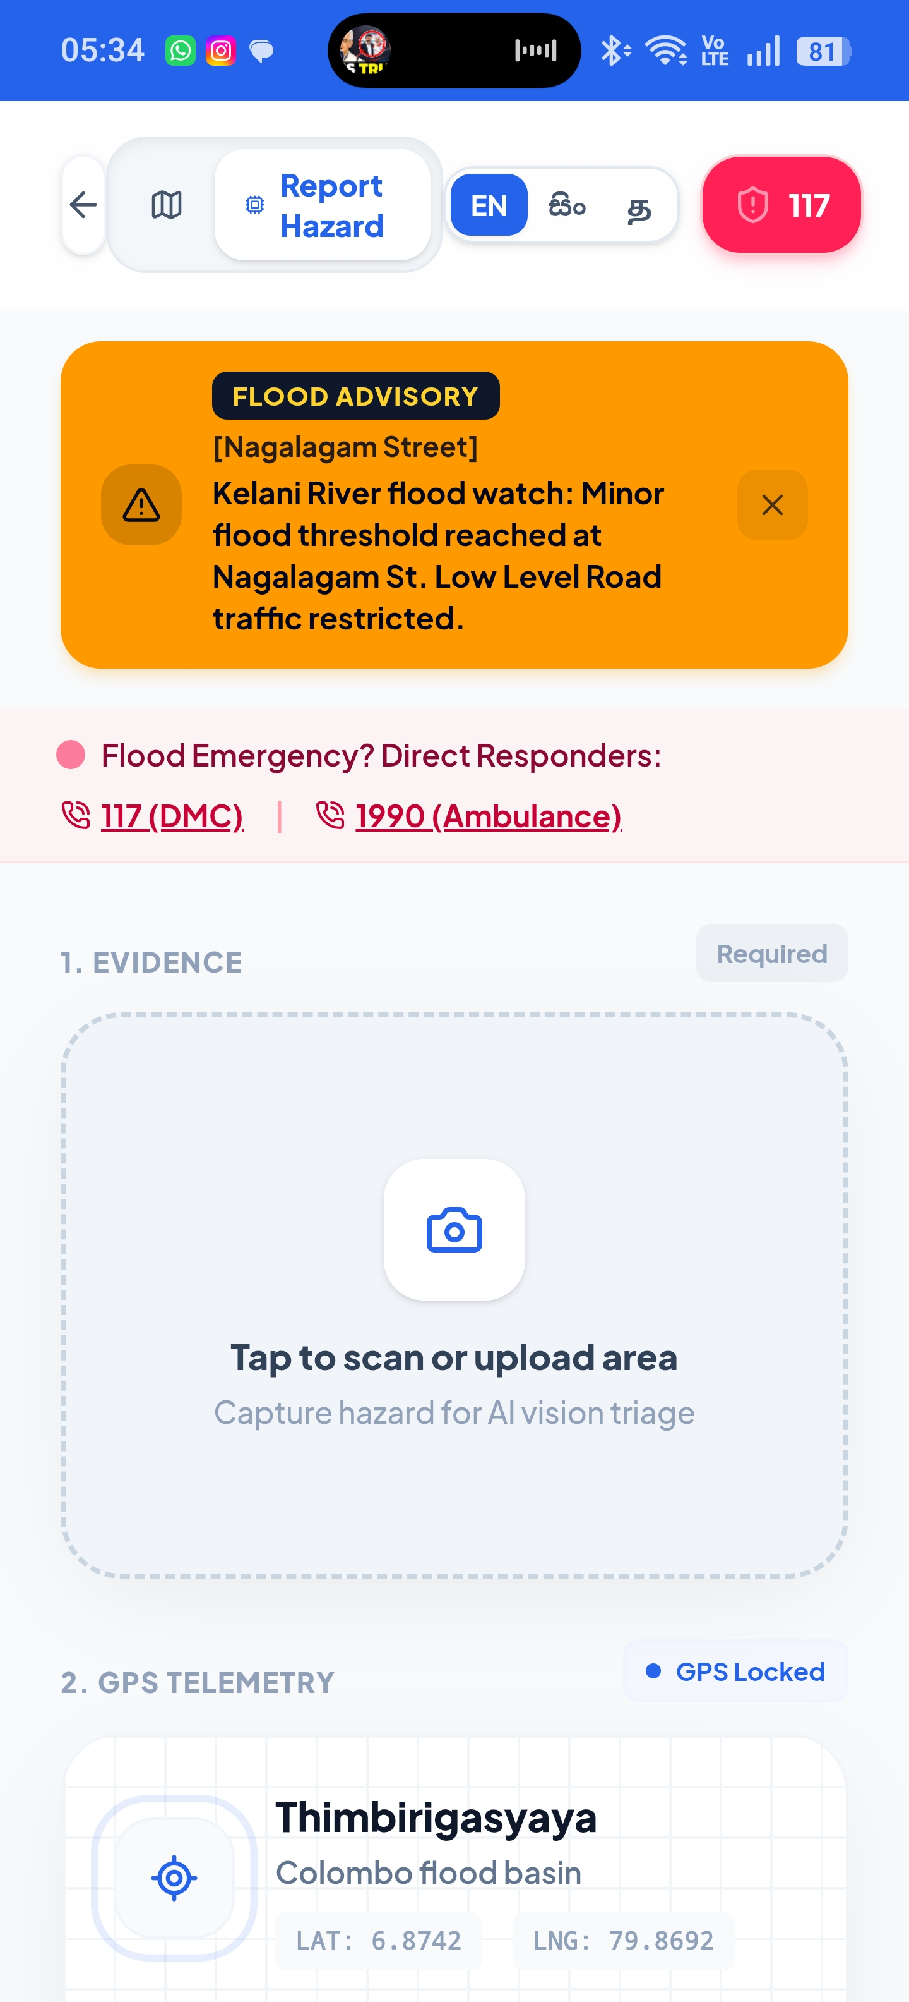
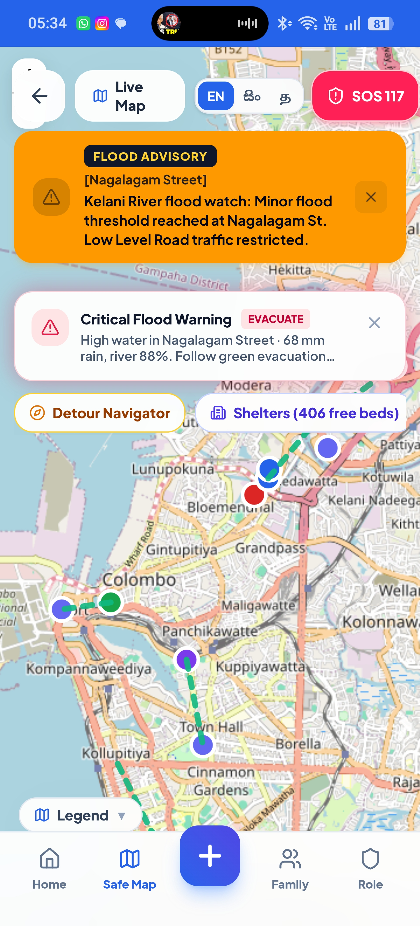
LIVE PLATFORM TOUR · SCREEN 2
Citizen Emergency Lifeline & Interactive Map
15-second geotagged intake, offline SOS, and live evacuation routing
Trilingual Lifelines
One-tap Camera + GPS
Interactive Safe Map
117 / 1990 dialers, flood advisory, offline QR SOS.
Locked coordinates + live 5-check AI progress modal.
Pulsing hazard pins, detours, and open-shelter paths.
FENDER · CodeArena '26 · Topic 04: Disaster Response
6 / 10
Notes:
For citizens trapped by rising waters, simplicity is survival. Fender is an installable PWA that works on any mobile browser. It speaks their language—English, Sinhala, or Tamil. A citizen can report a hazard in 15 seconds. On the public safe map, they see active flood pins and safe, non-submerged evacuation routes to open shelters.

Slide 7
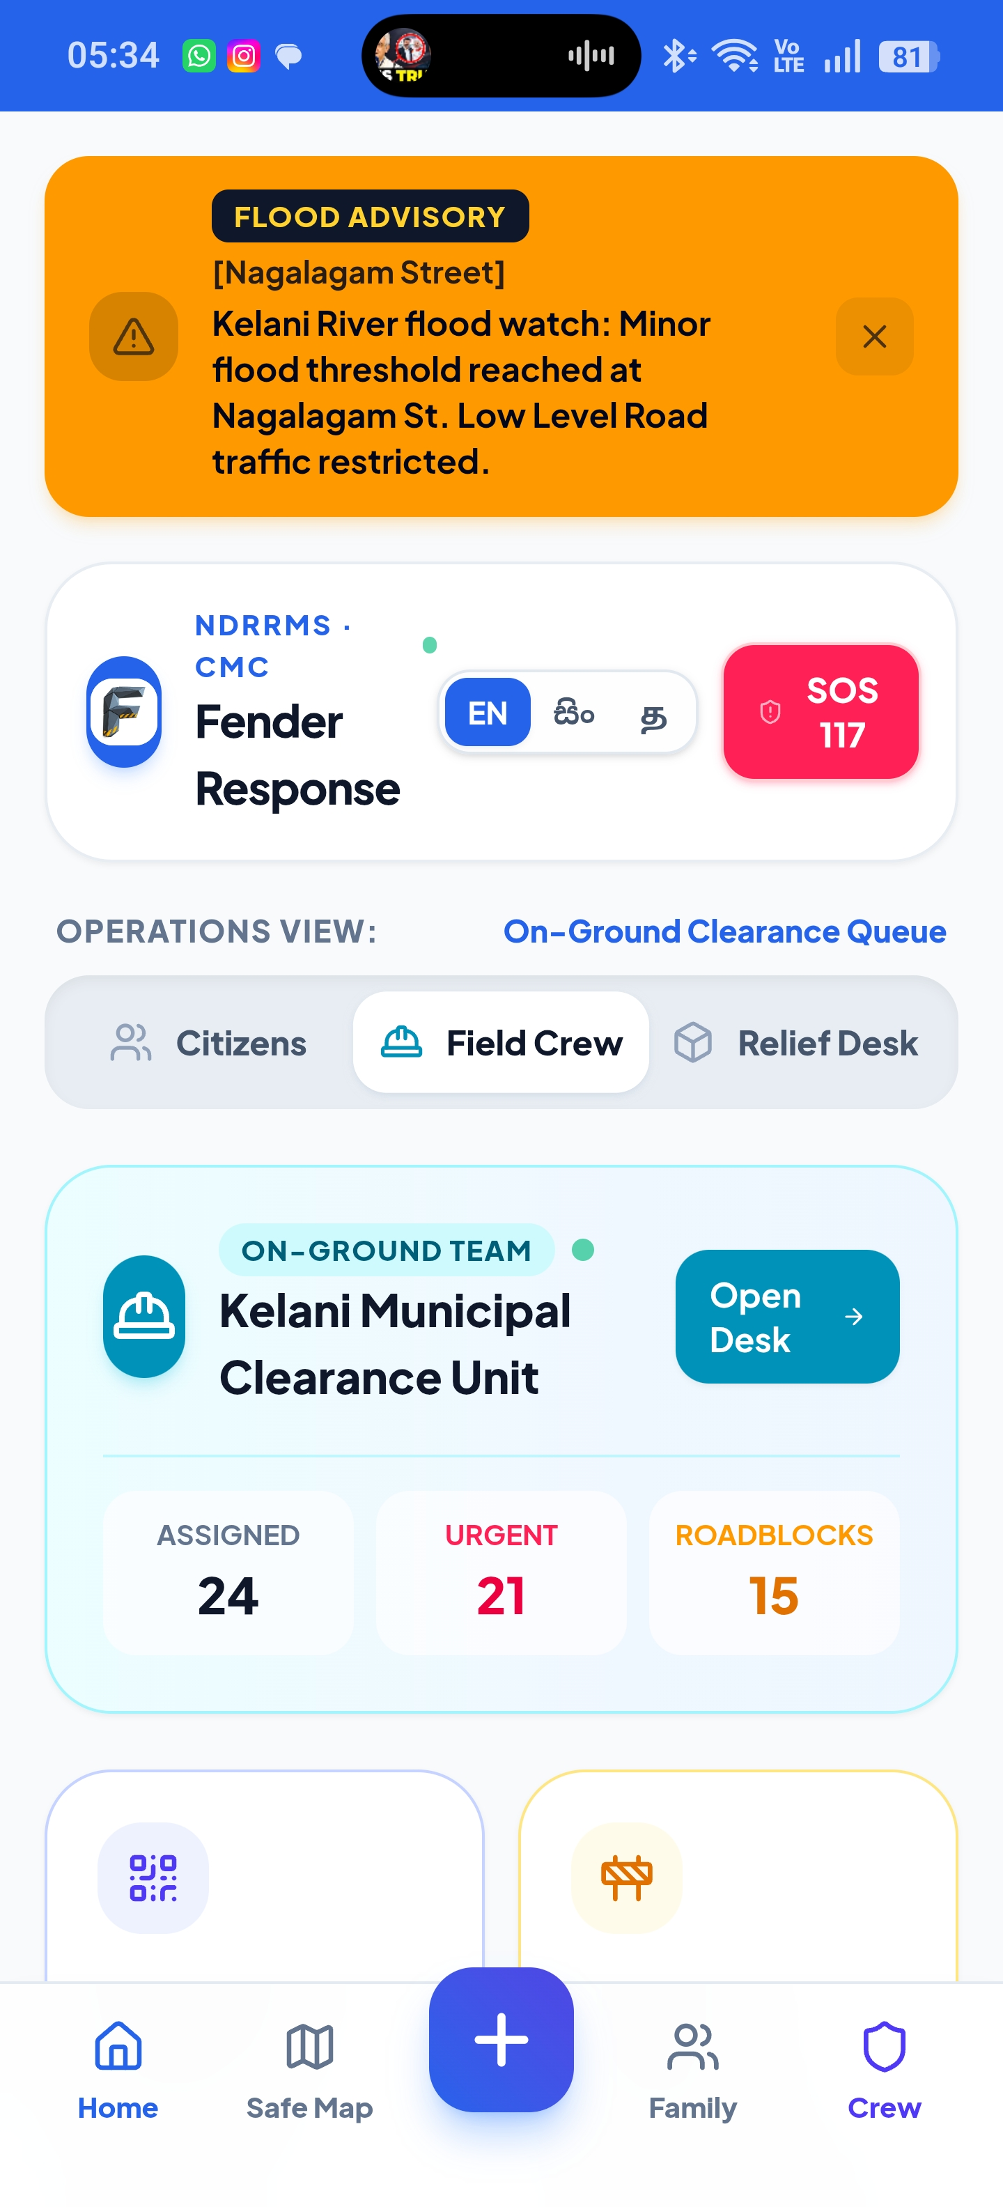
LIVE PLATFORM TOUR · SCREEN 3
Field Crew Dispatch & Anti-Ghost Verification
Tickets cannot close until a live after-fix photo proves the road is clear
Multi-agency dispatch
Built for Sri Lanka Navy rescue boats, DMC crews, and CMC tree-clearing engineers.
Zero-trust closure
The Resolve button stays locked until a timestamped, GPS-stamped after-fix photo is uploaded.
Instant cascade
Supabase Realtime flips is_road_blocked = false. Public map pins go green in milliseconds.
Turn-by-turn routing
One tap opens navigation to the exact incident coordinates — no radio guesswork.
FENDER · CodeArena '26 · Topic 04: Disaster Response
7 / 10
Notes:
A critical flaw in existing municipal systems is ghost clearances—workers marking roads cleared over the radio when fallen trees still block emergency ambulances. With Fender, tickets cannot be closed with a button. Field crews must capture an on-site photo showing the obstruction cleared. Once verified, the database flips is_road_blocked to false, and the public map updates instantly.

Slide 8
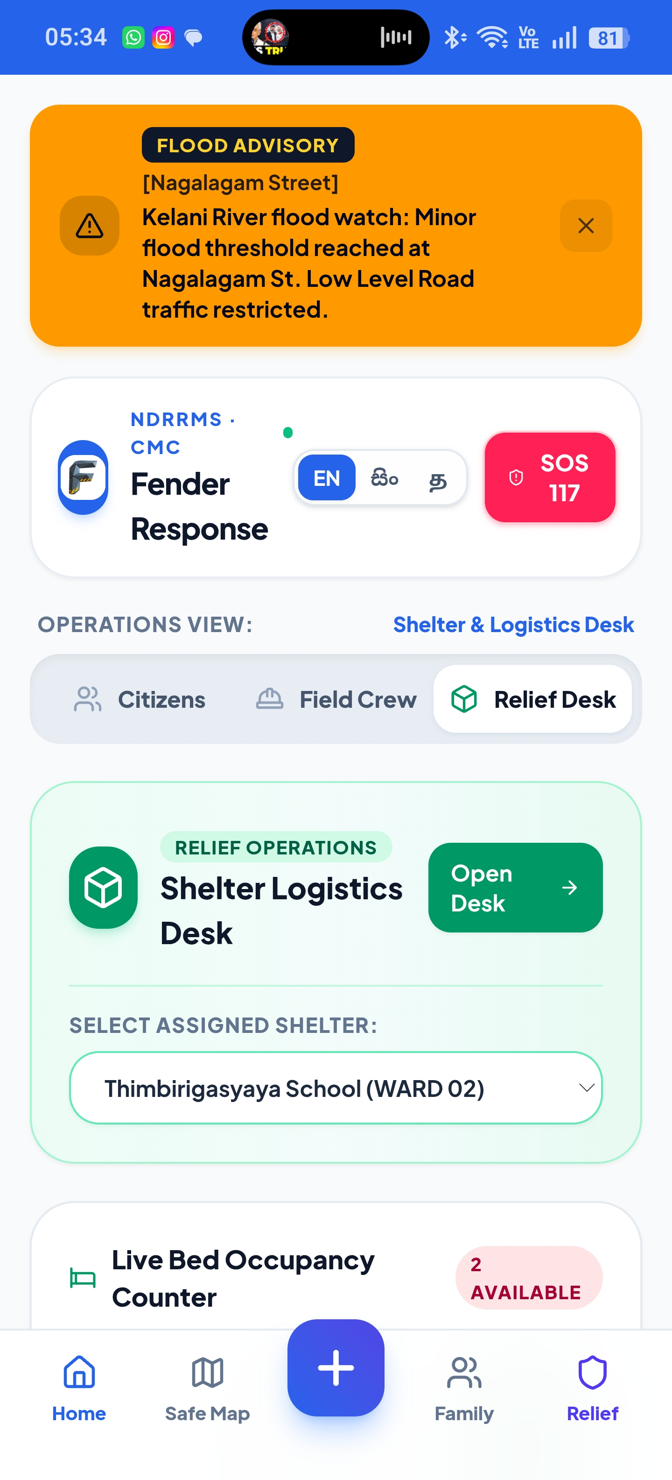
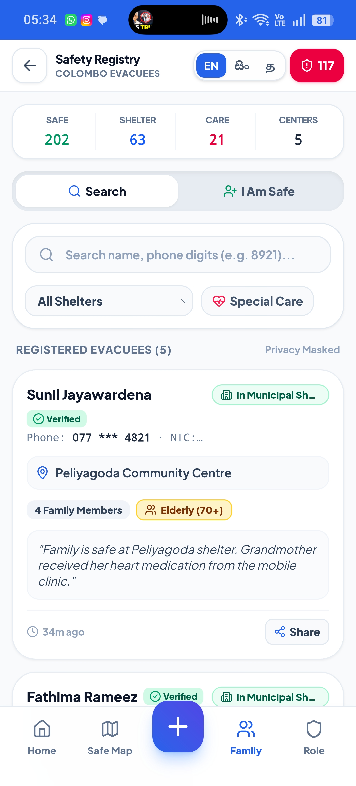
LIVE PLATFORM TOUR · SCREEN 4
Humanitarian Relief & Family Reunification
Live shelter vacancy, medical matching, and the I'm Safe public registry
Live bed & supply telemetry
Track free beds and meals across Colombo camps — St. Anthony's, Sedawatta Temple, Thimbirigasyaya School — before overflow.
I'm Safe family registry
Evacuees check in in 30 seconds. Relatives search by name, NIC, or phone from anywhere in the world.
Vulnerability matching
Prioritize insulin, dialysis, oxygen, infant formula, and wheelchair needs for NGO and medical teams.
Privacy by design
Public view shows name + shelter + status. NIC, phone, and medical notes stay hashed and search-gated.
Shelter Hub
I'm Safe Registry
FENDER · CodeArena '26 · Topic 04: Disaster Response
8 / 10
Notes:
Disaster response doesn't end when the rescue boat docks. Displaced citizens are often separated from children and elderly parents. Our I'm Safe registry lets evacuees register in 30 seconds, enabling loved ones anywhere in the world to search and verify their safety. Simultaneously, relief coordinators track real-time shelter bed counts so camps never dangerously overflow.

Slide 9
TECHNICAL EXCELLENCE & REAL-WORLD IMPACT
Measurable Impact & Production Architecture
Built to scale under catastrophic load — not a mockup, live on Vercel
< 3s
90%
100%
3 LNG
AI TRIAGE SPEED
DUPLICATE CUT
VERIFIED CLEARANCES
TRILINGUAL PARITY
Down from 45 minutes of manual dispatcher phone triage.
PostGIS ST_DWithin collapses 50 calls into 1 master dispatch.
Zero ghost clearances. Closure requires a live photo.
Full English, Sinhala, and Tamil support for every citizen.
FULL-STACK ARCHITECTURE
Frontend & PWA
Spatial & Database
Intelligence
Mobile Native
Next.js 16.3 App Router
React 19 · Tailwind v4 · Leaflet
Supabase PostgreSQL
PostGIS · Realtime WebSockets
Gemini 2.5 Flash Vision
Structured JSON + fallback rules
Expo SDK 57
React Native 0.86 · offline cache
PRODUCTION READY · Live on Vercel Edge
backend-chi-gilt-80.vercel.app
Zero cold-start pooling · Row Level Security · Deterministic AI fallback if Gemini is down
FENDER · CodeArena '26 · Topic 04: Disaster Response
9 / 10
Notes:
Fender delivers immediate, measurable impact: a 90% reduction in dispatcher triage time, 90% duplicate elimination, and zero ghost clearances. Our architecture is built for production: Next.js 16.3 on Vercel Edge, Supabase PostGIS with Row Level Security, and Google Gemini 2.5 multimodal vision.

Slide 10
FUTURE ROADMAP & CONCLUSION
Saving Lives Before the Waters Rise
From Colombo’s Kelani River to a national disaster infrastructure standard
PHASE 1
PHASE 2
PHASE 3
LoRa / BLE Mesh Sync
Drone Stream Vision
National DMC Integration
Peer-to-peer offline hop for total cellular blackout. SOS packets travel 5 km without towers.
Feed UAV video into Gemini Vision to trace breached levees and expanding flood boundaries.
Bidirectional telemetry into Sri Lanka’s 117 / DMC dispatch and municipal siren systems.
Thank you. Questions & live demo?
Flash floods are inevitable. Blind disaster response is not.
https://backend-chi-gilt-80.vercel.app
Command Desk /dashboard/officer
Safe Map /map
Safe Registry /safe
Crew Clearance /crew
FENDER · CodeArena '26 · Topic 04: Disaster Response
10 / 10
Notes:
Our vision goes beyond this competition. We are architecting offline LoRa mesh synchronization for total cellular tower blackouts, aerial drone video feeds, and direct integration with Sri Lanka's Disaster Management Centre. When monsoons come, speed and clarity save lives. Fender delivers both. Thank you—we welcome your questions!

