Slide 1

BUILT FOR
Kelani River Basin
Nagalagam · Sedawatta
Wellampitiya · Kolonnawa
THE LOOP
Citizen → AI triage
Officer → Field crew
Shelter → Family
NDRRMS · CMC
CODEARENA '26 · TOPIC 04 DISASTER RESPONSE
FENDER
The closed-loop flood command system for Colombo.
Verify in seconds. Dispatch with proof. Reunite families.
5-Check Gemini AI
PostGIS clustering
Photo-proof clearance
I'm Safe registry
Live · backend-chi-gilt-80.vercel.app
Next.js 16 · Supabase PostGIS · Gemini 2.5 · Expo SDK 57
FENDER · CodeArena '26 · Topic 04
01 / 10
Notes:
Open with the monsoon: when the Kelani breaches, dispatchers drown in calls before they drown in water. FENDER is the closed loop — citizen photo in, verified map out, crews cannot close without proof. Then click through. Do not read the pills.

Slide 2
THE CRISIS IN COLOMBO
The deadly information void
TRADITIONAL DISPATCH
WITH FENDER
45 min
< 3s
Photo + GPS in.
Five checks score the report.
Duplicates collapse into one ticket.
River gauges raise the ward themselves.
The map updates before the next call.
That is how long it takes a dispatcher to confirm a single flood call — while ambulances drive into submerged culverts and families wait on rooftops in Nagalagam, Sedawatta, and Kolonnawa.
The water is not the only failure. The information is.
FENDER · CodeArena '26 · Topic 04
02 / 10
Notes:
Hold the 45 vs 3 contrast. Judges remember the number. Then: 'The tragedy is not only the flood. It is the 45-minute void while we decide if the flood is real.'

Slide 3
WHY RESPONSE COLLAPSES
Four bottlenecks. One monsoon. Zero shared picture.
01
02
Spam & verification lag
Duplicate avalanches
117 / 1990 drown in panic calls. Officers cannot tell a real drowning from a rumour for half an hour.
Fifty people report the same fallen tree. Crews fan out to one pin while a flash flood 500 m away waits.
03
04
Ghost clearances
Missing families
Radio says the road is open. The ambulance arrives to a submerged culvert. No photograph. No truth.
Children and elders scatter across temples and schools. There is no shared roster, no 'I'm safe' search.
FENDER · CodeArena '26 · Topic 04
03 / 10
Notes:
Walk the four failures as an ops story, not a feature list. End on families — that is the human hook before you show the product.

Slide 4
THE FENDER ECOSYSTEM
One platform. Four desks. Zero silos.
PORTAL 1
PORTAL 2
PORTAL 3
PORTAL 4
Citizen lifeline
Command console
Crew clearance
Relief & safe
EN · සිං · தமிழ் PWA
Municipal HQ
Navy · DMC · CMC
Shelters + families
Photo + GPS in 15 seconds. Offline QR SOS. Direct 117 / 1990. Live 5-check verdict.
Queue, map, river gauges, AI threshold slider, override with a full audit trail.
Navigate to the pin. Cannot close without a live after-fix photo. Map unblocks instantly.
Live bed counts, aid matching, and a public I'm Safe search by name or NIC.
Supabase Realtime · every action on any desk hits every other screen in under 200 ms
FENDER · CodeArena '26 · Topic 04
04 / 10
Notes:
FENDER is not a reporting app. It is the operating system of the flood: citizen, officer, crew, shelter. Same data fabric.

Slide 5
THE SECRET SAUCE
Five checks. One verdict. Under three seconds.
01
02
03
04
05
Input AI
Gemini Vision
Weather
PostGIS cluster
Risk AI
Sinhala, Tamil, English. Distress keywords. Clean operational summary.
Flood depth, live wires, structural damage. Rejects stock photos.
Rain > 40 mm or Kelani gauge > 75% confirms the environment.
ST_DWithin 150–200 m. Fifty calls become one master incident.
Ward topology, road blockage, population exposure → urgency.
Weight 15%
Weight 35%
Weight 20%
Weight 20%
Weight 10%
AGGREGATOR
Score ≥ 0.75 auto-publish
0.50–0.74 need info · < 0.50 hold
DETERMINISTIC FALLBACK
If Gemini drops, weather + cluster still return a conservative verdict in < 200 ms. The demo never dies with the model.
FENDER · CodeArena '26 · Topic 04
05 / 10
Notes:
This is the technical punch. Stress Vision + PostGIS as the pair that kills fakes and duplicates. Mention the fallback so they know you thought about outages.

Slide 6
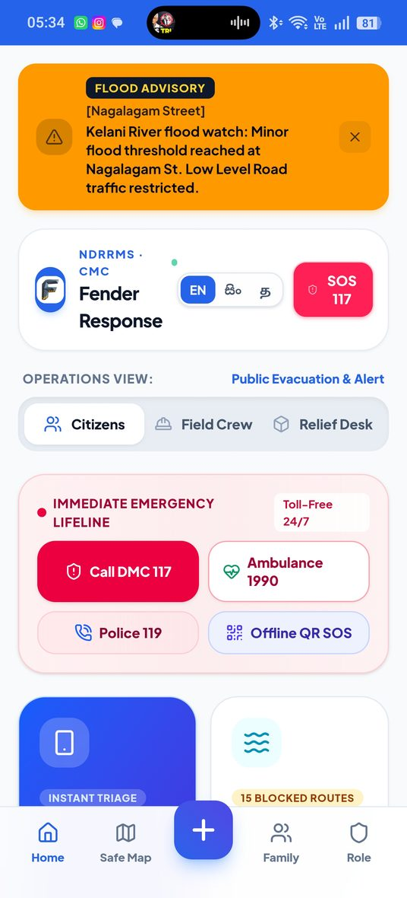
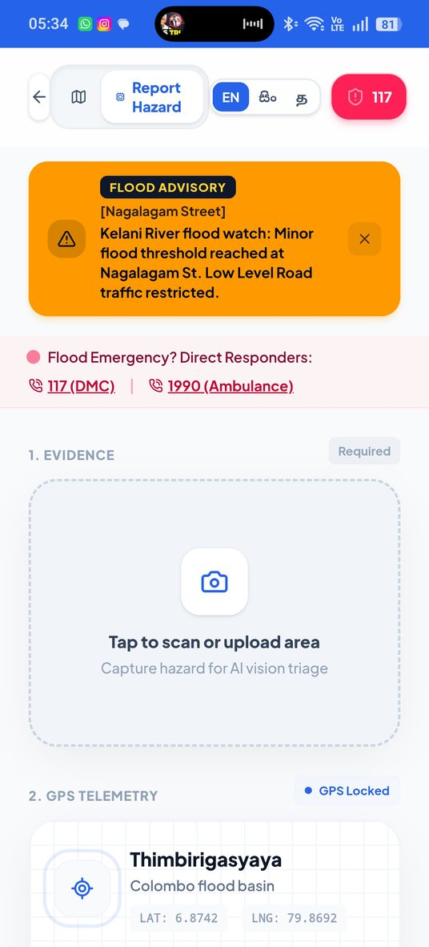
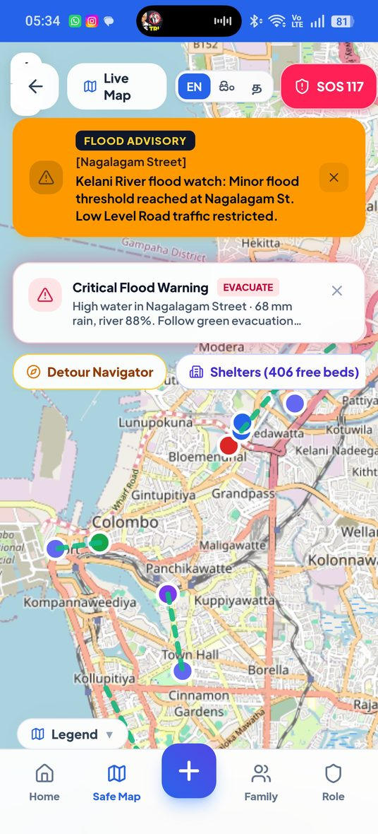
LIVE PRODUCT · CITIZEN
From rooftop to verified pin in one tap.
Lifeline hub
Hazard intake
Safe map
Flood watch, trilingual switch, 117 / 1990, offline QR SOS.
Camera + locked GPS. Live 5-check stepper. Instant verdict.
Pulsing pins, blocked roads, detours, live shelter beds.
FENDER · CodeArena '26 · Topic 04
06 / 10
Notes:
If you have a phone, live-demo the report here. If not, these three screens are the story: warn, capture, navigate.

Slide 7
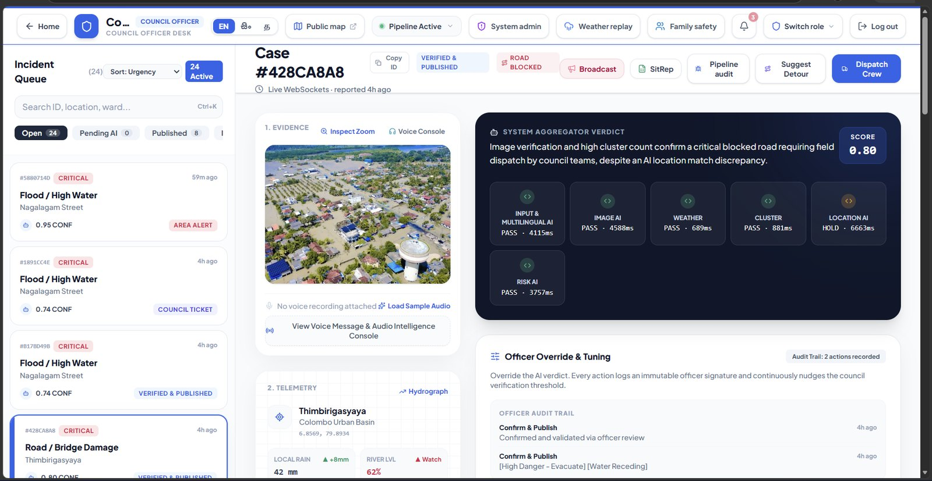
LIVE PRODUCT · MUNICIPAL HQ
Triage with evidence, not rumours.
5-check telemetry
Vision, weather, cluster, location, risk — scored on every ticket.
Threshold slider
Tighten or loosen auto-publish when the storm peaks.
One-click override
Publish, need-info, area alert, council ticket — with an audit trail.
Autonomous gauges
Rain and river telemetry can raise a ward to CRITICAL with no click.
FENDER · CodeArena '26 · Topic 04
07 / 10
Notes:
Point at case #428CA8A8 if live. Call out SCORE 0.80 and the five check chips. Officers stay in the loop — AI never silently publishes without a trail.

Slide 8
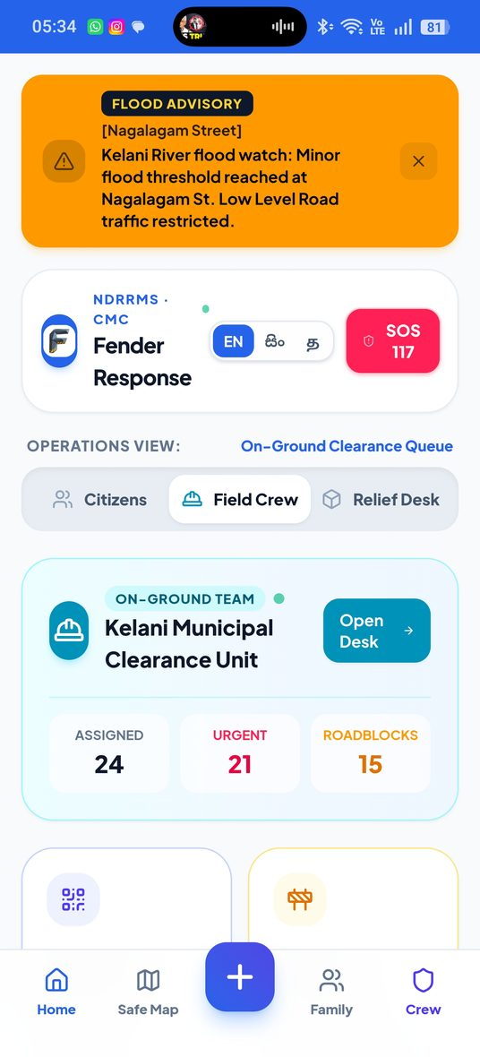
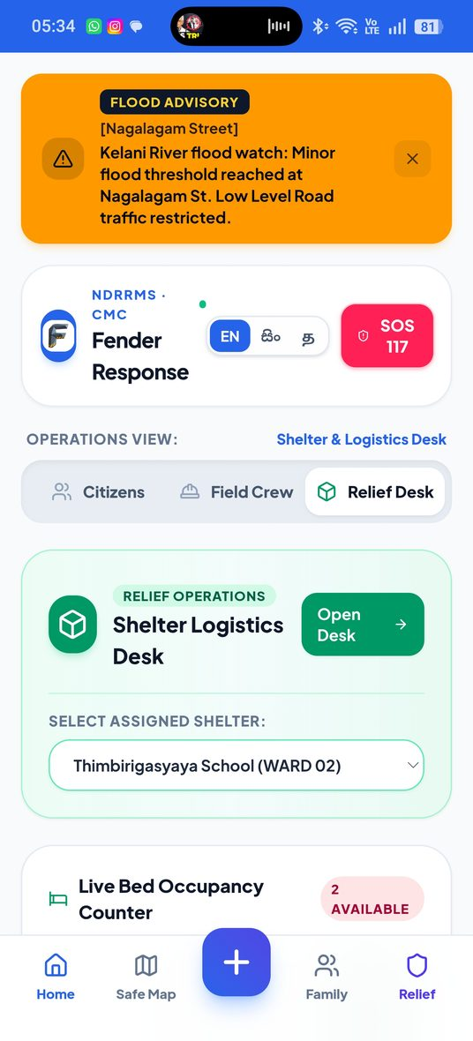
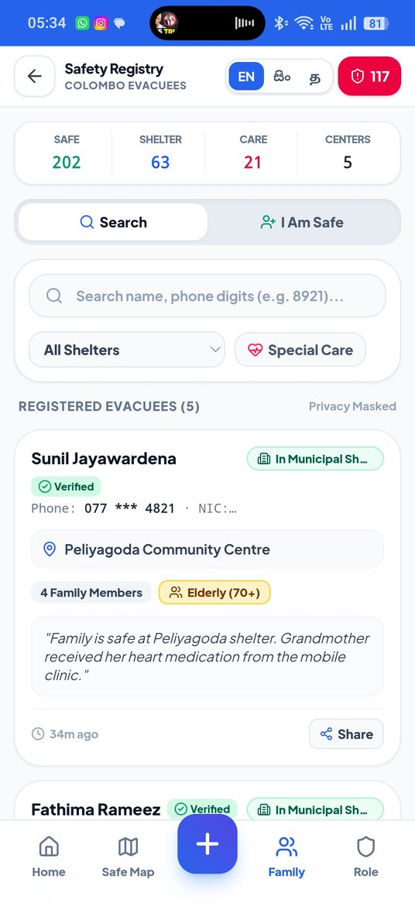
LIVE PRODUCT · CREW + HUMANITARIAN
No ghost clearances. No missing names.
Field crew
Relief desk
I'm Safe registry
Tickets, nav, mandatory after-fix photo. Resolve flips is_road_blocked on every public map.
Live beds, rations, medical kits. HELP_REQUEST matches the nearest shelter with space.
Check in as SAFE / IN_SHELTER / DISPLACED. Search by name, NIC, ward, or camp.
FENDER · CodeArena '26 · Topic 04
08 / 10
Notes:
Punchline: a crew cannot lie the road open. A family does not have to call twenty camps. That is the closed loop.

Slide 9
IMPACT · PRODUCTION ARCHITECTURE
Built to run the demo. Built to survive the storm.
< 3s
90%
100%
3
AI triage
Duplicates cut
Photo proof
Languages
From 45 minutes of phone sorting.
ST_DWithin collapses 50 calls to 1.
Zero ghost clearances by design.
English, Sinhala, Tamil — full parity.
Web & PWA
Spatial DB
Intelligence
Native
Next.js 16.3 · React 19 · Tailwind v4 · Leaflet
Supabase Postgres · PostGIS · Realtime · RLS
Gemini 2.5 Flash · structured JSON · fallback engine
Expo SDK 57 · React Native · offline cache
FENDER · CodeArena '26 · Topic 04
09 / 10
Notes:
These metrics are design targets from the locked spec, not a year of production telemetry. Be honest if asked. Then: it is live on Vercel tonight.

Slide 10
Flash floods are inevitable.
Blind response is not.
FENDER gives Colombo a shared picture in seconds — and a standard that can travel to every river basin in the country.
NOW
NEXT
NATIONAL
Kelani corridor live ops: report, triage, prove, reunite.
SMS / USSD fallback when towers fail. LoRa mesh SOS.
DMC 117 interoperability. Drone vision into the same pipeline.
Thank you. Questions — and a live demo.
https://backend-chi-gilt-80.vercel.app · /dashboard/officer · /map · /crew · /safe
FENDER · CodeArena '26 · Topic 04
10 / 10
Notes:
Stop talking. Invite the live demo. If time is gone, stay on this slide and take questions. Demo order: report → officer queue → crew close → map pin flips → I'm Safe search.

