Slide 1
Toronto city explorer
Coursera data science capstone

Slide 2
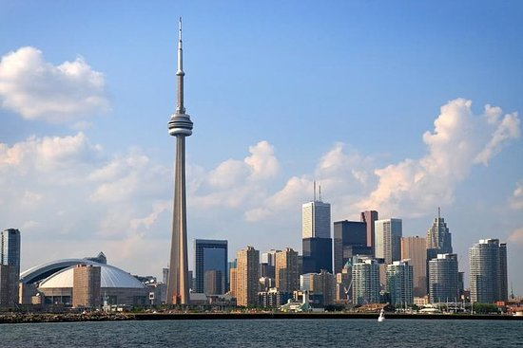

Slide 3
Contents
Introduction/ problem
Data
Exploration and analysis
Methodology
Results
Discussion
Conclusion

Slide 4
Introduction /problem
Introduction/ buisness problem
A lot of potential thoughts and considerations are given to the locations whenever we visit a city. What if we could look at specific important/busy areas in the city or place of interest of a city we are visiting. In that case what if we could cluster neighborhoods on the basis of the potential tourism interests. It would help travelers, tourism agencies and real estate investors too.
Explanation
Toronto is a fast growing financial hub. With increasing city centers and sparling residential hubs. This makes tourism and real estate one of many growing business ventures Toronto has had. The city is well connected and well planned and is financially flourishing and that aspect brings in a lot of travelers. Hence determining interests and hotspots is definitely beneficial and aids new tourists and investors
Who are our stakeholders
Anyone who's interested in the region, it can be individuals, tourists or even the residents who would want to know if they are in the right neighborhood according to their interests and needs. Well for tourists they get a comprehensive city guide and real estate investors get to know where their gold lies
What am i trying to do
I will use datasets regarding neighborhoods in Toronto and complement them with foursquare API data on popular places or hotspots close to the places of interest then i can cluster the neighborhoods with their amenities/ hotspots and map them using folium¶

Slide 5
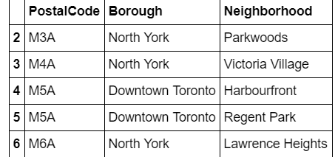
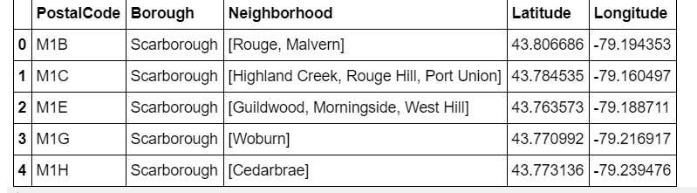
Data
I required the city’s neighbourhood data which was acquired from wiki, geospatial data was acquired too for mapping proposes.

Slide 6
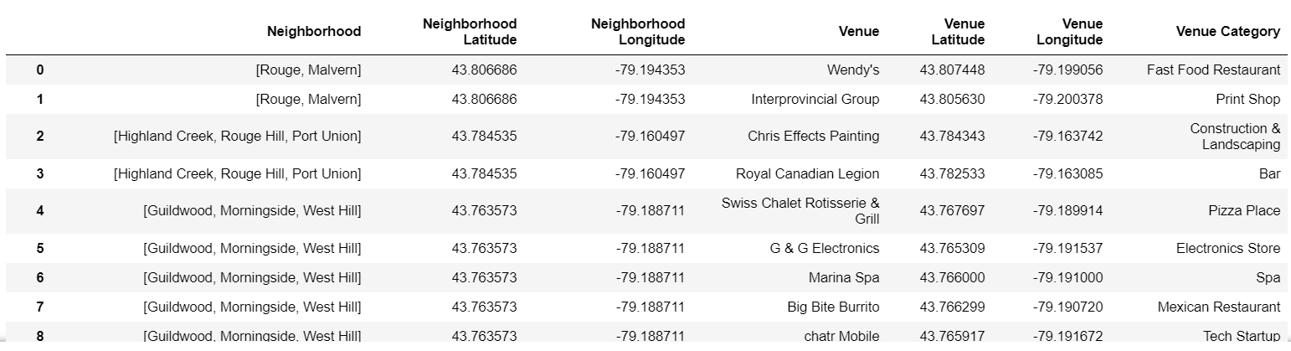
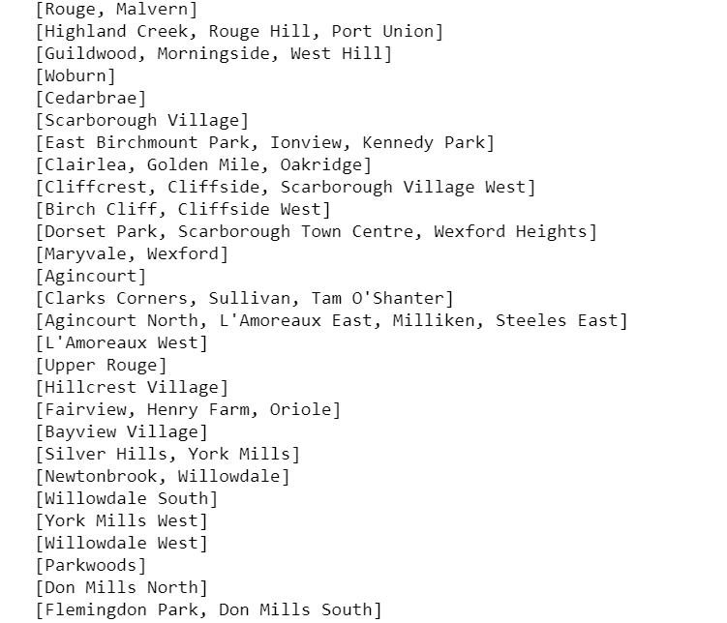
Exploration / analysis

Slide 7
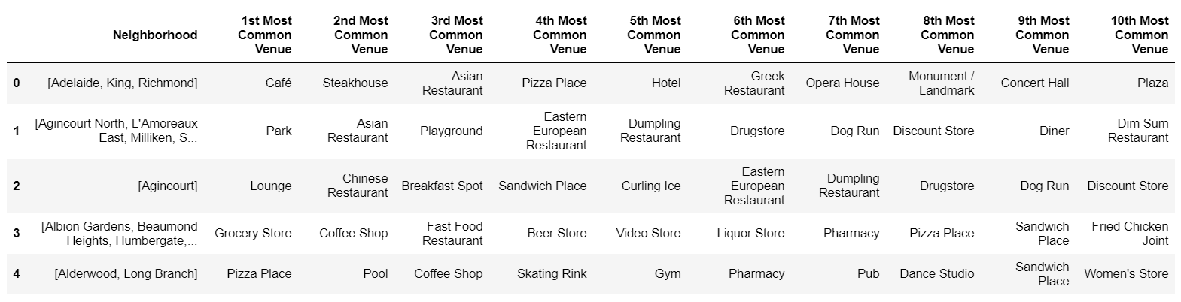
venues data exploration

Slide 8
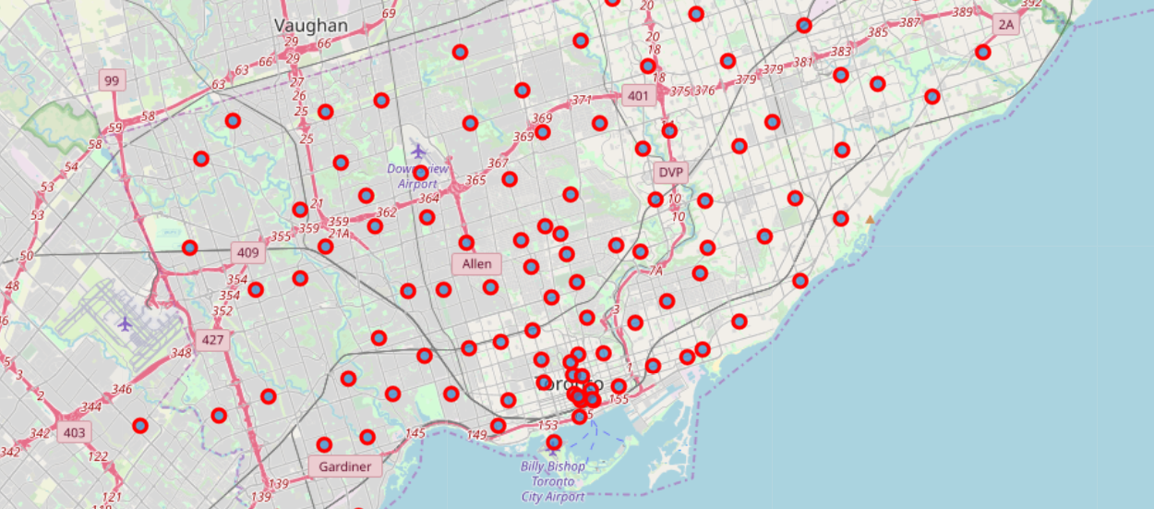
Results

Slide 9
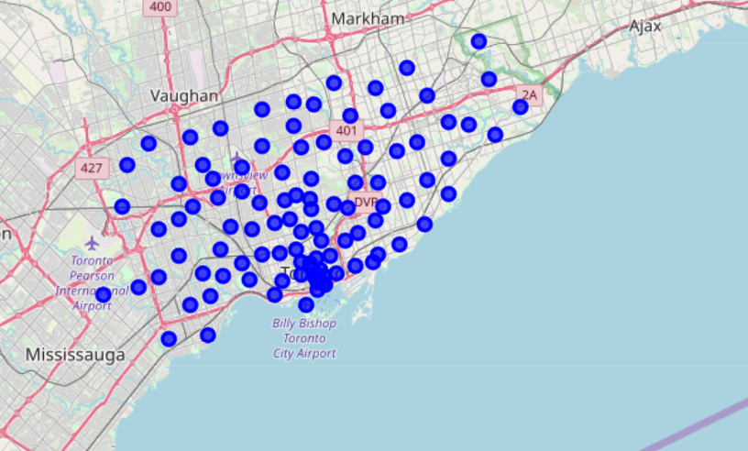
Venues assorted by neighbourhoods

Slide 10
Conclusion
The maps show which neighbourhoods are popular with respect to specific venues and assorted venue types.
This is just a singular paradigm of what we could do with this data,
We could also sort neighbourhoods and study investment opportunities with respect to opening new business in that particular area.
There’s a lot more we can attempt to do but that would take another project
This sums up my project report

Slide 11
Thank you
Happy learning

