Slide 1
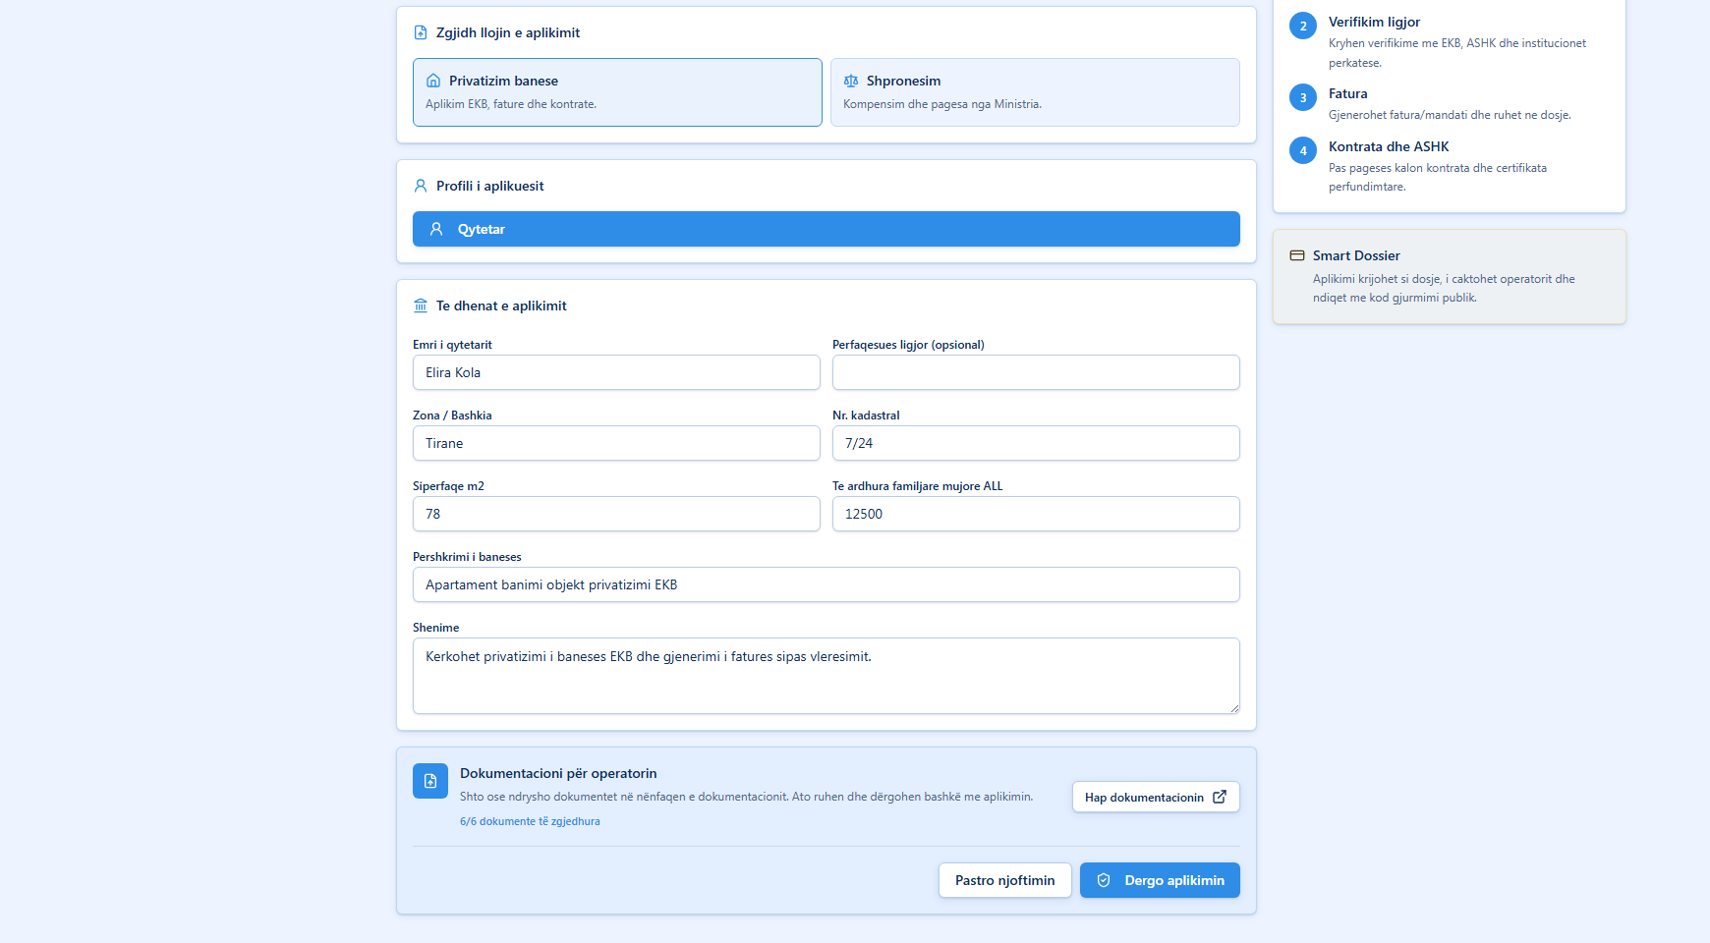
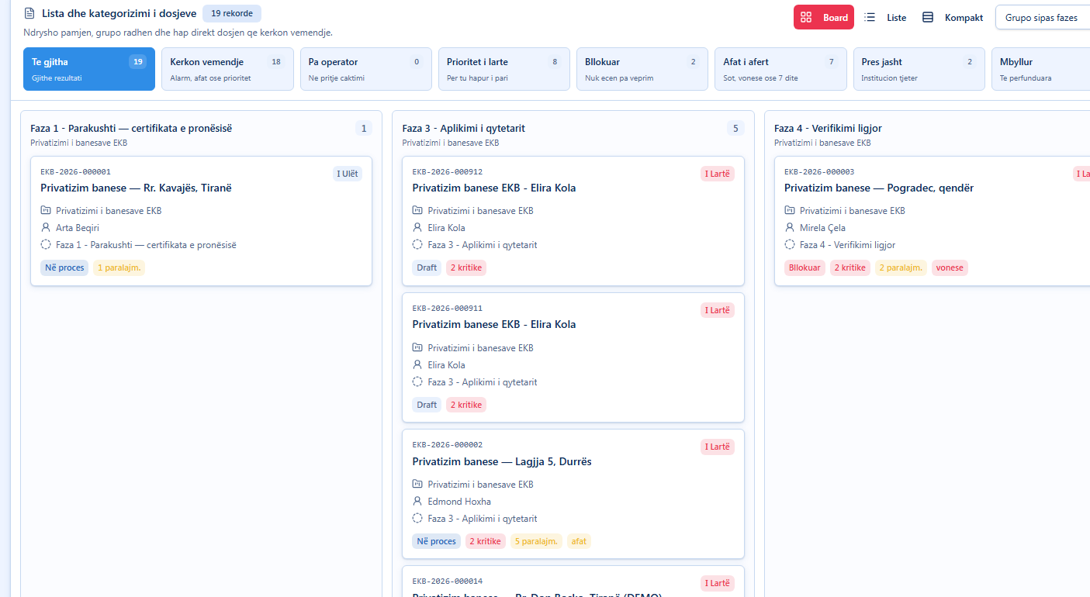
SMART DOSSIER
Property
services,
made clear.
A digital workspace for applications, case tracking, operational queues and management reporting.
Built for citizens, businesses, operators and administrators
Notes:
Open with the promise: Smart Dossier turns property-related procedures into a clear, trackable digital workflow.

Slide 2
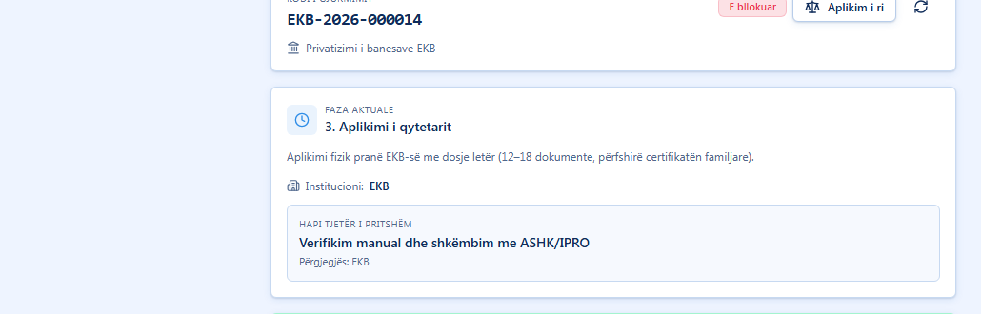
PUBLIC SERVICE JOURNEY
02
One guided path from request to status.
The applicant submits the request, receives a tracking code and follows the next step without calling the office.
Clear for non-experts
Application, documents and tracking are separated into clear steps.
Result: fewer unclear visits, fewer missing documents and a visible case status.
Notes:
Explain the citizen and business flow: submit, keep the code, track the status and know the next step.

Slide 3
OPERATOR WORKSPACE
03
A work queue that shows priorities first.
Cases are grouped by phase, status, deadline and responsibility.
What the team sees
19
total cases
18
need attention
8
high priority
0
unassigned
Notes:
Move from the public flow to operations: the queue helps staff decide what needs attention first.

Slide 4
CASE PROGRESS
04
Every case has a visible timeline.
The team can see the current phase, upcoming institution and progress toward completion.
Current phase
Next check
Responsible body
Application submitted
Manual verification
Assigned institution
The value is simple: everyone talks about the same case, the same phase and the same next step.
Notes:
Use this slide to show traceability: status, phase and responsibility are visible in one place.

Slide 5
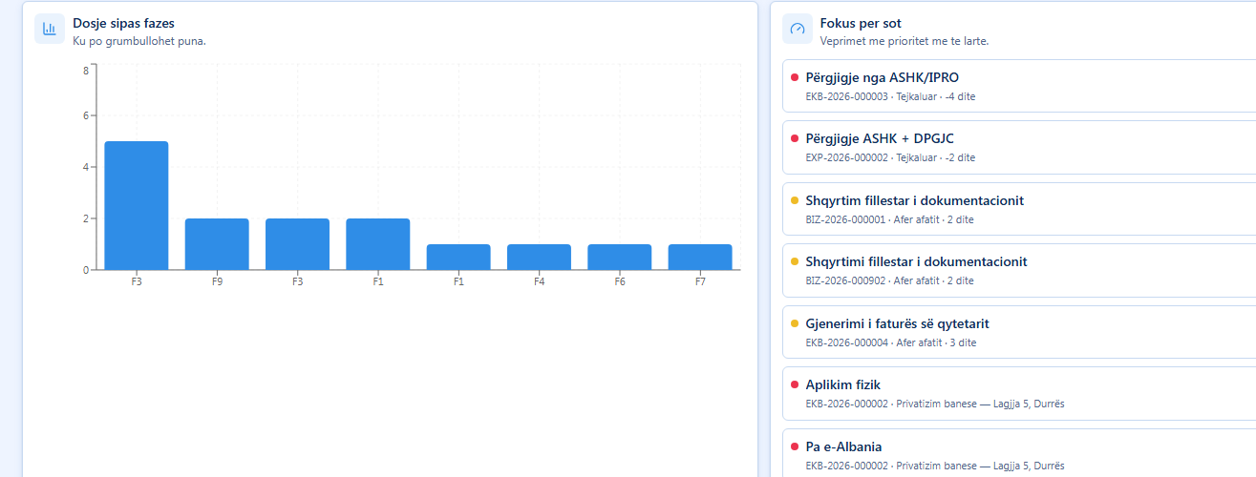
MANAGEMENT REPORTING
05
Reports turn daily work into decisions.
Managers see risk, deadlines, workload and bottlenecks without opening every case.
Signals for action
16
at risk or waiting
7
deadline alerts
3
without operator
The dashboard makes the next management action obvious.
Notes:
Reports are the executive view: they show where time is lost and what should be handled first.

Slide 6
WHY IT STANDS OUT
A complete
service story.
From public request to management visibility.
01
Simple public access
Citizens and businesses know where to start.
02
Operational clarity
Staff see priority, status and ownership.
03
Management confidence
Leadership sees risk and deadlines clearly.
Demo flow: Apply -> Track -> Process -> Report
Notes:
Close with the product story: a clear start for the public, a clear queue for staff and clear reporting for managers.

