Slide 1
Confounders, Causality and DAGs
Kayhan, Brian, and Sofia

Slide 2


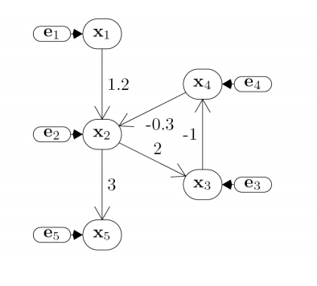
Directed Acyclic Graph (DAG)
Nodes represent observed and unobserved random variables. Edges denote influence/dependence.
It is a data structure/language to represent factorization of joint distribution.
The graph may denote the data generating procedure.
In these particular graphs, cycles are not allowed.

Slide 3
Local Structures & Independencies
B
Common parent
Fixing B decouples A and C
"given the level of gene B, the levels of A and C are independent"
Cascade
Knowing B decouples A and C
"given the level of gene B, the level gene A provides no
extra prediction value for the level of gene C"
V-structure (C is a collider)
Knowing C couples A and B
because A can "explain away" B w.r.t. C
"If A correlates to C, then chance for B to also correlate to B will decrease"
The language is compact, the concepts are rich!
A
C
A
B
C
A
B
C

Slide 4
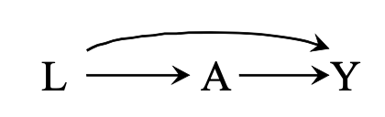

Backdoor Path
In a causal DAG, a backdoor path is a noncausal path between treatment and outcome.
If we block (condition on) all backdoor paths, we can determine causality instead of just association.

Slide 5
Back-Door Criterion
Back-Door Criterion: Guarantee that DAG has no back-door paths.
For Treatment X and Outcome Y, all confounders Z must satisfy:
i) No Z is a descendant of X.
ii) Z blocks every path from X to Y
We satisfy these by Conditioning on Z.

Slide 6
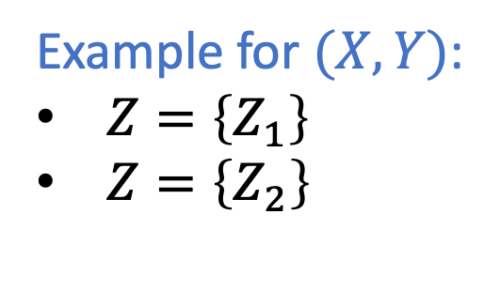
Back-Door Criterion
Back-Door Criterion: Guarantee that DAG has no back-door paths.
For Treatment X and Outcome Y, all confounders Z must satisfy:
i) No Z is a descendant of X.
ii) Z blocks every path from X to Y
We satisfy these by Conditioning on Z.
Z1
Example for $(X,Y)$:
$Z=\left\{Z_{1}\right\}$
$Z=\left\{Z_{2}\right\}$
X
Z2
Y

Slide 7
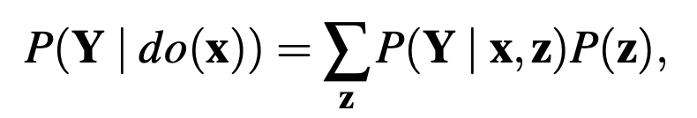
Back-Door Criterion
If Back-door Criterion is satisfied, then we can use this expression:
This means we can calculate the interventional probability using only observational data.

Slide 8
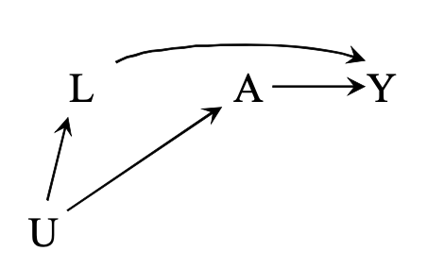
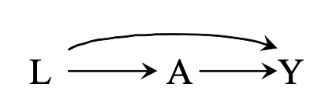
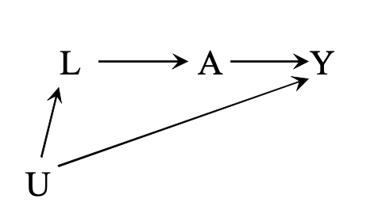
What is a “Confounder”?
Heart Disease
Smoker
Risk of Stroke
Death
Sedative
Lifestyle
Aspirin
Personality
Heart Disease
Aspirin
Risk of Stroke
Atherosclerosis
A: Treatment
Y: Outcome
L: Additional Measurable Variable
U: Additional Unmeasurable Variable

Slide 9
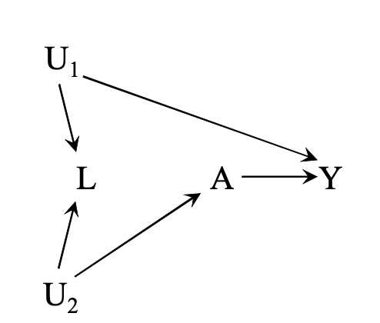
More Complex Examples
Pre-cancer
Legion
Pap
Smear
Cervical
Cancer
Physical
Activity
Health-conscious
Personality
A: Treatment
Y: Outcome
L: Additional Measurable Variable
U: Additional Unmeasurable Variable
L is a collider. Conditioning on L induces bias!

Slide 10
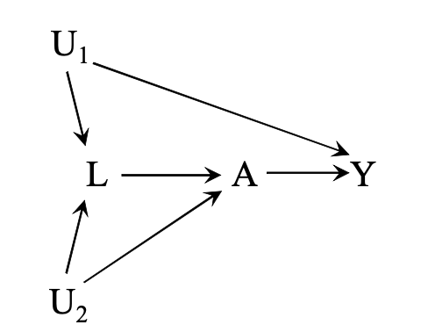
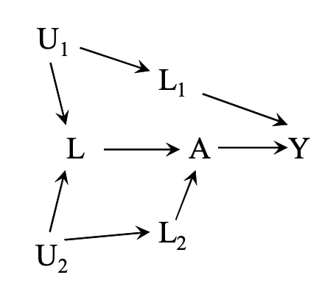
How to Choose Variables to Control?
Impossible to determine causal relationship via backdoor criterion.
A: Treatment
Y: Outcome
L: Additional Measurable Variable
U: Additional Unmeasurable Variable

Slide 11
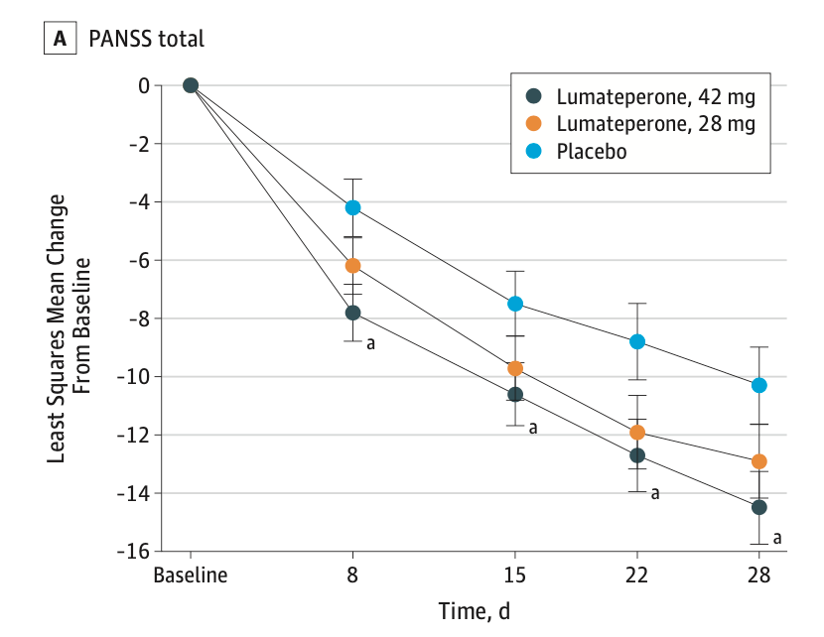
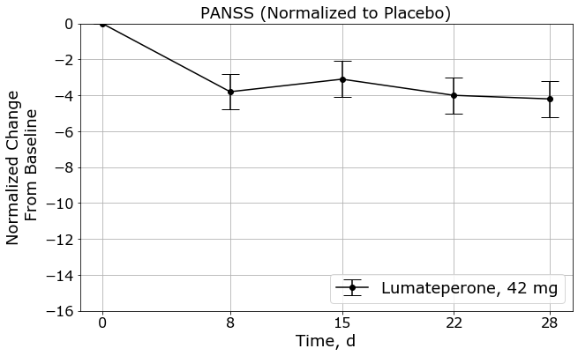
Real World Example: Lumateperone and Schizophrenia
Cohort: 450 Schizophrenic Patients.
Randomized Trial testing 3 treatments.
PANSS (Positive and Negative Syndrome Scale)
Lower number is better (relative change from baseline)
All subjects are inpatients.
Study starts at t=day 0, ends at t=day 28.
Schizophrenia
Inpatient
Lumateperone
Improvement
Efficacy and Safety of Lumateperone for Treatment of Schizophrenia A Randomized Clinical Trial
Christoph U. Correll, MD; Robert E. Davis, PhD; Michal Weingart, PhD; Jelena Saillard, MS, MBA; Cedric O’Gorman, MD, MBA; John M. Kane, MD; Jeffrey A. Lieberman, MD; Carol A. Tamminga, MD; Sharon Mates, PhD; Kimberly E. Vanover, PhD
JAMA Psychiatry

Slide 12
Confounders and Data Science
Terminology:
T_{i}: Treatment (either 1 or 0)
Y_{i}: Observed Outcome for subject i (Continuous Variable)
Y_{0i}: potential outcome for T_{i}=0
Y_{1i}: potential outcome for T_{i}=1
Average Treatment Effect (ATE): E[Y₁ – Y₀]
This is typically the Goal, and measures Causation. It can be hard to get.
Average Treatment Effect on the Treated (ATET): E[Y₁-Y₀|T=1]
Easy to get from observed data, but potentially biased.

Slide 13

Confounders and Data Science
Association vs Causation:
Average Treatment Effect (ATE): E[Y₁ – Y₀] (Causation)
Average Treatment Effect on the Treated (ATET): E[Y₁-Y₀|T=1]
Association: E[Y|T=1] – E[Y|T=0]
Only if BIAS = 0 does Association = Causation (and Causation = ATET)

Slide 14
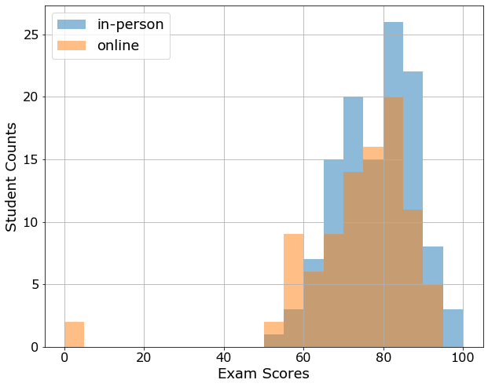
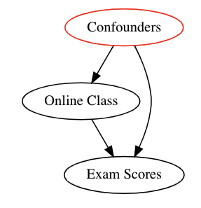
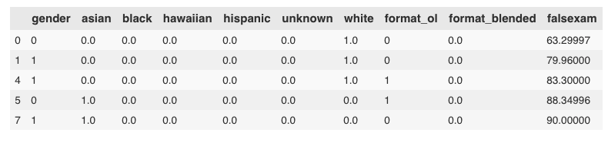
Linear Regression and Causality: Intro
Treatment: In-person vs Online classes
Result: Exam scores
Confounders/Bias: Assume RCT

Slide 15

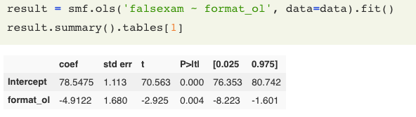
Linear Regression and Causality: Intro
Mean (online) = 73.5
Mean (in-person) = 78.5
ATE = ATE = 73.5 – 78.5 = -5
… do more, calc std, calc CL
: Average Test score (in person)
: Average Treatment Effect (online)
: Error Term (online)

Slide 16
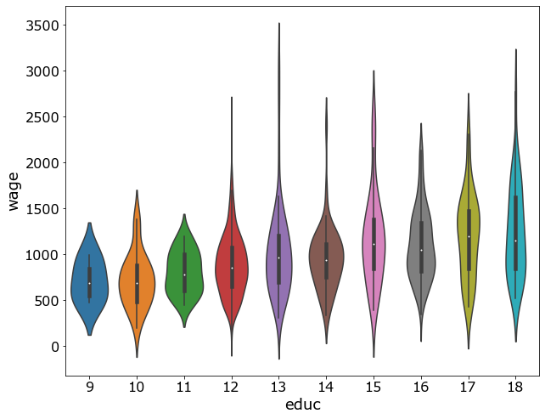
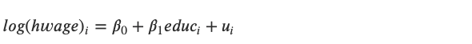
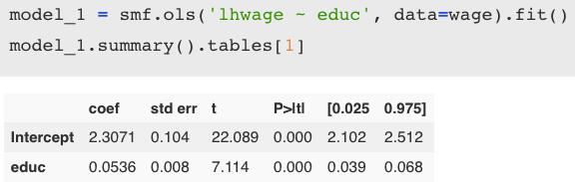
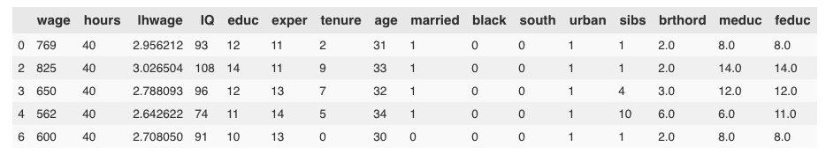
Linear Regression and Causality: Confounders
Every year of education predicts increase in wage by 5.36%

Slide 17
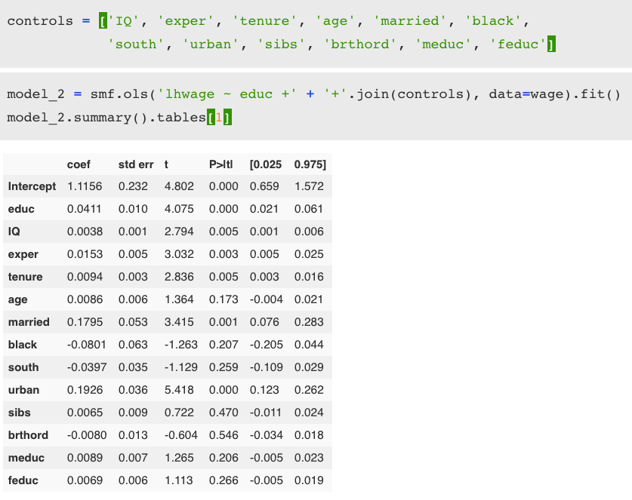
Linear Regression and Causality: Confounders
Every year of education predicts increase in wage by 4.11%, controlling for all other factors

Slide 18
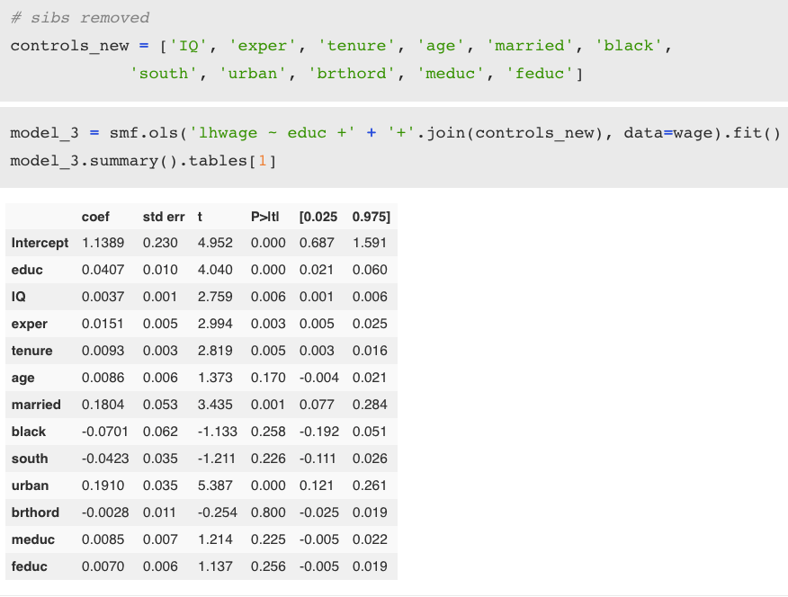
Linear Regression and Causality: Confounders
Every year of education predicts increase in wage by 4.07%, controlling for all other factors, not including number of siblings

Slide 19
Causal Inference for The Brave and True
https://matheusfacure.github.io/python-causality-handbook/landing-page.html
https://github.com/matheusfacure/python-causality-handbook

