Slide 1
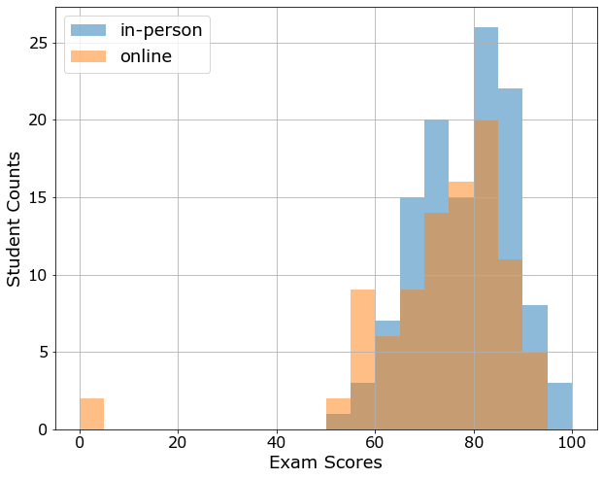
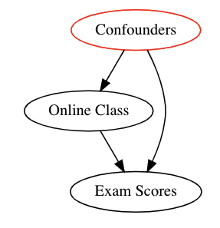
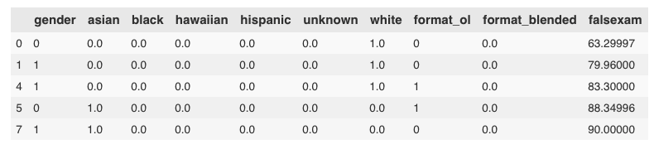
Linear Regression and Causality: Intro
Treatment: In-person vs Online classes
Result: Exam scores
Confounders/Bias: Assume RCT

Slide 2

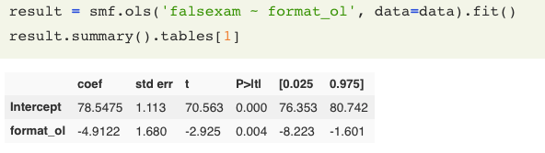
Linear Regression and Causality: Intro
Mean (online) = 73.5
Mean (in-person) = 78.5
Average Treatment Effect
= 73.5 – 78.5 = -5
… do more, calc std, calc CL
: Average Test score (in person)
: Average Treatment Effect (online)
: Error Term (noise)

Slide 3
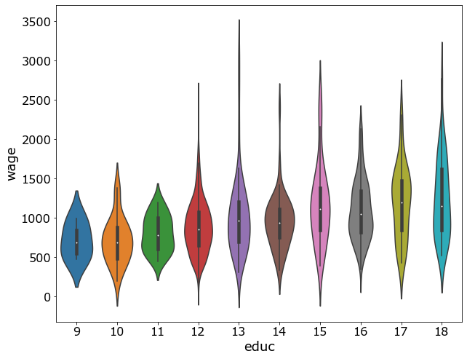
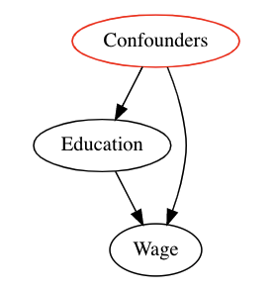
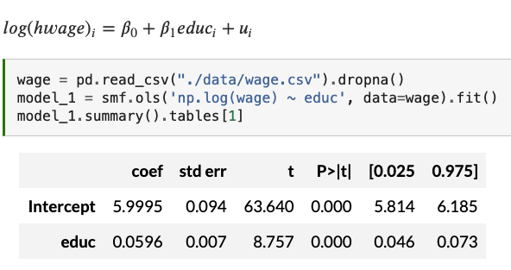
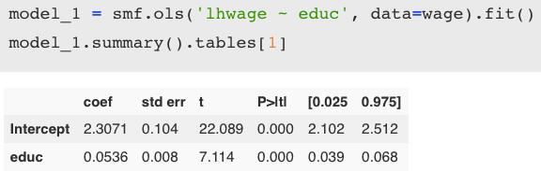
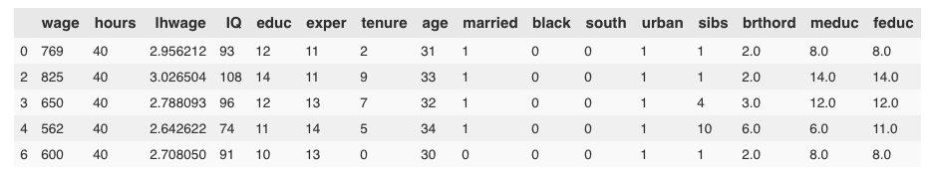
Linear Regression and Causality: Confounders
Education vs Income: Does more education mean more income?
Every year of education predicts increase in wage by 5.36%

Slide 4
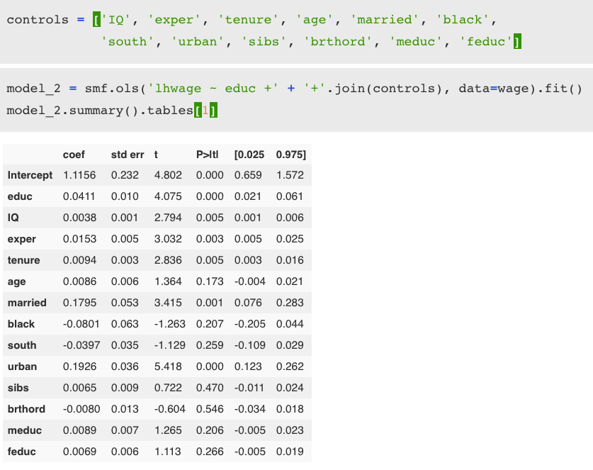
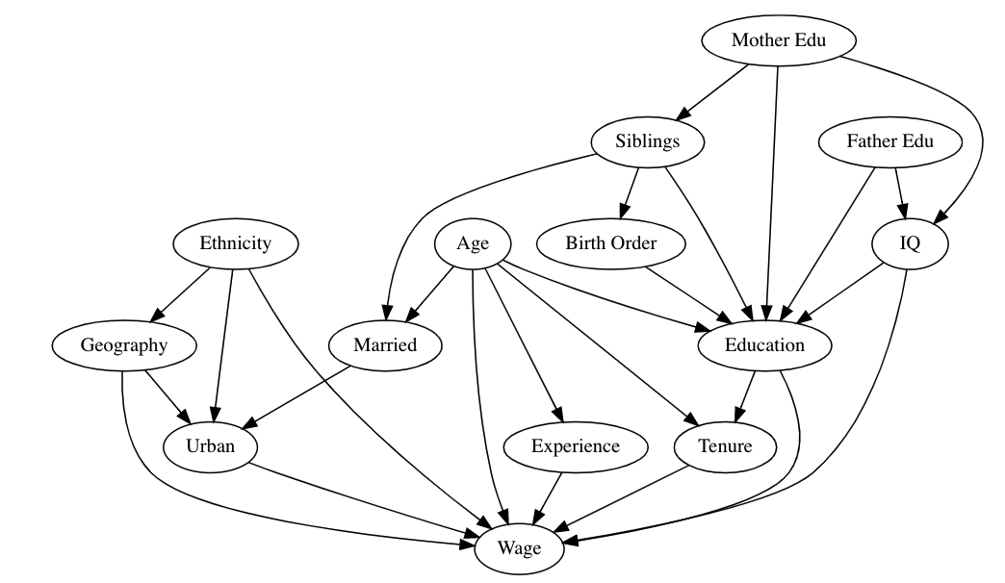

Linear Regression and Causality: Confounders
Every year of education predicts increase in wage by 4.11%, controlling for all other factors

Slide 5
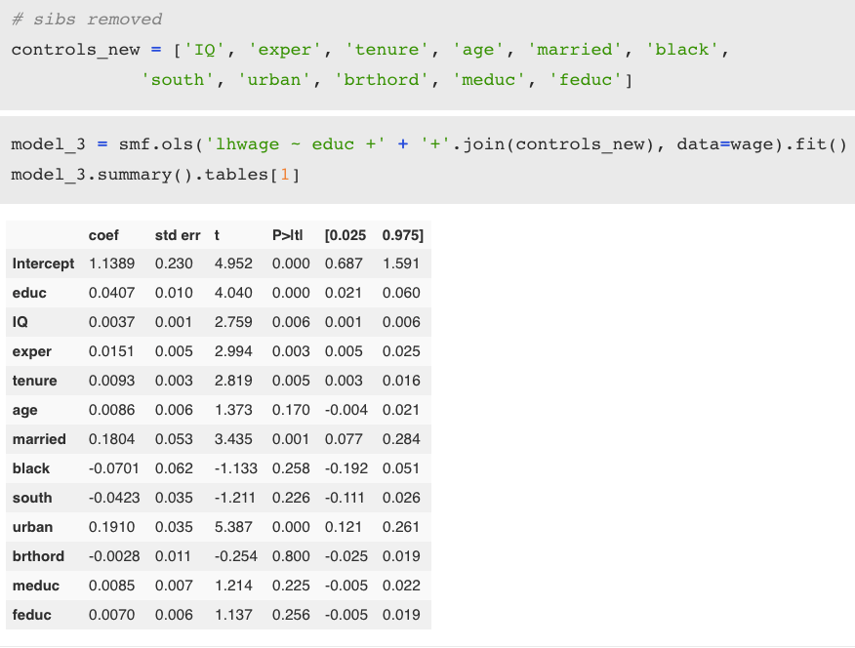
Linear Regression and Causality: Confounders
No Confounders: 5.36%
All confounders: 4.11%
All (except n_sibs): 4.07%
Every year of education predicts increase in wage by 4.07%, controlling for all other factors, not including number of siblings

Slide 6
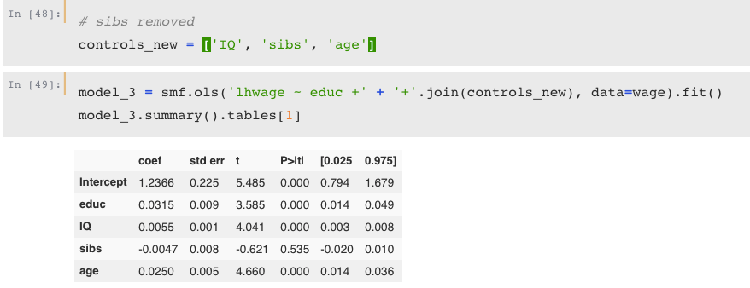

Slide 7
Causal Inference for The Brave and True
https://matheusfacure.github.io/python-causality-handbook/landing-page.html
https://github.com/matheusfacure/python-causality-handbook

