Slide 1
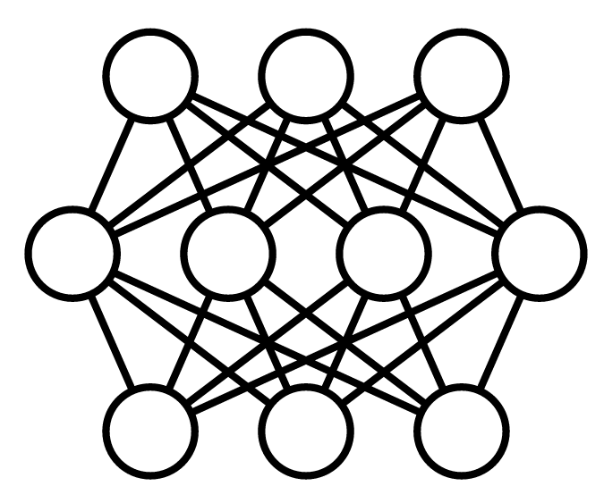
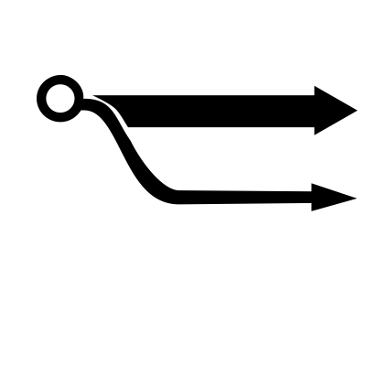



Slide 2


Slide 3


Slide 4


Slide 5

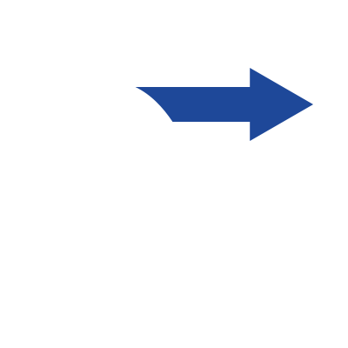

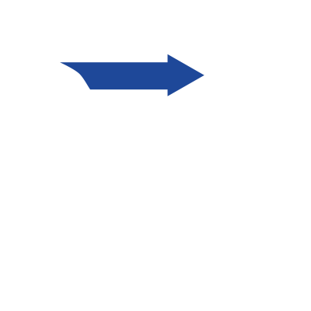
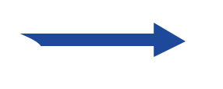


Slide 6



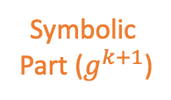

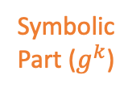


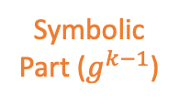

Iteration $k−1$
Iteration $k$
Iteration $k+1$
…
Fine Tune
Training
Fine Tune
Training
Fine Tune
Training
Fine Tune
Training
…
Residual ($r^{k−1}$)
Residual ($r^{k}$)
Residual ($r^{k+1}$)
Symbolic
Part ($g^{k−1}$)
Symbolic
Part ($g^{k}$)
Symbolic
Part ($g^{k+1}$)

Slide 7
Causal Explanation
U
X
M
Y
Aim 1.1
Aim 1.3
Aim 1.2
Logical
Interpretation

Slide 8



Causal Explanation
Aim 2
U
U
X
M
Y
Aim 1.1
$$M_{1}$$
X
Y
Aim 1.3
$$M_{2}$$
Aim 1.2
Logical
Interpretation

Slide 9
Causal Explanation
Aim 2
U
U
X
M
Y
Aim 1
$$M_{1}$$
X
Y
Aim 4
$$M_{2}$$
Blackbox Model
Aim 3
Logical
Interpretation

Slide 10
Aim 2
U
Causal Explanation
$$M_{1}$$
X
Y
U
$$M_{2}$$
X
M
Y
Intervention
Aim 1
Blackbox Model

Slide 13
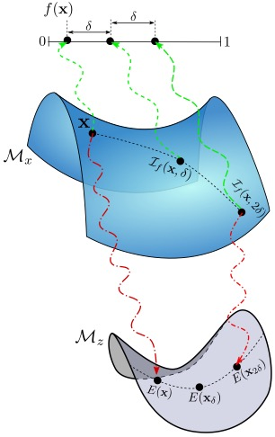
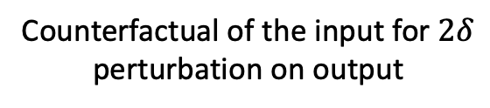
Output of the Blackbox
Data Manifold
Counterfactual of the input for $2δ$ perturbation on output
Original input
Manifold of the Encoding space of the data

Slide 14
(a)
(b)

Slide 15
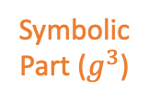

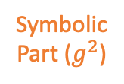




Residual ($r^{0}$)
Residual ($r^{1}$)
Residual ($r^{2}$)
Residual ($r^{3}$)
Symbolic
Part ($g^{2}$)
Symbolic
Part ($g^{3}$)
Symbolic
Part ($g^{1}$)

Slide 16
Residual ($r^{0}$)
Residual ($r^{1}$)
Residual ($r^{2}$)
Residual ($r^{3}$)

Slide 17






Copy
Residual ($r^{0}$)
Residual ($r^{1}$)
Residual ($r^{2}$)
Residual ($r^{3}$)
Notes:
\phi\circ h^0

