Slide 1
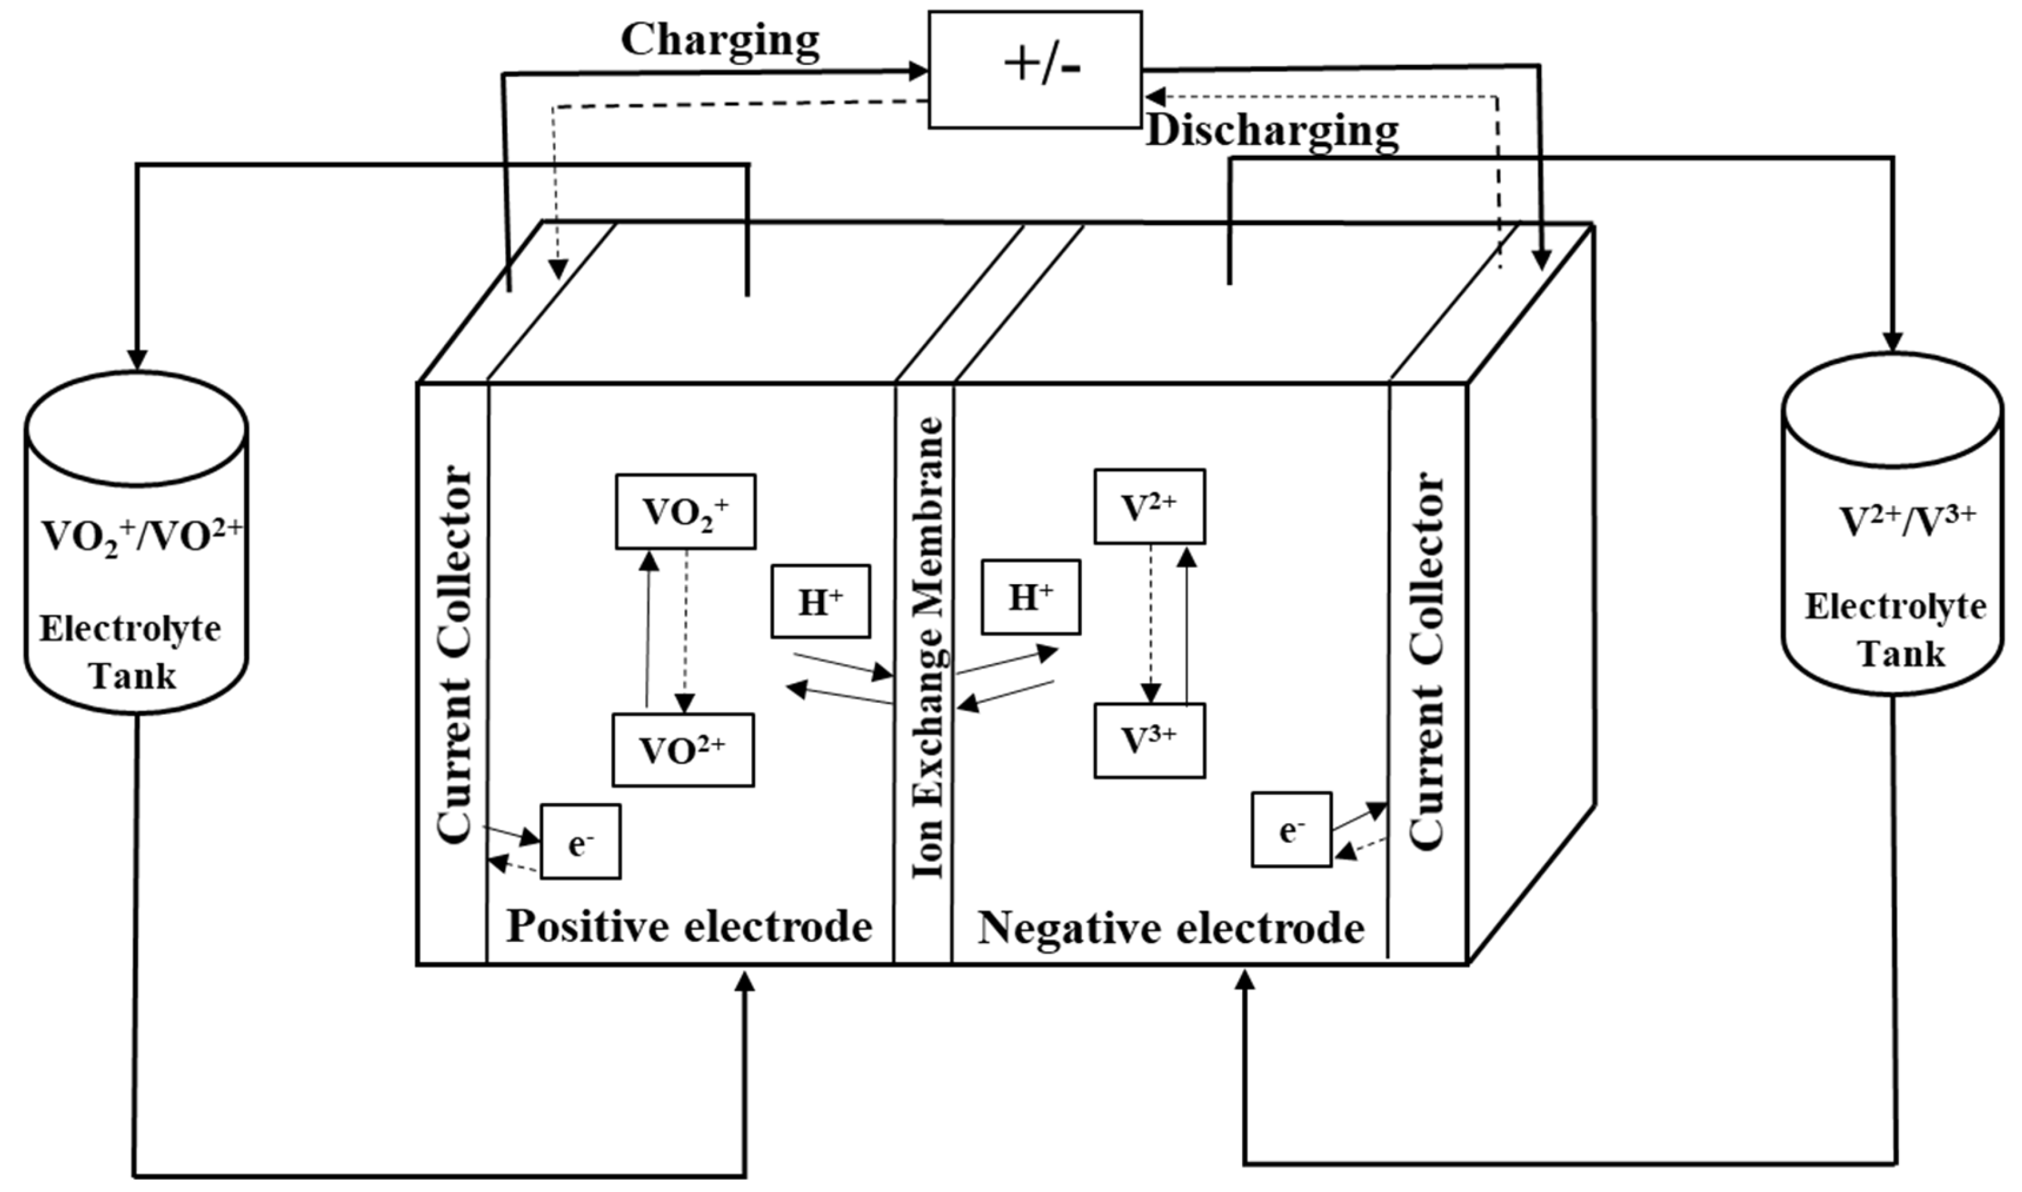
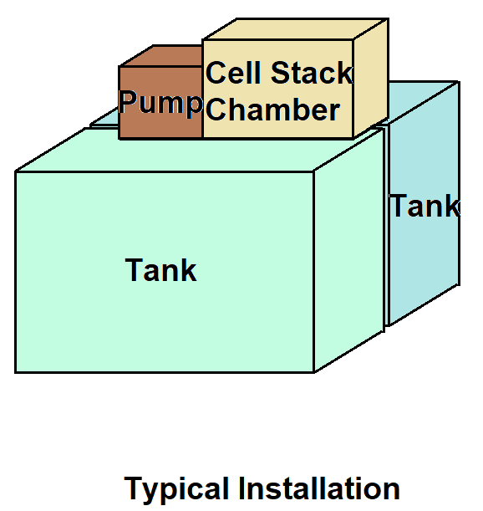
1) Optimized Vanadium Redox-Flow Battery
Objectives:
Energy Efficiency (Model 1 → implemented Matlab)
Minimized Costs (Model 2 → to be synthesized)
Constraints
Electrical Range (voltage, current)
Minimal operation time for given load
Minimal DC power output
Flow maldistribution along the stack for electrolyte flow
Design Variables
%% Electrical Model
elec.Ns = 20; % Number of series connected cells in the battery stack
elec.V0 = 1.3; % Single cell electrode potential, V
elec.R0 = 1e-2; % Cell ohmic resistance, Ohm
elec.R1 = 1e-2; % Cell 1st RC pair resistance, Ohm
elec.Tau1 = 10; % Cell 1st RC pair time constant, s
elec.SOC = 1; % Cell initial state of charge
%% Chemistry
chem.Len = 0.40; % Length of porous electrode, m
chem.Wid = 0.25; % Width of porous electrode, m
chem.Thk = 3e-3; % Thickness of porous electrode, m
chem.Por = 0.9; % Electrode porosity
chem.Mem = 1e-3; % Membrane thickness, m
chem.M = 2; % Vanadium molarity, mol/l
chem.D2 = 0.877e-11; % Va(II) diffusivity through membrane, m^2/s
chem.D3 = 0.322e-11; % Va(III) diffusivity through membrane, m^2/s
chem.D4 = 0.682e-11; % Va(IV) diffusivity through membrane, m^2/s
chem.D5 = 0.589e-11; % Va(V) diffusivity through membrane, m^2/s
%% Flow and Thermal
hydr.TankVol = 0.095; % Tank volume, m^3
hydr.FlowMalDistrPos = ones(1,elec.Ns); % Flow maldistribution along stack, catholyte
hydr.FlowMalDistrNeg = ones(1,elec.Ns); % Flow maldistribution along stack, anolyte
temperature = 298; % Temperature, K
flowrate_lpm = 0; % Flowrate, lpm
systemLoad = 0.3; % External resistance as system load, Ohm
Project AMDO
Robert Flassig, 23.11.2023
Notes:
flowrate LPM

Slide 2
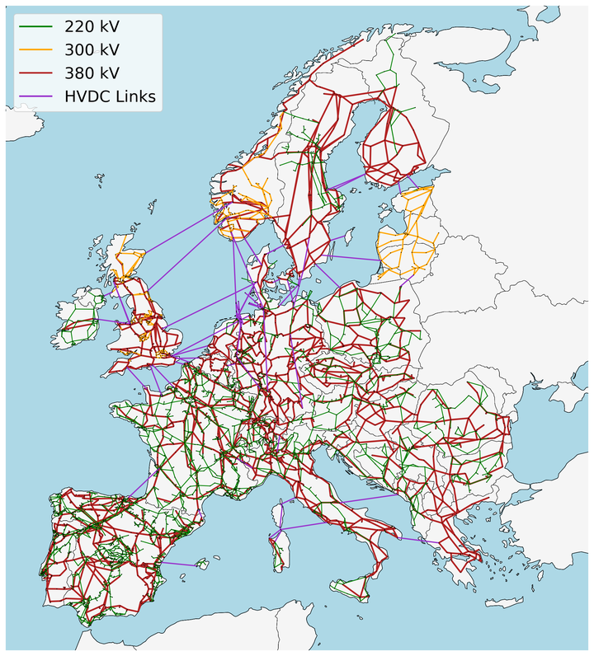
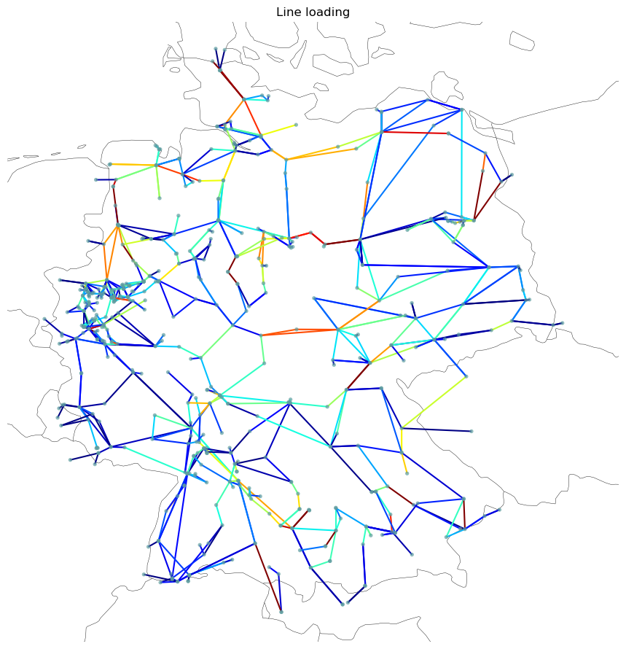
2) Optimized European Energy System
Objectives:
Minimize vulnerability (Model 1 → to be synthezised from PyPSA)
Minimized costs (Model 2 → to be synthezised)
Minimize curtailment, homogeneous marginal price distribution…
PyPSA-Eur: An Open Optimisation Model of the European Power System
Constraints
Loads, Sources, Sinks
CO2 reduction path
To approximate n-1 security and allow room for reactive power
flows, don’t allow any line to be loaded above 70% of their thermal rating
Design Variables
capacities of generation
storage and transmission lines
Notes:
power system analysis:
https://pypsa.readthedocs.io/en/latest/examples/scigrid-lopf-then-pf.html

